Slide 1
COMPASSIONATE INTEGRITY TRAINING
Center for Compassion, Integrity and Secular Ethics
Life University
© 2020 Brendan Ozawa-de Silva, Michael Karlin and Life University
COMPASSIONATE INTEGRITY TRAINING SERIES II: RELATING TO OTHERS SKILL 5: IMPARTIALITY AND COMMON HUMANITY

Slide 2
COMPASSIONATE INTEGRITY TRAINING
SERIES I: SELF-CULTIVATION
Calming Body and Mind
Ethical Mindfulness
Emotional Awareness
Self-Compassion
SERIES II: RELATING TO OTHERS
Impartiality and Common Humanity
Forgiveness and Gratitude
Empathic Concern
Compassion
SERIES III: ENGAGING IN SYSTEMS
Appreciating Interdependence
Engaging with Discernment
COMPASSIONATE INTEGRITY TRAINING SERIES II: RELATING TO OTHERS SKILL 5: IMPARTIALITY AND COMMON HUMANITY

Slide 3
COMPASSIONATE INTEGRITY TRAINING
SERIES I: SELF-CULTIVATION
Calming Body and Mind
Ethical Mindfulness
Emotional Awareness
Self-Compassion
SERIES II: RELATING TO OTHERS
Impartiality and Common Humanity
Forgiveness and Gratitude
Empathic Concern
Compassion
SERIES III: ENGAGING IN SYSTEMS
Appreciating Interdependence
Engaging with Discernment
COMPASSIONATE INTEGRITY TRAINING SERIES II: RELATING TO OTHERS SKILL 5: IMPARTIALITY AND COMMON HUMANITY
Notes:
Content:
Participants will explore explicit and implicit bias and methods for weakening them.
Participants will explore what we all have in common as human beings, such as wanting happiness and wanting to avoid harm and suffering.
Participants will learn that psychological essentialism (relating to categories as if they had real, fixed essences) can have harmful effects and perpetuate injustice and division.
Practice:
Participants will learn to reduce partiality and bias and increase a sense of common humanity by reflecting on the superficial nature of the categories of friend, enemy and stranger in light of the deeper commonalities shared by all people.

Slide 4
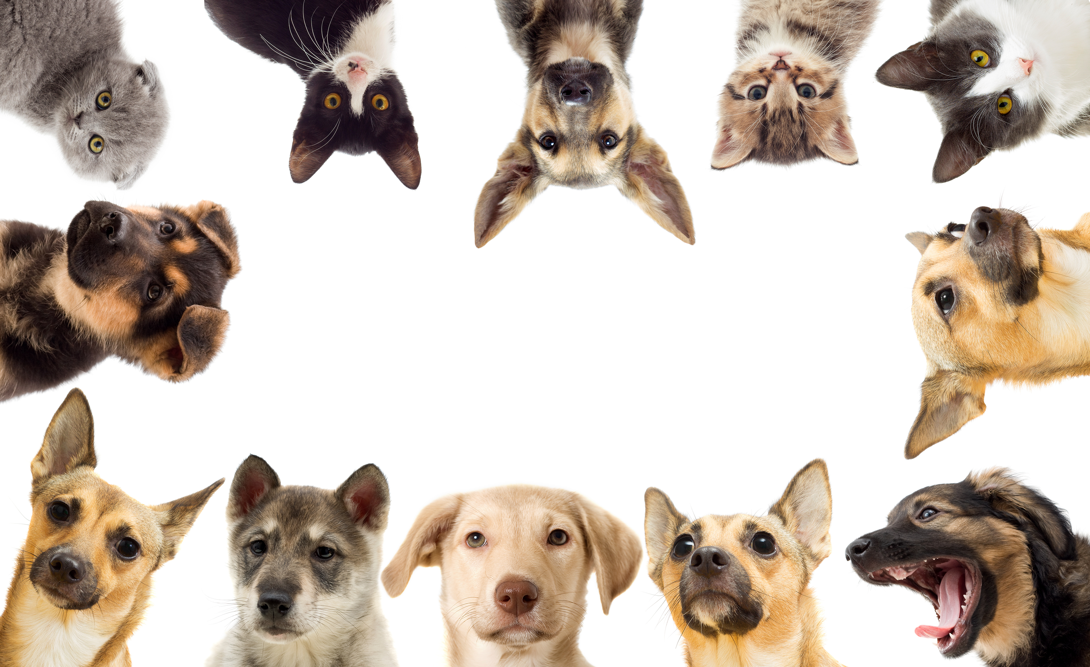
Group Activity
Notes:
“Hi, who are you?” Critical Insight Activity from Facilitator Guide

Slide 5
Bias
Based on our natural need to create categories
The problem is when we mistake these categories as absolute
Notes:
Bias is natural. Categorizing information and objects is necessary for quickly understanding the world. Category systems attempt to provide maximum information with the least cognitive effort and are very beneficial. If one walks into a room and sees an object for the first time, it is useful to be able to know, based on the perceived attributes of four legs and a flat surface that this object is likely in the category “chair” and can be sat upon. It is evolutionarily adaptive to be able to categorize large, furry, four-legged, living beings with large teeth and claws into the category of “dangerous animal.” Categorizing and stereotyping people can also be very beneficial, such as when we are lost in a city and look for a taxi driver or police officer. These categories are not totally arbitrary and are based on the perceived world and the needs of the perceiver. Categorization is also influenced by experience and culture. The problems come when we mistake an individual with the attributes we associate with the category we place them in and when we concretize the category as absolute and unchanging. As we will see, as useful as categories can be, they are superficial and fluid.

Slide 6
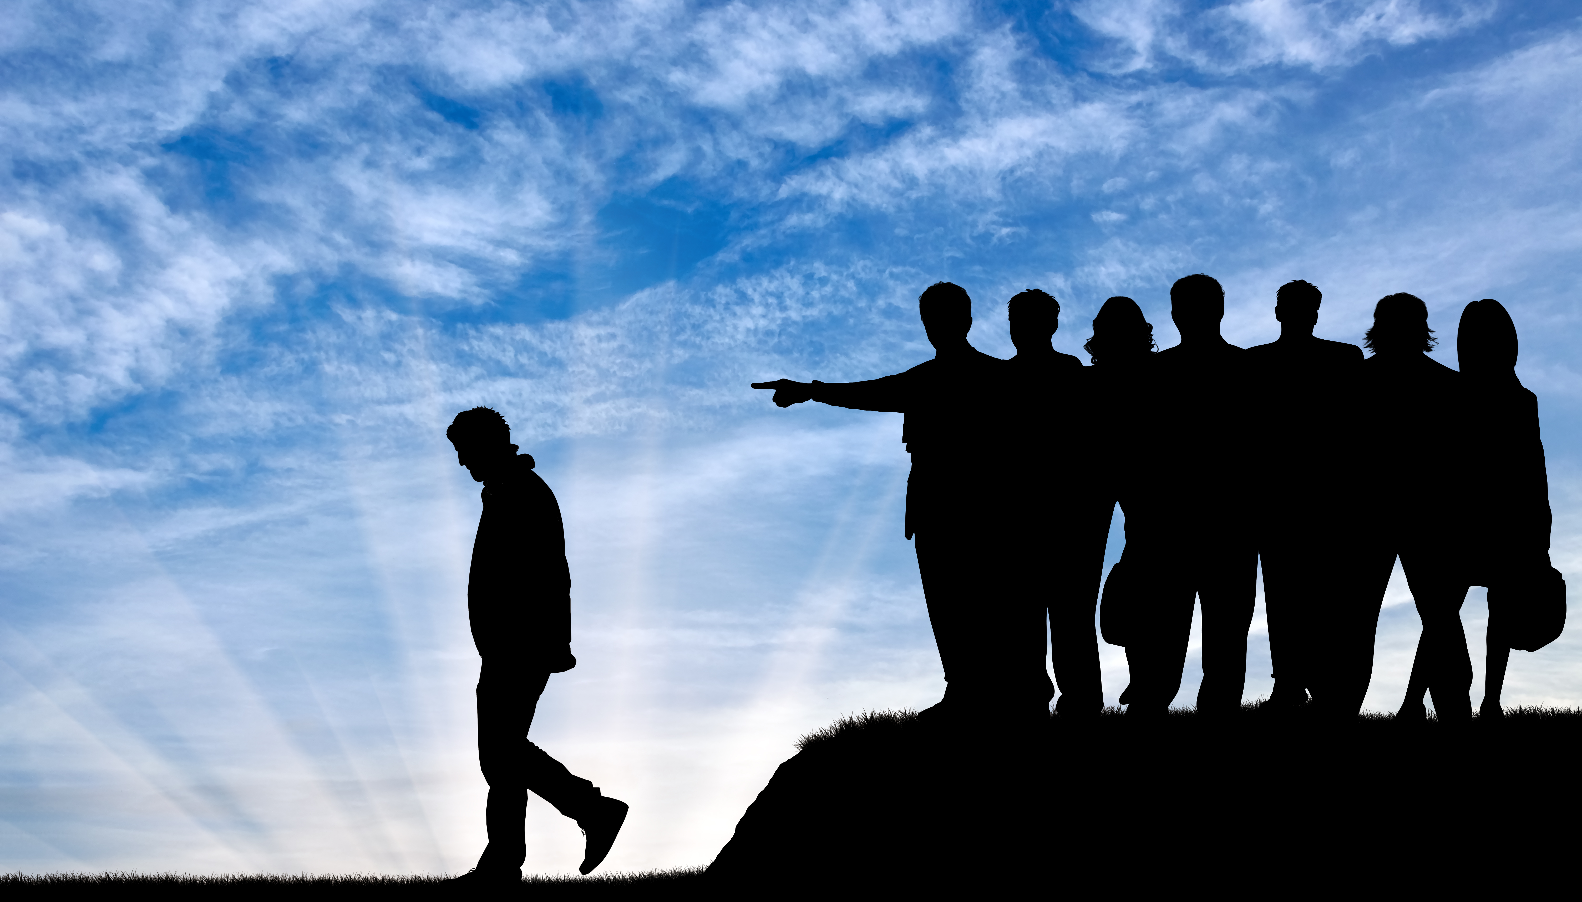
Thinking Trap: In-Group Bias
Notes:
Creating in-groups and out-group is based on our natural tendency to create categories.
In-group bias is a Thinking Trap that can lead to Stereotyping and Psychological Essentialism. Essentialism is the belief that categories have a fixed, underlying, true nature (or set of characteristics) that gives them their identity and is responsible for similarities that members of that category share. This belief can exist even if one cannot name the essence the group is supposed to possess. Essentialism is responsible for a great deal of out-group discrimination. Categories such as race, religion, gender are some examples of categories that are often essentialized. Upon deeper examination, we can easily see that members who comprise any category are as varied and unique as snowflakes. Although there may be some useful characteristics that some group members share, these characteristics are not what define them nor do they make up some underlying, true, unchanging nature. Although it is easy to think of the way we essentialize major categories, we also do so with less obvious categories as we construct in-groups and out-groups everyday.

Slide 7
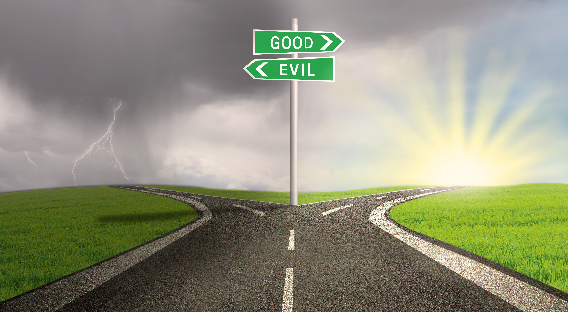
Notes:
These superficial categories can eventually lead to us labeling the out groups as evil or even inhuman. Seeing others as essentially different is an extremely risky Thinking Trap, because it can justify all sorts of negative and unethical behaviors. Discrimination, unfair treatment, exploitation, and violence are all made possible by a failure to recognize common humanity.

Slide 8
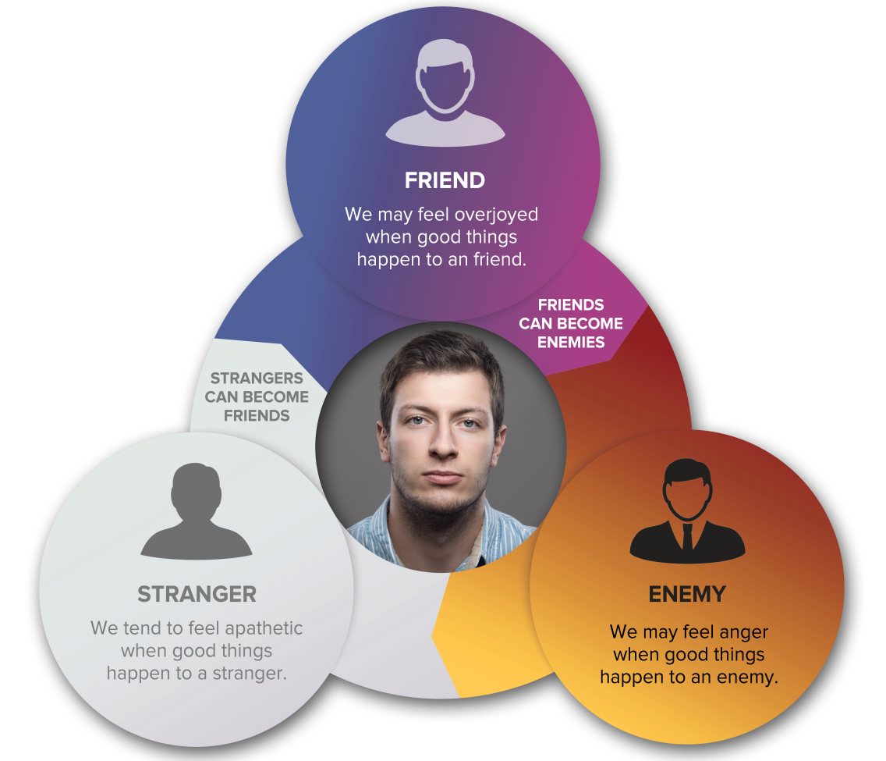
Thinking Trap: Essentialism
Notes:
The categories we construct are even more nuanced than simply friend and enemy, good and evil. We tend to broadly categorize people into groups of friends, enemies and strangers. This taxonomy of friend, enemy and stranger can be further broken down into the other ways we categorize people, such as race, religion, political party, and gender. To use a less heated example, my sports team and their fans are my “friends.” My teams rival and their fans are my “enemies.” All other teams and their fans are “strangers.” While this may seem like a superficial example, even these categories can be the cause of emotional and physical violence. To help us work out of this Thinking Trap, we will learn that the categories of friend, enemy and stranger are limited and changeable, yet how we categorize people affects how we relate to them. You may ask if the participants have any examples of these categorizations they would like to share.

Slide 9
Reflective Writing & Mindful Dialogue
Notes:
Be totally present for the other person. We rarely have someone’s undivided attention during a conversation. It is a gift. This presence can manifest through maintaining eye contact and verbal and nonverbal gestures that let your partner know that you are following what he or she is saying. Please turn off any electronic devices to prevent unexpected distractions and interruptions.
Try not to ask questions. Although we are not always conscious of it, questions have a tendency to drive a conversation in the direction the questioner wants it to go, rather than where the responder wants to take it. If you feel you must ask a question, make it something like, “Is there anything more you would like to add?”
Try not to give advice. The purpose of these conversations is to allow your partner to vocalize important experiences or insights, and to have someone honor them by listening attentively and without judgment. Often, instead of truly listening, we spend time thinking about what we would give. While this urge can be motivated by compassion, it can also interfere with our ability to actually be fully present to what the person is saying.
Keep everything your partner says in total confidence. Nothing creates safe space more effectively than trust. Knowing that each of you will keep everything you hear confidential will build that trust.

Slide 10
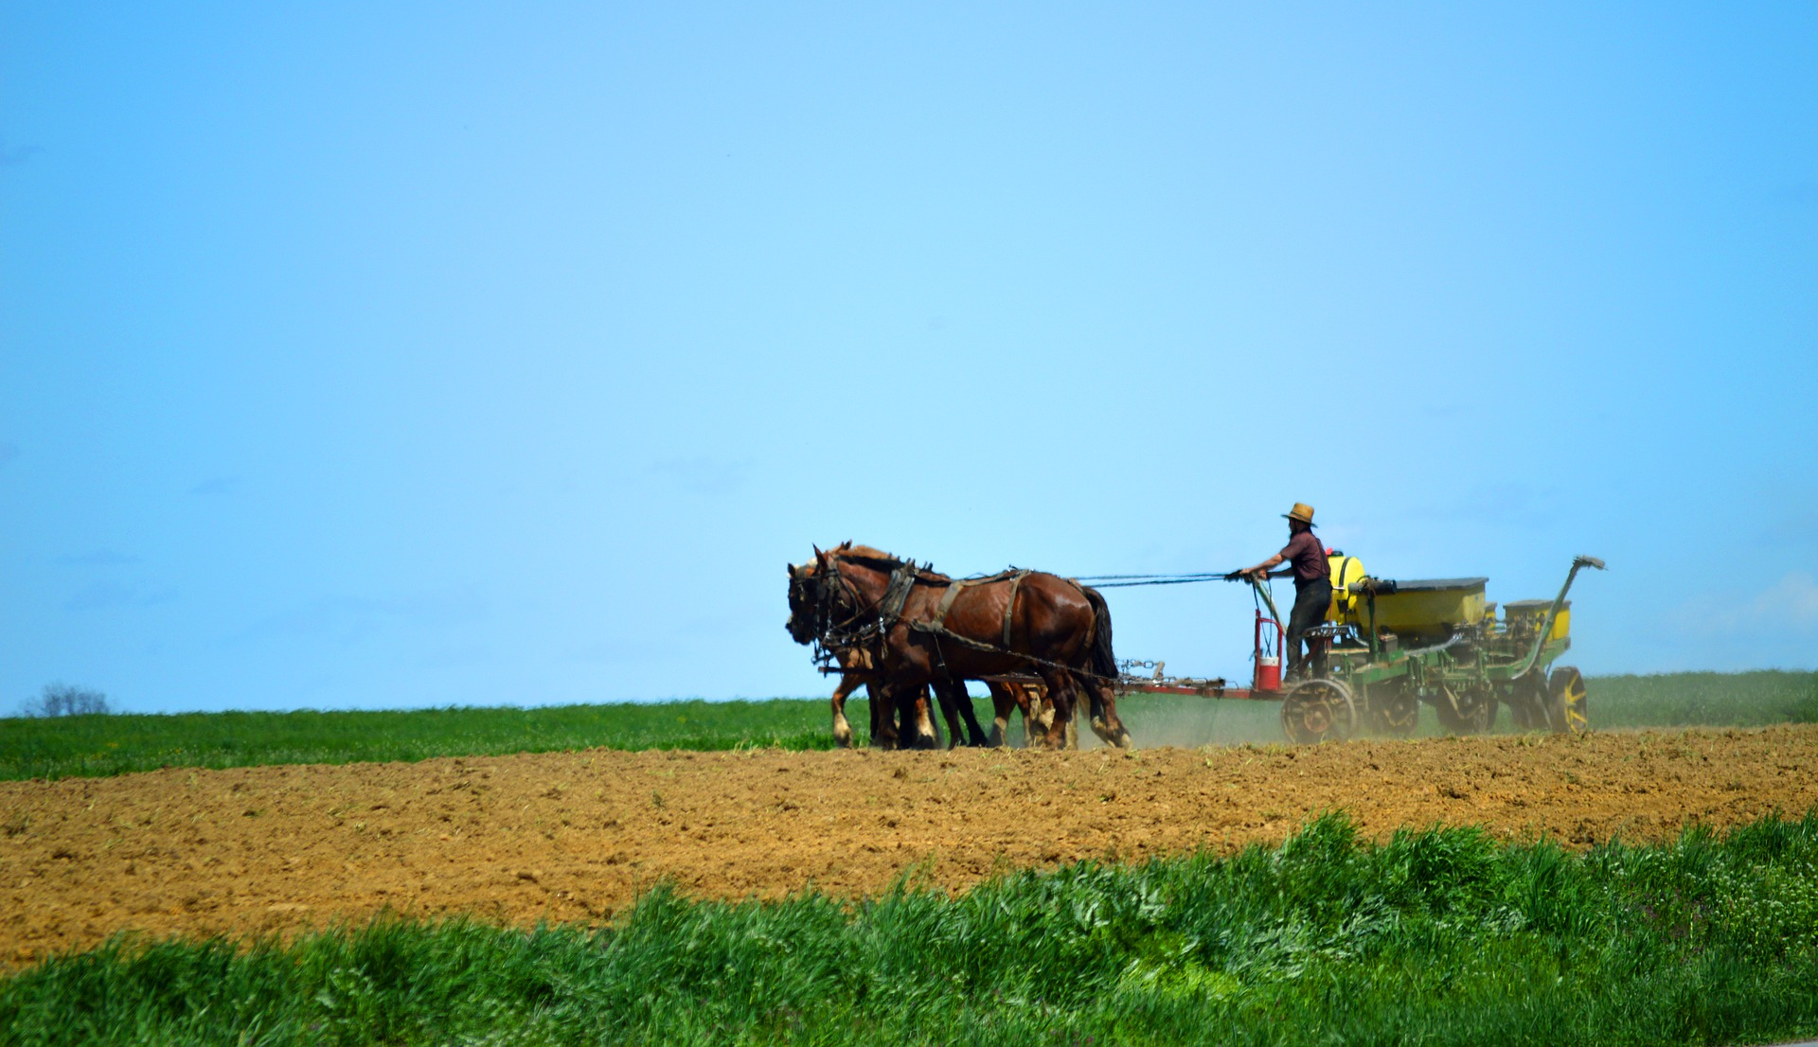
Impartiality
Notes:
Plowing the Field Metaphor
What does this picture have to do with impartiality? Why is impartiality important?
As we begin cultivating the seeds of pro-social values, such as forgiveness, gratitude, etc., it is important to prepare the field, so these crops grow evenly and benefit the greatest number of people, not only those closest to us. We do this by reducing our bias. Cultivating Impartiality helps combat the Thinking Trap of In-Group bias.

Slide 11
Impartiality
Notes:
The Sunshine Metaphor
Some may misunderstand the idea of Impartiality as a desire to be neutral or apathetic toward all people. The sun metaphor is a good way to explain the goal of impartiality. We can think of our love and compassion like the sun. The sun shines impartially. At different times of the day and year, some places on the Earth will be closer to the sun than others and will benefit from it more than others. Similarly, although we ultimately want to cultivate impartiality towards all people, there are people who are closer to us and will naturally benefit from our love and compassion more than others. Impartiality, therefore, is not being apathetic or neutral towards everyone. We are not seeking to reduce our feelings for our loved ones. Instead, we are elevating how we appreciate and value others.

Slide 12
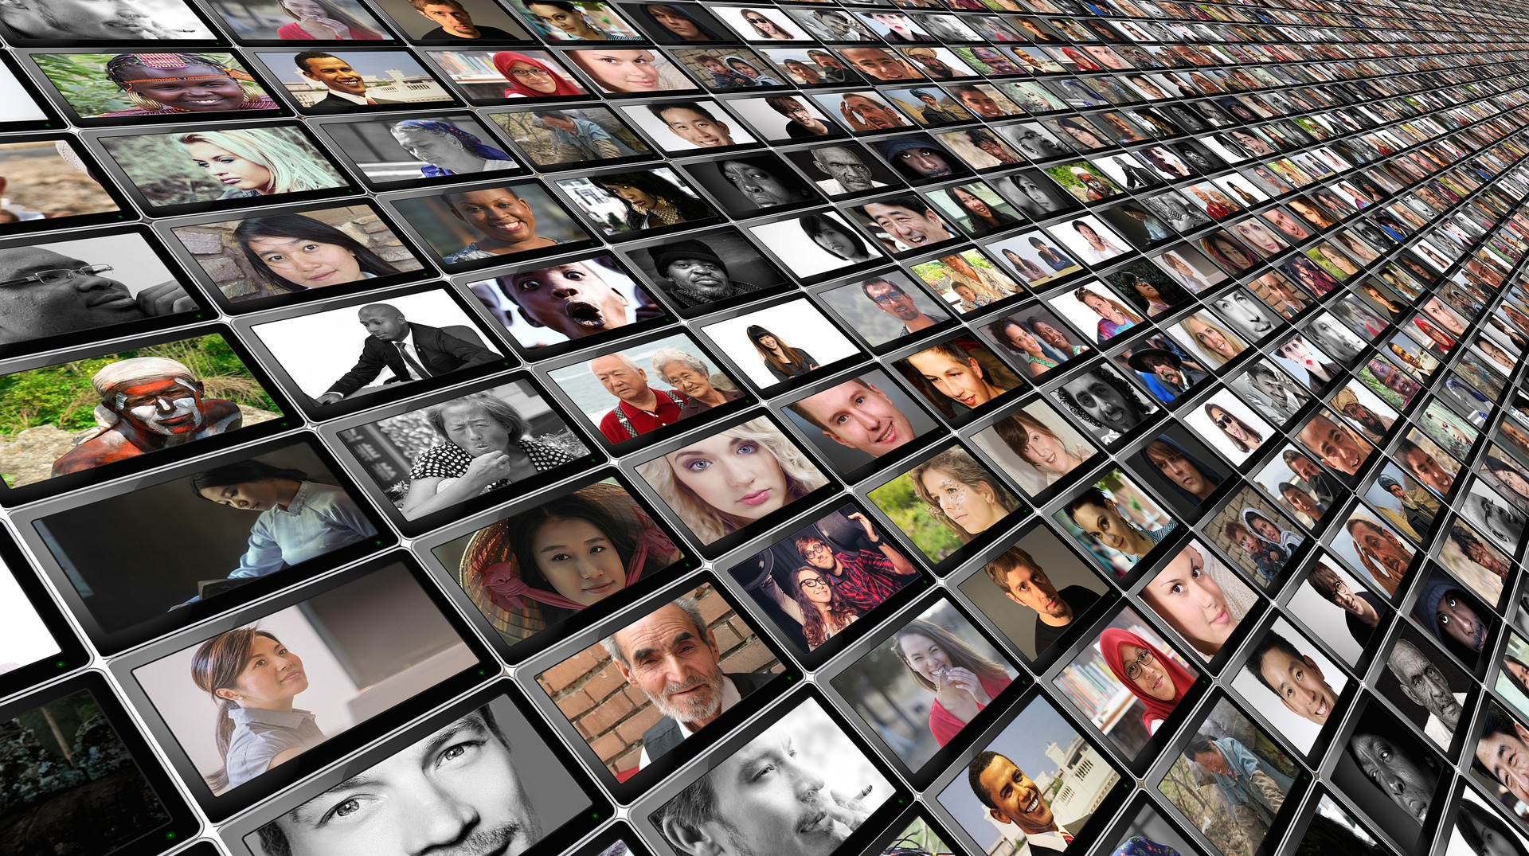
Common Humanity
Focusing on that which all human beings share, such as our wish for greater well-being and less suffering or dissatisfaction.
Notes:
Recognizing our common humanity can help us appreciate others and see others’ lives as being as important as our own.

Slide 13
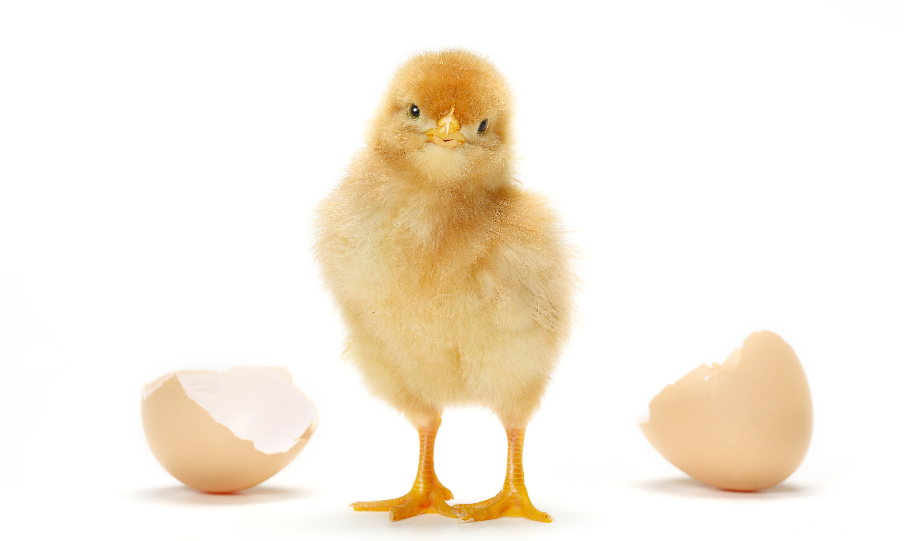
Break Out Groups
Notes:
“Common Humanity Stories” Critical Insight Activity from the Facilitator Guide

Slide 14
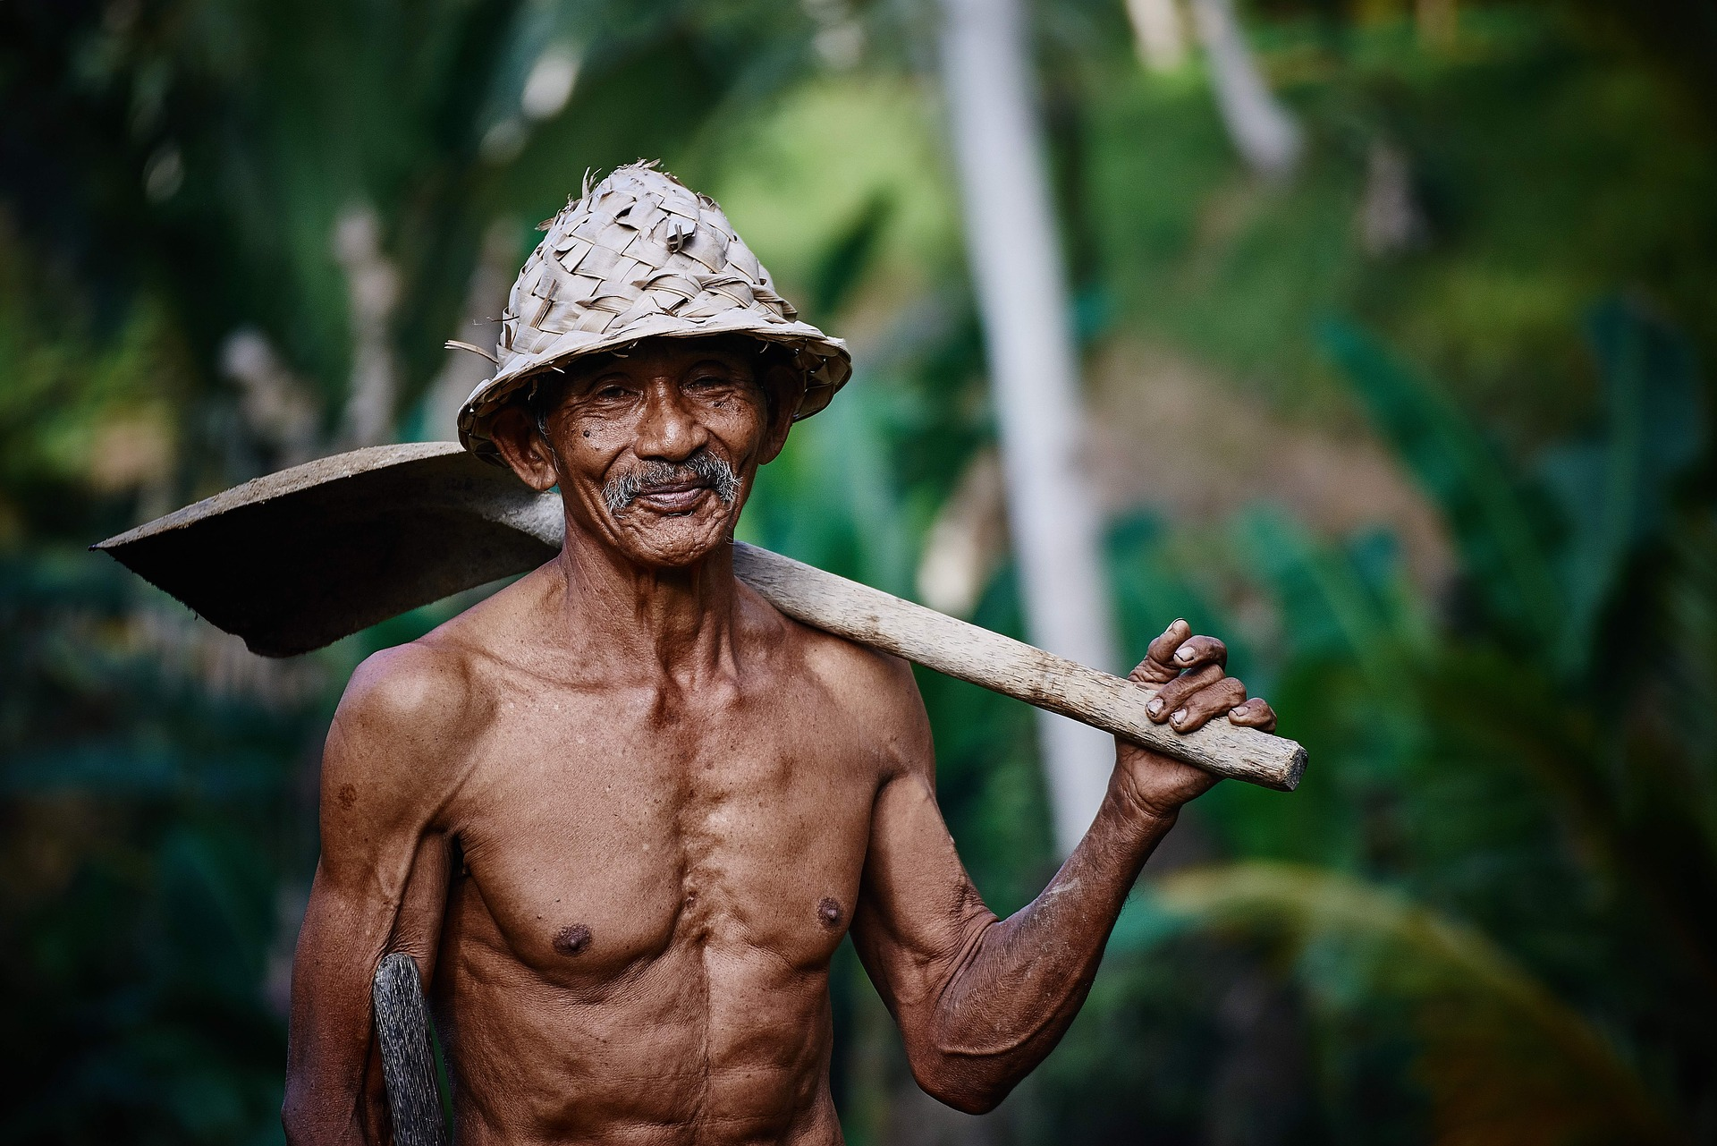
Notes:
Choose two of the following five images for the “Common Humanity Stories” Critical Insight Activity from CIT Facilitator Guide

Slide 16
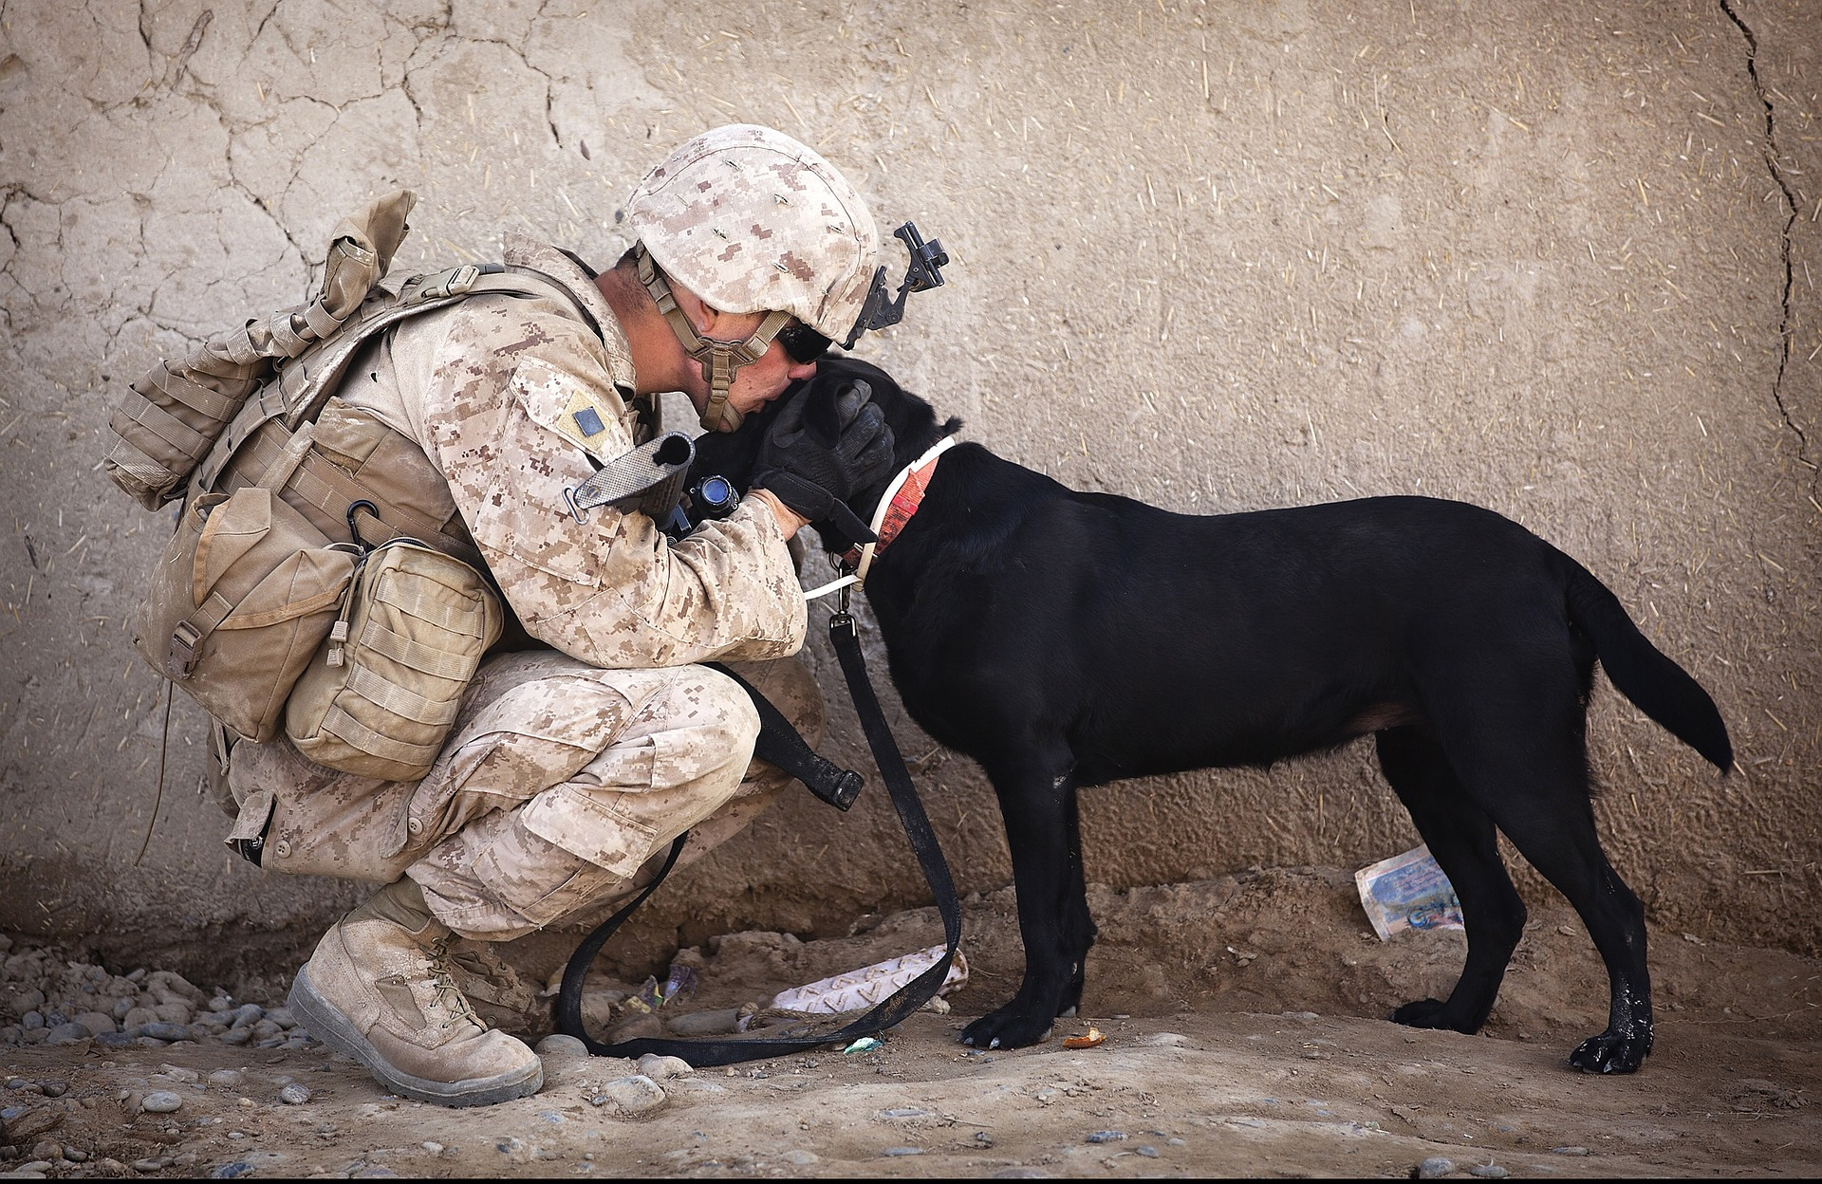

Slide 17
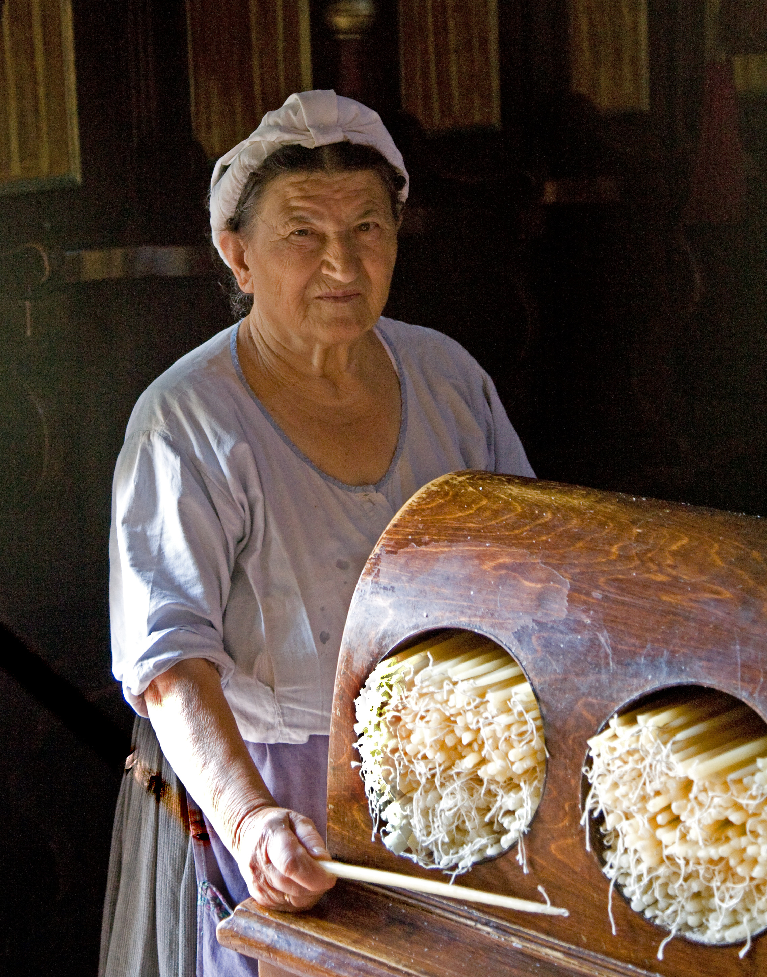

Slide 18
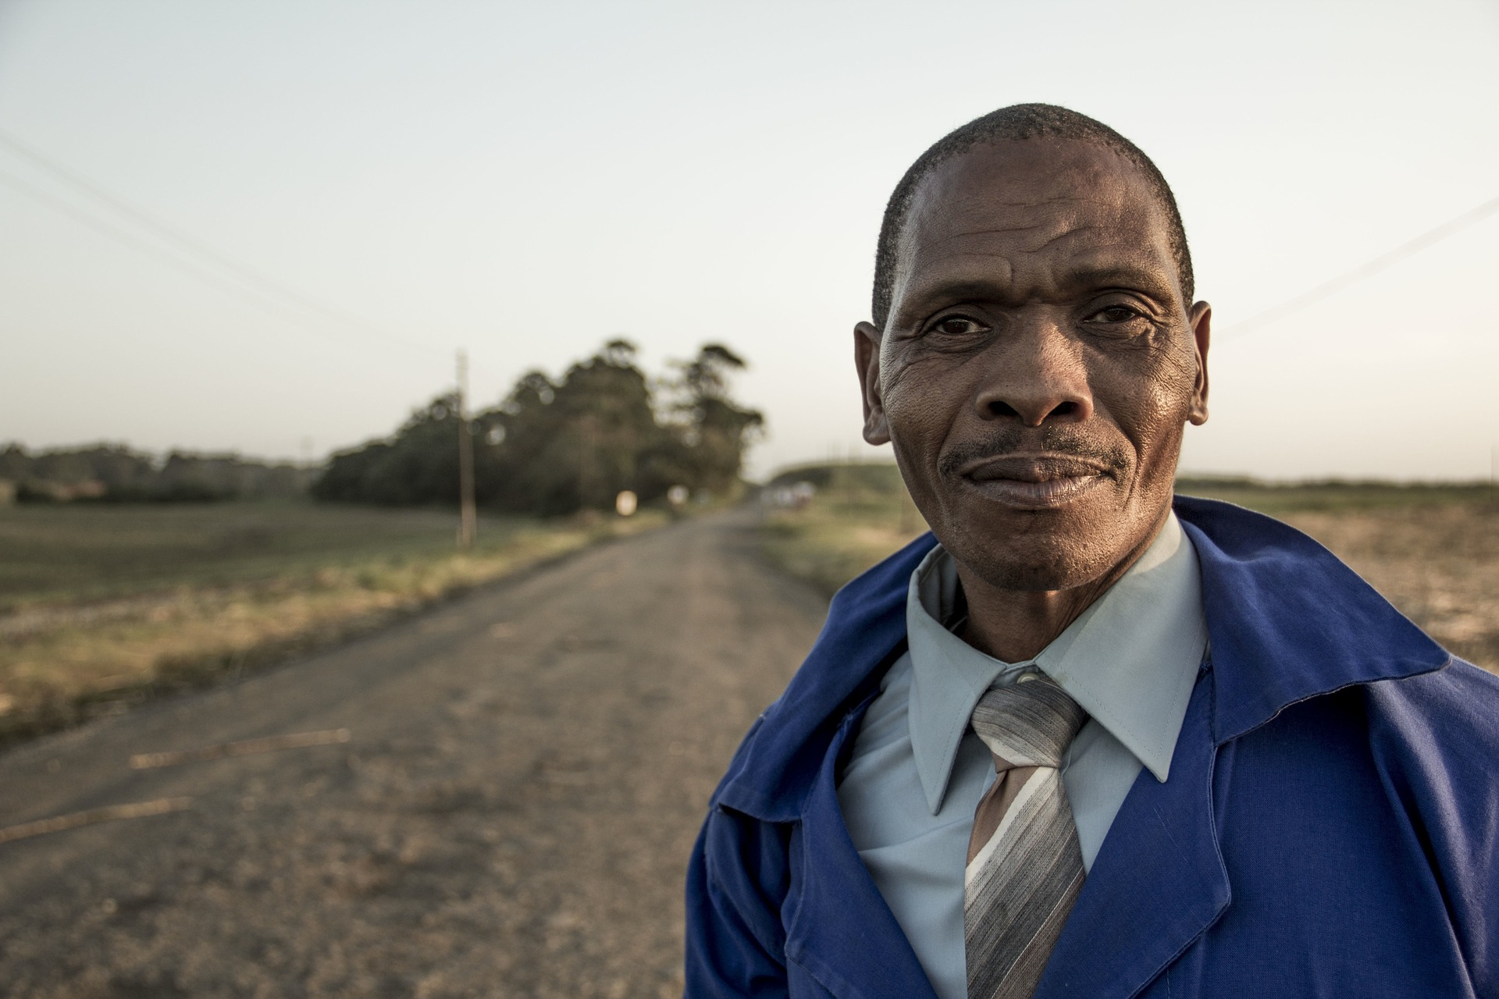

Slide 19
Notes:
After completing the “Common Humanity Stories” Critical Insight Activity, ask what do all of these people have in common with you?

Slide 20
Notes:
How about these people?

Slide 21
Notes:
“All That We Share” Video
https://www.youtube.com/watch?v=jD8tjhVO1Tc

Slide 22
Thinking Trap: Not Seeing Common Humanity
Notes:
Not seeing common humanity is a Thinking Trap. All human beings suffer and have needs. By virtue of merely being alive, we all face emotional pain and distress, we all encounter sickness, we are all aging, and we will all die. On the surface, a person may appear to have no problems whatsoever, but if we take time to investigate, we will doubtless discover that they do indeed experience emotional pain, relationship issues, financial worries, non-obvious physical ailments, or any of countless forms of suffering that are not readily obvious to an outsider. Even if they are not suffering now, we know that as a human being they are vulnerable to suffering just by being alive on this earth. Overcoming this Thinking Trap can help us can help us feel more connected to others and build the foundation for rest of the skills in CIT.

Slide 23
Strategies for Cultivating Impartiality
Examine the limitations of categories
Focus on common humanity
Recognize the benefits of impartiality
Notes:
These are strategies for helping us overcome the Thinking Traps of In-Group Bias, Stereotyping and Psychological Essentialism.

Slide 24
Contemplative Practice
Notes:
“Just Like Me,” ”Common Humanity,” or “Impartiality” Practice from the Facilitator Guide

Slide 25
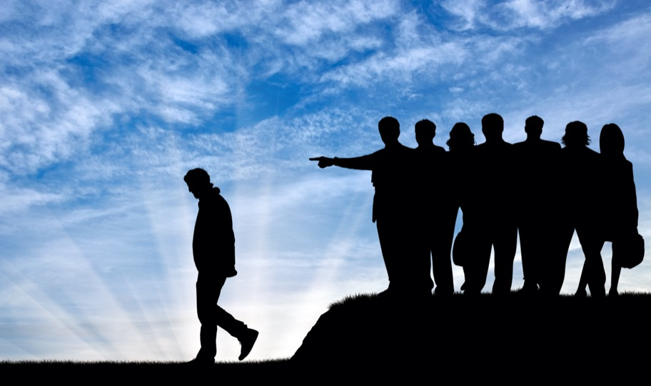
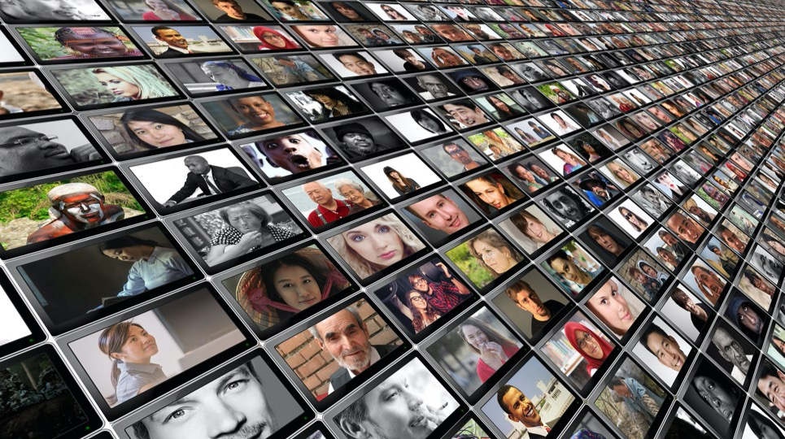
Thinking Traps
In-group Bias
Essentialism
Not Seeing Common Humanity
Notes:
To review, the Thinking Traps we have covered in this skill are In-group Bias, Essentialism, and Not Seeing Common Humanity. The practices we will do for this skill will help us overcome these traps.

Slide 26
COMPASSIONATE INTEGRITY TRAINING
Center for Compassion, Integrity and Secular Ethics
Life University
© 2020 Brendan Ozawa-de Silva, Michael Karlin and Life University
COMPASSIONATE INTEGRITY TRAINING SERIES II: RELATING TO OTHERS SKILL 5: IMPARTIALITY AND COMMON HUMANITY

