Slide 1
COMPASSIONATE INTEGRITY TRAINING
Center for Compassion, Integrity and Secular Ethics
Life University
© 2020 Brendan Ozawa-de Silva, Michael Karlin and Life University
COMPASSIONATE INTEGRITY TRAINING SERIES I: SELF-CULTIVATION SKILL 4: SELF-COMPASSION

Slide 2
COMPASSIONATE INTEGRITY TRAINING
SERIES I: SELF-CULTIVATION
Calming Body and Mind
Ethical Mindfulness
Emotional Awareness
Self-Compassion
SERIES II: RELATING TO OTHERS
Impartiality and Common Humanity
Forgiveness and Gratitude
Empathic Concern
Compassion
SERIES III: ENGAGING IN SYSTEMS
Appreciating Interdependence
Engaging with Discernment
COMPASSIONATE INTEGRITY TRAINING SERIES I: SELF-CULTIVATION SKILL 4: SELF-COMPASSION

Slide 3
COMPASSIONATE INTEGRITY TRAINING
SERIES I: SELF-CULTIVATION
Calming Body and Mind
Ethical Mindfulness
Emotional Awareness
Self-Compassion
SERIES II: RELATING TO OTHERS
Impartiality and Common Humanity
Forgiveness and Gratitude
Empathic Concern
Compassion
SERIES III: ENGAGING IN SYSTEMS
Appreciating Interdependence
Engaging with Discernment
COMPASSIONATE INTEGRITY TRAINING SERIES I: SELF-CULTIVATION SKILL 4: SELF-COMPASSION
Notes:
Content:
Participants will explore whether the underlying motivation beneath all of our thoughts and actions is a desire for happiness and well-being.
Participants will explore how suffering and happiness do not depend solely on external situations, but on our own emotions, thoughts, attitudes and habits of mind, which we can transform.
Participants will learn how seeking external sources of happiness (material gain, sensory-dependent pleasure, praise and status), rather than internal ones, often fails to bring lasting satisfaction.
Participants will explore how unrealistic expectations can lead to suffering and excessive self-criticism.
Practice:
Participants will explore through practice how harmful mental states can be changed, gaining confidence in the possibility of self-transformation.
Participants will generate increasing resolve and determination to gradually transform their afflictive mental states.

Slide 4
Self-Compassion
Recognition of our innate value, deeply understanding the true causes of happiness and suffering and…

Slide 5
…resolving to engage in self-transformation.

Slide 6
Notes:
This image reminds us of the Resting the Mind in its Natural State practice. Are the mental states we observed during the practice leading us toward our fundamental aspiration for greater well-being and less suffering?

Slide 7
Notes:
We all seek greater well-being and less suffering and difficulties, and in general, our thoughts, feelings, emotions, and sensations are an attempt to achieve these goals. Upon examination, however, we may find the opposite is true: many of our thoughts, feelings, and emotions actually lead us away from happiness and well-being and toward suffering and difficulty.

Slide 8
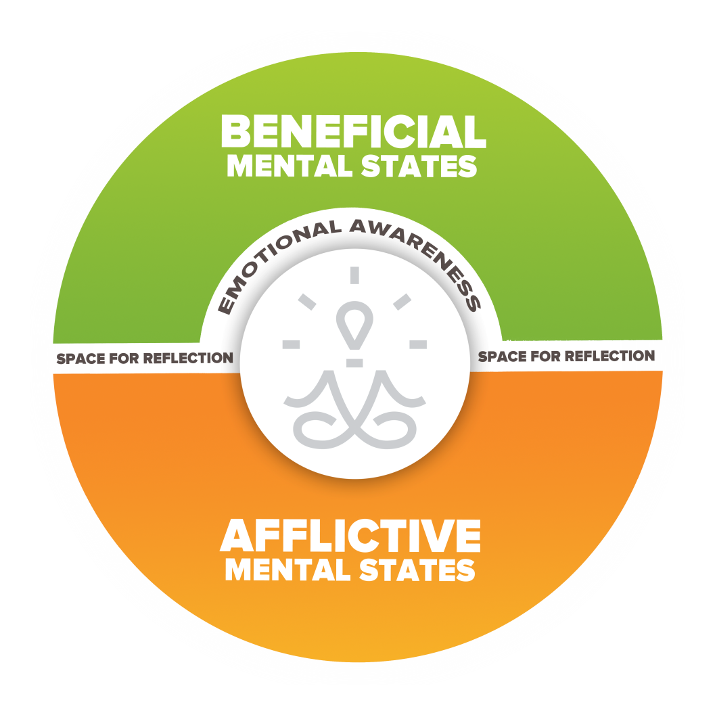
Anger
Jealousy
Impatience
Hatred
Fear
Notes:
As discussed in Skill 3, if mental states lead towards suffering for ourselves and others, they are considered afflictive mental states. As a reminder, this slide shows some of the afflictive mental states we’ve discussed. To cultivate Self-Compassion, it can be helpful to understand what fuels these harmful mental states. In other words, we want to ask ourselves what goals do we pursue that we think will bring us happiness and help us avoid suffering that can cause us to distort reality and lead to greater suffering instead? What am I really trying to achieve with my anger, hatred, jealousy, etc. and is it truly leading me towards greater well-being and less suffering for myself and others?

Slide 9
Status
Insignificance
Notes:
One useful model for helping us think of the things we strive for and try to avoid that also often lead to harmful mental states is the Eight Worldly Concerns. Our society often tells us that certain external things will bring happiness. This model can be a useful tool for examining whether these external things or circumstances bring us the happiness we seek.
It is not that wealth, pleasure, praise or status are inherently bad, and we should not seek them at all. There is no question that they play a role in our happiness and well-being. The real question is how much of a role. How invested should we be in seeking them as genuine causes of happiness? It is when this craving — a mental state — becomes too strong and too distorted that we begin to have problems. We lose sight of the fact that our inner qualities are more important and are better guarantees of happiness and well-being. We lose our sense of equanimity, a balanced state of mind where we are not overly-invested in either achieving or avoiding these concerns. This loss of balance is a major source of dissatisfaction.

Slide 10
Financial Gain
Financial
Loss

Slide 11
Blame
Praise

Slide 12
Pain
Pleasure

Slide 13
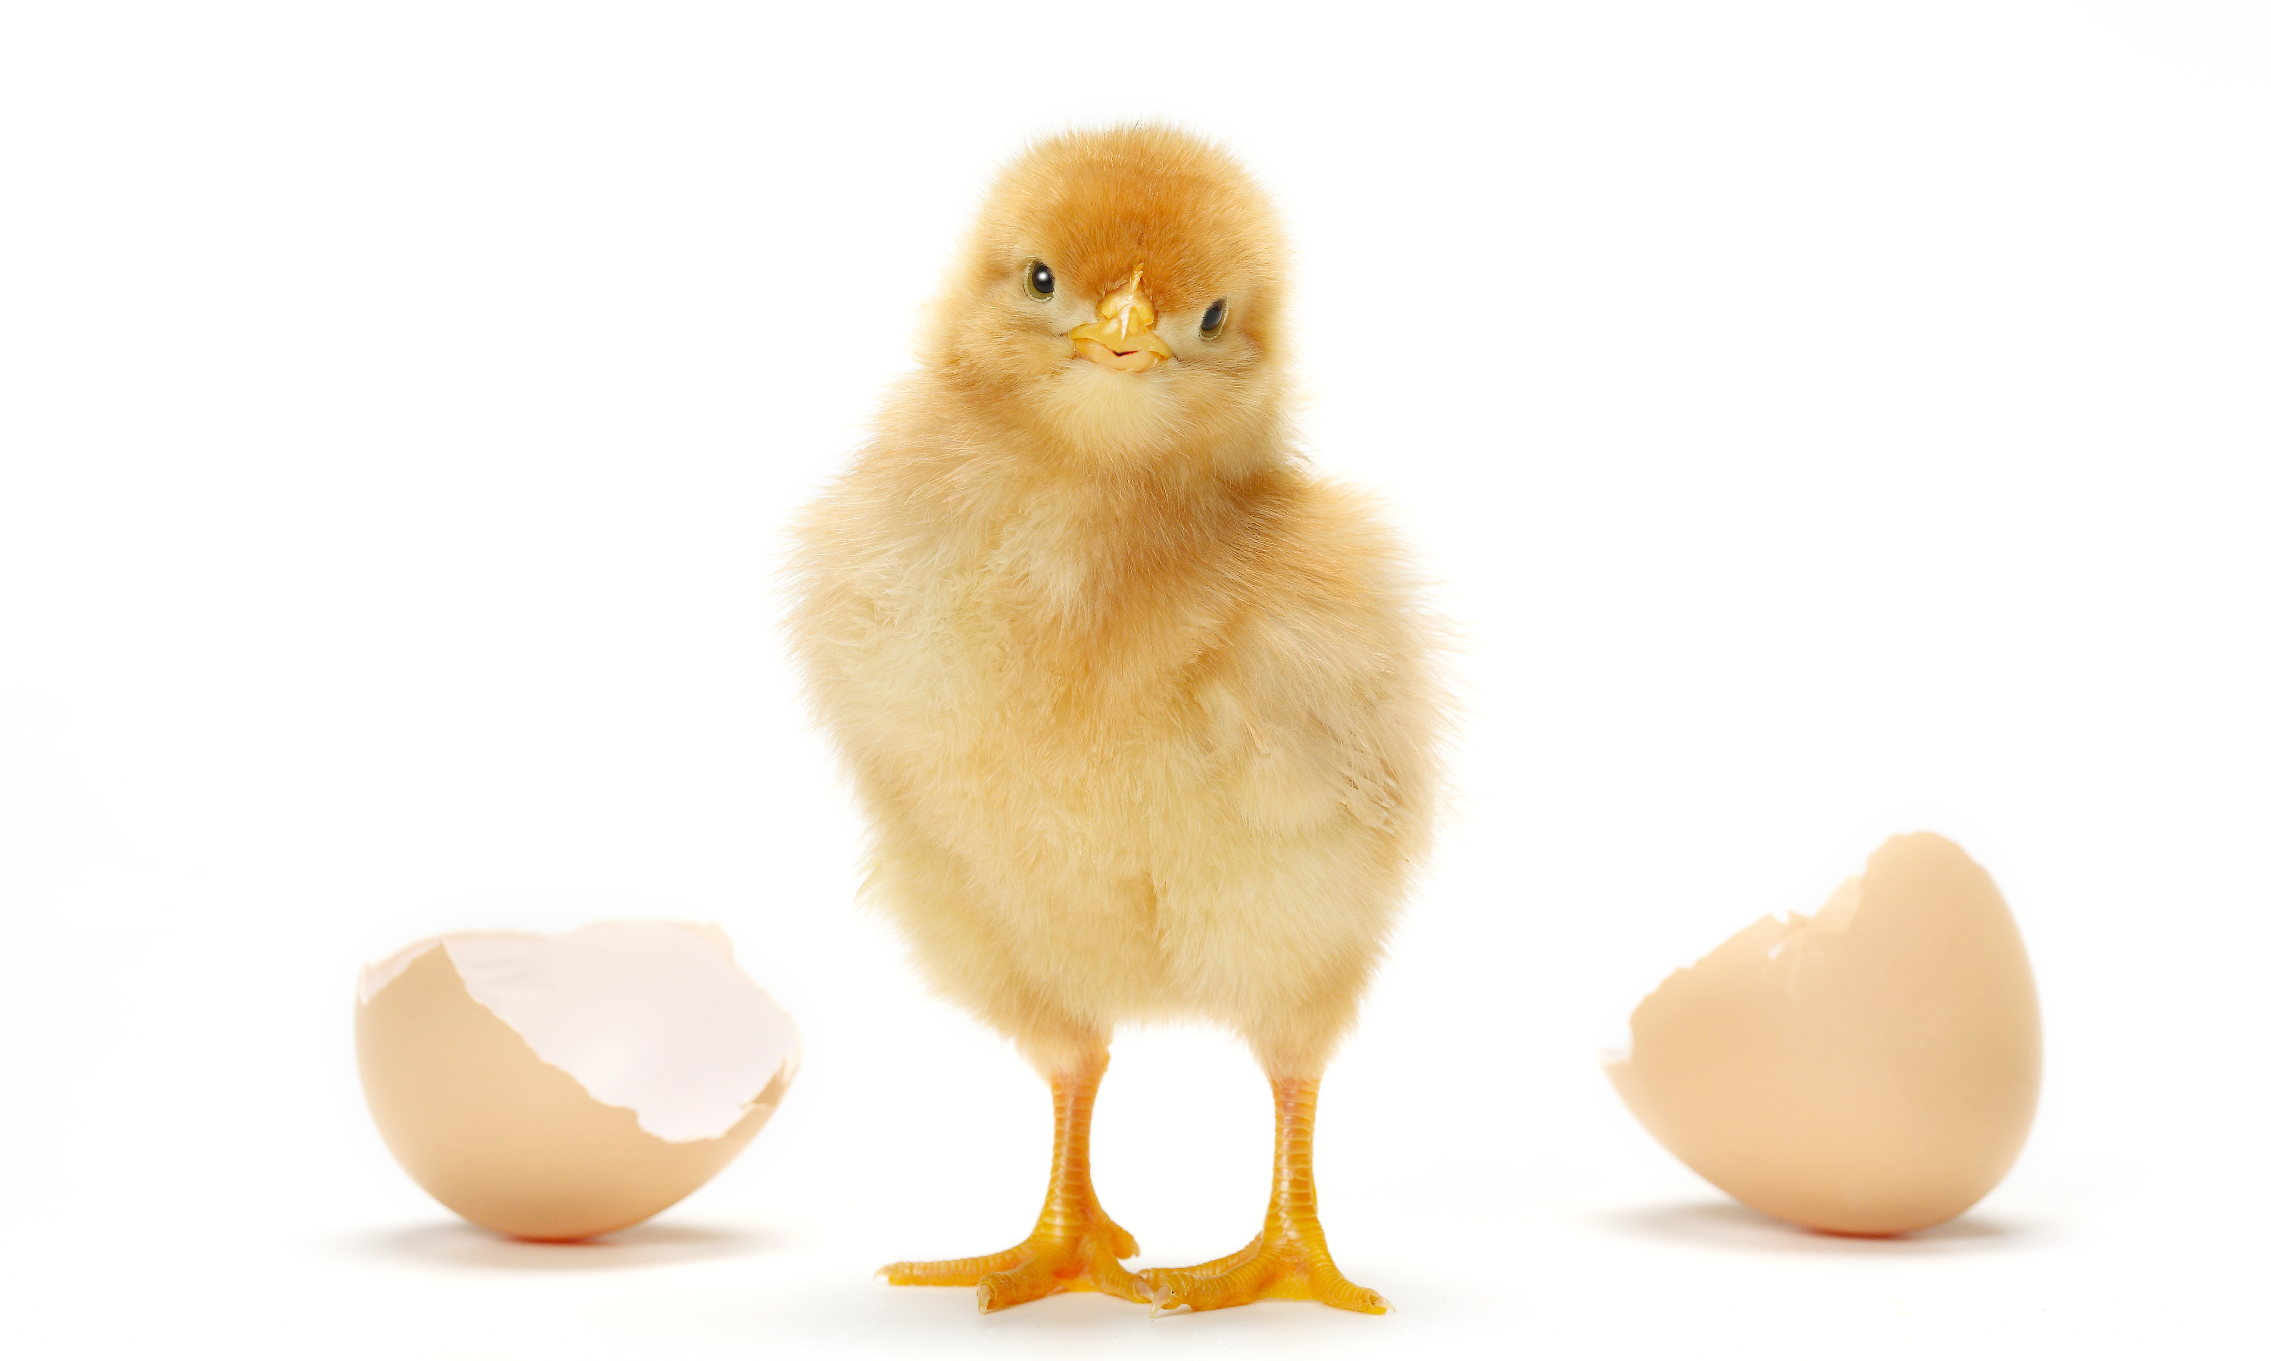
Break Out Groups
Notes:
“Eight Worldly Concerns” from Facilitator Guide

Slide 14
Status
Insignificance
Financial Gain
Financial Loss
Praise
Blame
Pleasure
Pain

Slide 15
Thinking Traps
Notes:
We now need to introduce the idea of Thinking Traps, so we can apply them to the Eight Worldly Concerns. Thinking Traps is what we will call specific, recurring harmful mental states that distort reality and get in the way of our genuine well-being.
In this image the horizontal line in both images is the exact same length, even though most people will perceive the top line as longer. When you click on the slide, the arrowheads will disappear to show the lines are the same length. Clicking again will bring the arrowheads back. We have been speaking about the way harmful or afflictive mental states distort reality. Just like we often do not visually perceive the world accurately, we oftentimes distort reality through our thoughts. When these distortions relate to the way we think, we will refer to them as Thinking Traps in CIT. Like perceptual illusions, Thinking Traps are based on a difference between the way things appear and the way they actually are. These illusions are not always problematic, but if one were to be designing a structure, for example, it would be important to know that what one is perceiving is not the same as reality. In the same way, we want to know when our thoughts and way of seeing the world cognitively do not align with reality.
It is important to always emphasize that Thinking Traps have evolved to help us survive and can lead to beneficial results. Also, not everyone experiences every Thinking Traps as afflictive. For example, the Thinking Trap of Personalization is when someone takes everything others do or say personally. They believe that what others do or say is a direct, personal reaction to them, even when they are not thinking about them at all. Not everyone gets trapped by Personalization.

Slide 16
Thinking Traps
Notes:
There are also auditory illusions, which you may wish to demonstrate here, especially if you have a participant who has visual impairment. This is called the Shepard Tone and sounds as if it is ascending in tone forever, when in fact, it is not. The image is a picture of the sound wave it produces.

Slide 17
Thinking Trap: Permanence
Notes:
We already encountered one Thinking Trap. It is Permanence. We often see the world as static and unchanging, when it is actually changing every moment.
You can ask the group, “Are you the same moment-to-moment or are you in a state of change?”
Changes are happening every moment inside us. Our heart is beating, our lungs are breathing, our stomach and intestines are digesting food, blood is circulating through our veins, our nerves are sending information to our brain from throughout our body, and our brain itself is constantly processing information. We can also clearly see that we’ve grown older over time and probably a lot taller since we were babies or small children. Our bodies have changed in other ways as well, and our minds have certainly changed too. We’ve had new experiences, we’ve learned things, we’ve met people, we’ve gained skills and knowledge. Perhaps even some of our opinions or attitudes have changed over time.
You can ask the group, “How might thinking that everything (including people) stay the same be a thinking trap? When could it lead to distortions or problems for ourselves and others? How and when might recognizing that things are always changing be helpful? How might appreciating Impermanence and escaping the Trap of Permanence relate to the Eight Worldly Concerns?

Slide 18
Thinking Trap: Hedonic Treadmill
Notes:
The first is the Hedonic Treadmill. The Hedonic Treadmill describes the propensity to quickly adapt to positive or negative events and return to a relatively stable level of happiness. From a survival perspective, it makes perfect sense that we would not simply be satisfied with achieving status, material resources, praise, or physical pleasure, as these things have generally been scarce and necessary for survival. Therefore, we are motivated to exaggerate the benefits that will come from achieving these things and avoiding their opposites, and then the well-being that is attained is short lived. If one were to find a bush filled with berries, for example, and was forever satisfied with the physical pleasure that was achieved by eating them, they would quickly die of starvation.

Slide 19
Reflective Writing & Mindful Dialogue
Notes:
Be totally present for the other person. We rarely have someone’s undivided attention during a conversation. It is a gift. This presence can manifest through maintaining eye contact and verbal and nonverbal gestures that let your partner know that you are following what he or she is saying. Please turn off any electronic devices to prevent unexpected distractions and interruptions.
Try not to ask questions. Although we are not always conscious of it, questions have a tendency to drive a conversation in the direction the questioner wants it to go, rather than where the responder wants to take it. If you feel you must ask a question, make it something like, “Is there anything more you would like to add?”
Try not to give advice. The purpose of these conversations is to allow your partner to vocalize important experiences or insights, and to have someone honor them by listening attentively and without judgment. Often, instead of truly listening, we spend time thinking about what we would give. While this urge can be motivated by compassion, it can also interfere with our ability to actually be fully present to what the person is saying.
Keep everything your partner says in total confidence. Nothing creates safe space more effectively than trust. Knowing that each of you will keep everything you hear confidential will build that trust.

Slide 20
Thinking Trap: Unrealistic Expectations
Notes:
Another set of Thinking Traps fall under the category of what we call Unrealistic Expectations. We often set unrealistic expectations for ourselves based on our desire for status, material gain, praise, and pleasure or our fear of insignificance, material loss, blame and pain. These expectations, upon deeper examination, may be distortions of reality and a Thinking Trap.

Slide 21
Superiority Biases
Notes:
Superiority Biases are Thinking Traps that help drive unrealistic expectations. Superiority Biases include Illusory Superiority, False Uniqueness, Unrealistic Optimism and others.
Common sense shows that it is a very unrealistic expectation to believe you must be above average in everything. Yet, if you ask people where they rank in terms of intelligence, job or school performance, popularity and many other areas, 80 to 90% of people will say they are in the top 50% of these categories. In some cases, as many as 40% will rank themselves in the top 10%. Statistically, this is impossible. By definition half of all people in any category are below average. What this means is that each one of us is below average in about half of every category.
This distortion in our self-perception might be fine if it did not actually lead to harm. Sadly, this combination of perfectionism and self-delusion does often lead to significant harm. Instead of having resilience, it means that when we fail, we may have very damaging experiences of self-hate, self-loathing or we may even feel like ending our lives. This is a complete overreaction, but it stems from this unrealistic sense of perfectionism.
This is one reason why self-esteem rather than self-compassion can be so damaging. Self-esteem is measured by how one compares to others, and we often need to feel we are above average to feel good about ourselves.

Slide 22
Inferiority Biases
Notes:
Unrealistic expectations are also be driven by Inferiority Biases when we overcompensate and set unrealistic standards for ourselves or when we do not set the bar high enough because we do not believe we are capable of achievement. Realistic expectations are about not setting the bar too low or too high but making a realistic assessment of our capabilities.

Slide 23
Perfectionism
Notes:
At the extreme, Unrealistic Expectations lead to Perfectionism, a Thinking Trap that is a tremendous cause of suffering within our society. Perfectionism causes us to judge ourselves harshly when we fail even in minor ways and to judge others harshly when they make mistakes and fall short of perfection. We can begin to fix this problem by analyzing these unrealistic expectations and shifting to a more realistic view of ourselves and others, one that is humble and realistic. A fundamental aspect of self-compassion is simply learning to see things more realistically, despite our mind’s tendency to distort reality. We tend to go through life with assumptions about the way things are or should be. When we place these assumptions under scrutiny, however, we often realize they are not accurate.

Slide 24
Aspirations…
Not Expectations
Notes:
In exploring Unrealistic Expectations, it is important to differentiate between expectations and aspirations. We do not mean to suggest that one should not aspire to achieve goals, but there can be a meaningful difference to one’s well being when we are afflictively attached to the outcome rather than gently aspire to it. A good mantra to share is “aspirations, not expectations.”

Slide 25
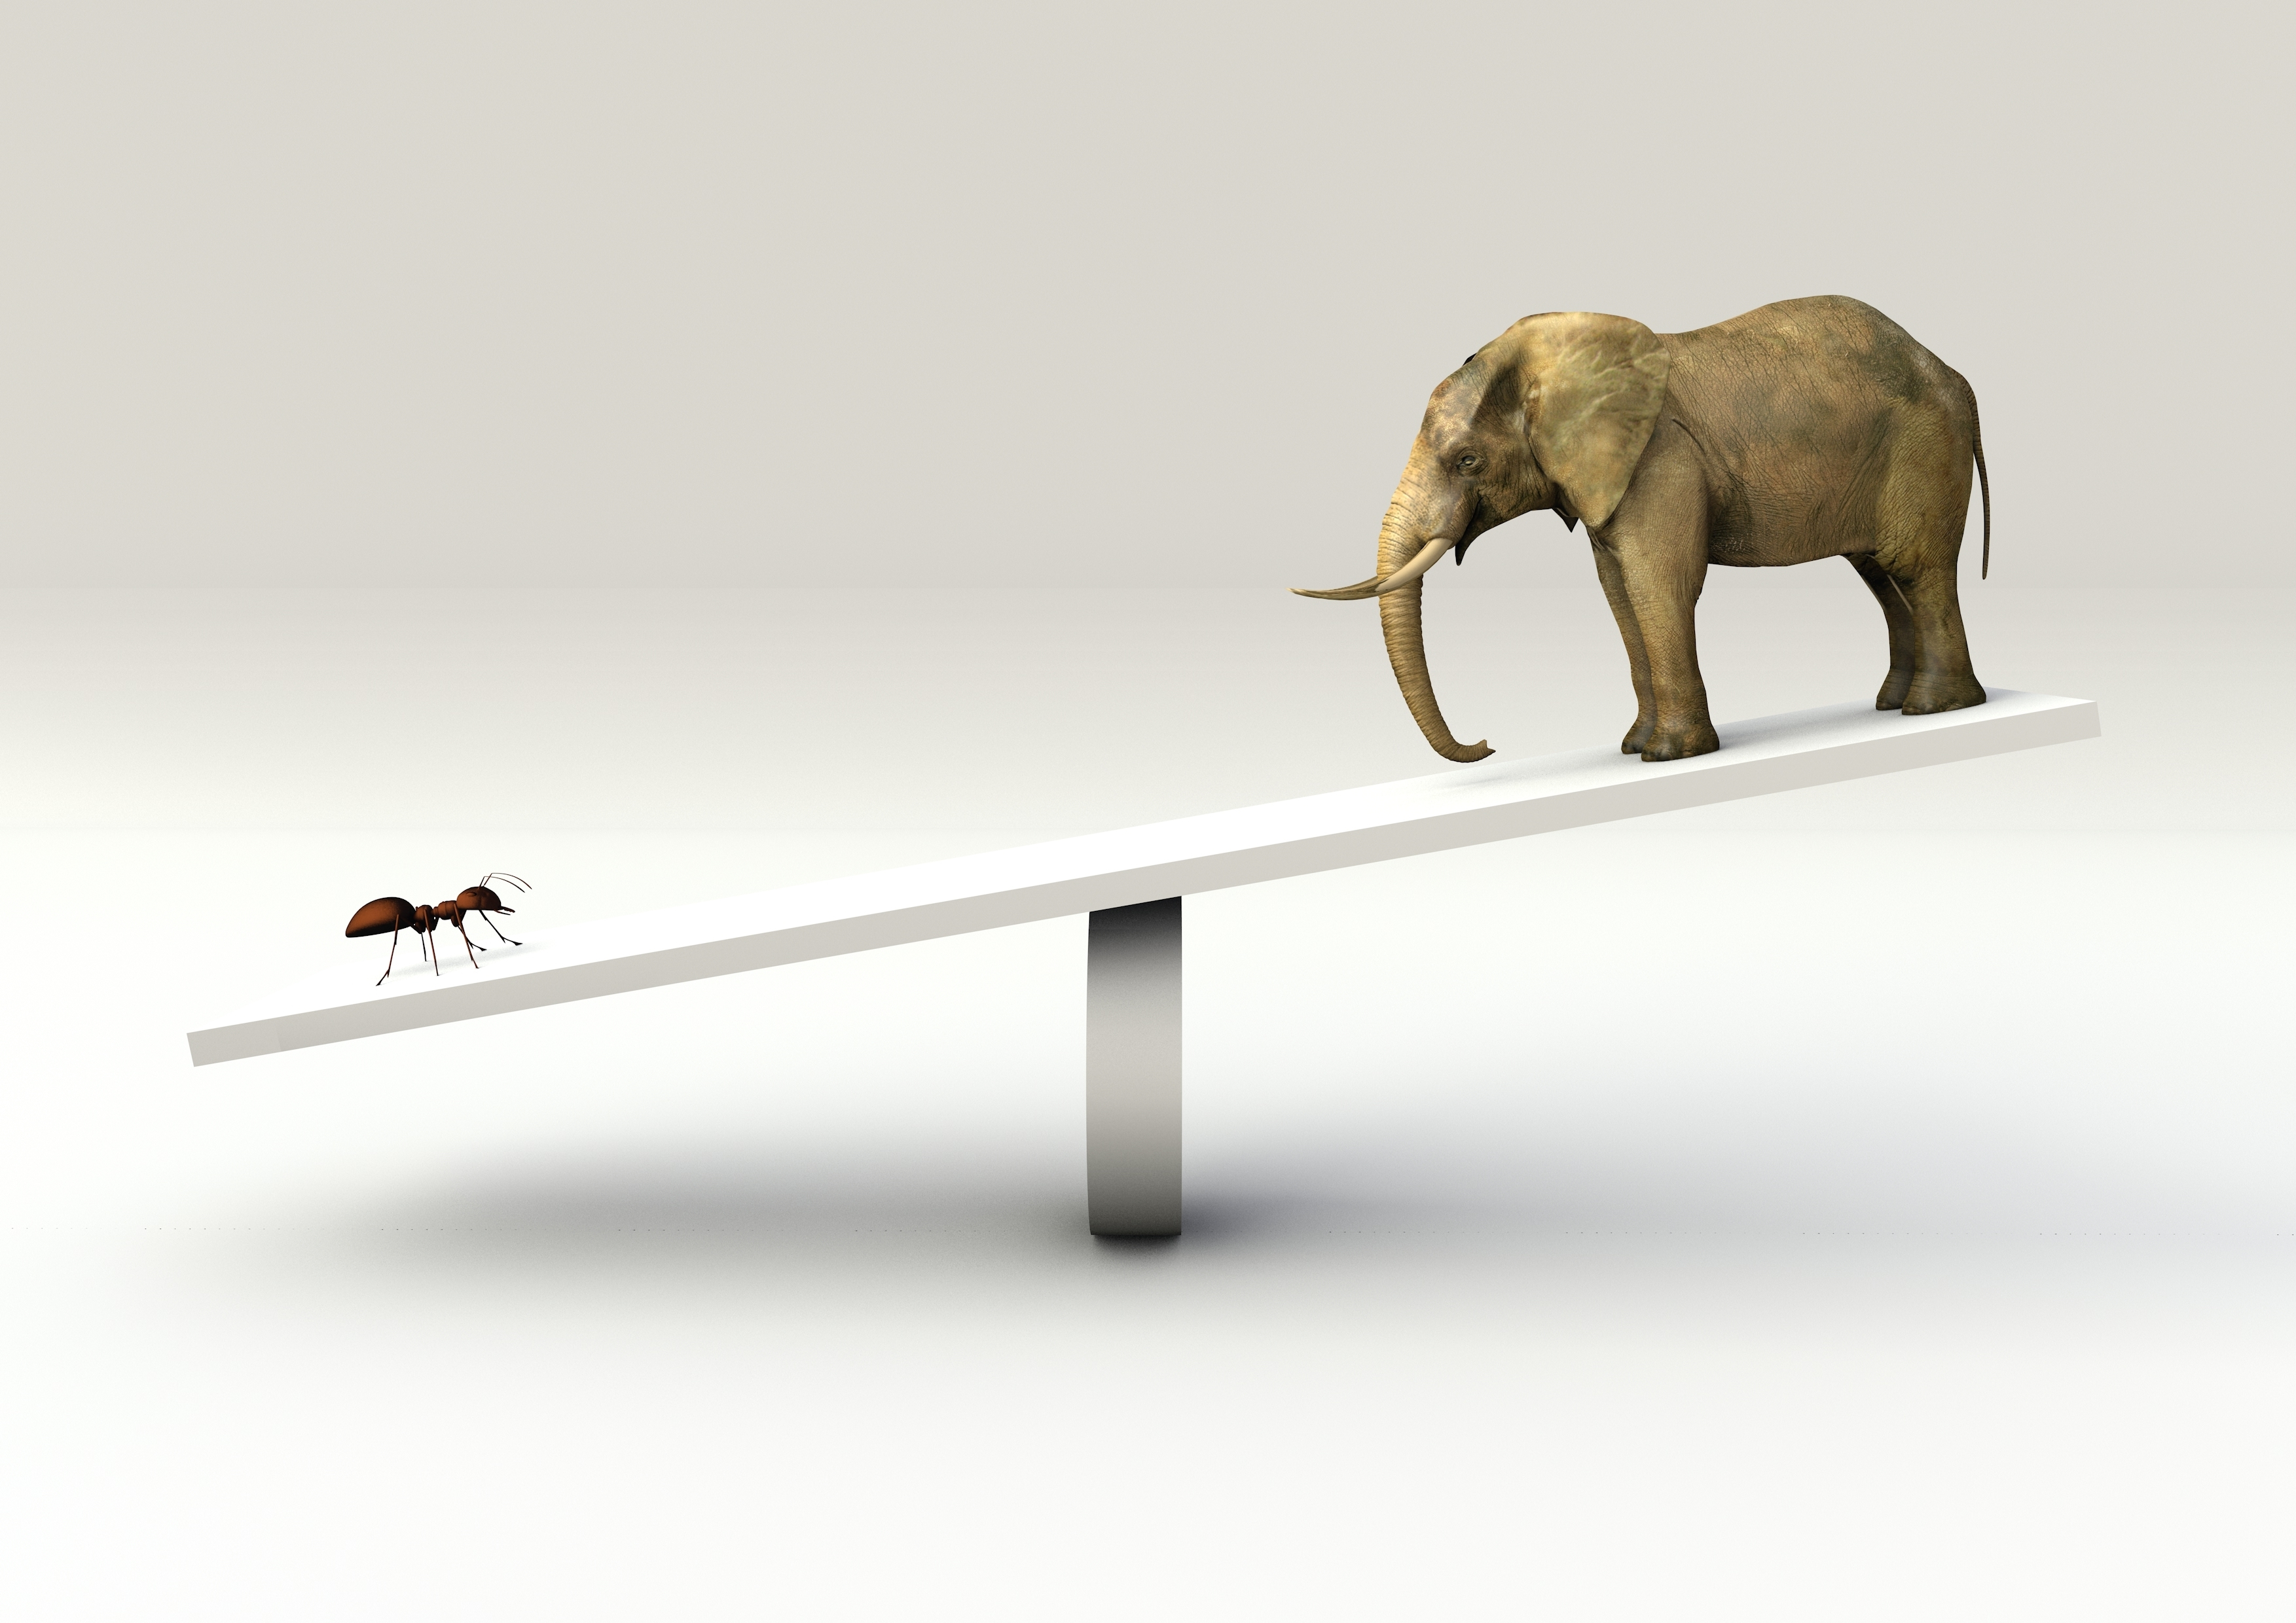
Thinking Trap: Negativity Bias
Notes:
The final of the three Thinking Traps we will discuss in Skill 4 is Negativity Bias. Negativity Bias is also known as Filtering because we “filter” out positive aspects of a situation, while magnifying the negative. Negativity Bias can lead to a related Thinking Trap called Catastrophizing.
When a person engages in catastrophizing, they expect disaster to strike, no matter what. This is also referred to as magnifying, and can also come out in its opposite behavior, minimizing. In this distortion, a person hears about a problem and uses what if questions (e.g., “What if tragedy strikes?” “What if it happens to me?”) to imagine the absolute worst occurring.

Slide 26
Thinking Traps
Permanence
Hedonic Treadmill
Unrealistic Expectations
Negativity Bias
Notes:
To review, the Thinking Traps we have covered so far include Impermanence, Hedonic Treadmill, Unrealistic Expectations (which includes Superiority Biases and Perfectionism) and Negativity Bias.

Slide 27
Self Compassion Helps Us
See Reality More Clearly
Notes:
The analytical practices we will do in this skill will help us escape the Thinking Traps and to see reality more clearly.

Slide 28
Contemplative Practice
Notes:
“Unrealistic Expectations” Contemplative Practice
From this point forward, we will be moving from stabilizing practices to analytical practices. Analytical meditation involves holding an object in one’s attention and then investigating it in order to gain a deeper insight. We’ve all had “aha” moments when we saw things in a different way, and we’ve all encountered people whose problems stem from their perspective. The purpose of analytical meditation is to gain these insights and shift our perspectives, allowing us to be free from things like resentment, jealousy or arrogance, which will inevitably cause problems for us. The analytical practices are designed to free us from our Thinking Traps more often.

Slide 29
Where would there be leather enough to cover the entire world? With just the leather of my sandals, it is as if the whole world were covered.
Likewise, I am unable to restrain external phenomena, but I shall restrain my own mind. What need is there to restrain anything else? -Shantideva
Notes:
An ancient Indian teacher, Shantideva, provides an excellent metaphor to summarize self-compassion as taught in CIT. He explains the futility of trying to achieve happiness by trying to get one’s external circumstances perfect. He states that if we want to prevent getting thorns stuck in our feet as we walk, we have two choices: either we can try to cover the whole world with leather, or we can put leather on the soles of our feet in the form of shoes. Covering our own two feet is as effective as covering the whole world, but far more practical. Similarly, we may think that we can achieve happiness by controlling all our external circumstances: only having nice people around us, only having nice things, always receiving good service, living in the best places, having the best cars or possessions, only eating the best food. However, this is unrealistic. In reality, the more we try to achieve happiness by controlling everything in the external world, the more we will meet with frustration, disappointment and unhappiness. It’s natural to want to avoid annoying people, but it just isn’t practical. Although it may seem more difficult at first, a better strategy is to transform one’s own mind and cultivate patience, learning to deal with adversity and beginning to see those annoying people and circumstances as slightly less annoying. This builds resilience, and gradually we begin to see that circumstances or persons we found difficult to tolerate are now much more manageable. By working on our own mental states or internal way of looking at the world and ourselves, we have a much better shot at achieving lasting happiness.

Slide 30
COMPASSIONATE INTEGRITY TRAINING
Center for Compassion, Integrity and Secular Ethics
Life University
© 2020 Brendan Ozawa-de Silva, Michael Karlin and Life University
COMPASSIONATE INTEGRITY TRAINING SERIES I: SELF-CULTIVATION SKILL 4: SELF-COMPASSION

