Slide 1



COMPASSIONATE INTEGRITY TRAINING
Center for Compassion, Integrity and Secular Ethics
Life University
© 2020 Brendan Ozawa-de Silva, Michael Karlin and Life University
COMPASSIONATE INTEGRITY TRAINING
SERIES II: RELATING TO OTHERS
SKILL 7: EMPATHIC CONCERN

Slide 2
COMPASSIONATE INTEGRITY TRAINING
SERIES I:
SELF-CULTIVATION
Calming Body and Mind
Ethical Mindfulness
Emotional Awareness
Self-Compassion
SERIES II:
RELATING TO OTHERS
Impartiality and Common Humanity
Forgiveness and Gratitude
Empathic Concern
Compassion
SERIES III:
ENGAGING IN SYSTEMS
Appreciating Interdependence
Engaging with Discernment
COMPASSIONATE INTEGRITY TRAINING
SERIES II: RELATING TO OTHERS
SKILL 7: EMPATHIC CONCERN

Slide 3
COMPASSIONATE INTEGRITY TRAINING
SERIES I:
SELF-CULTIVATION
Calming Body and Mind
Ethical Mindfulness
Emotional Awareness
Self-Compassion
SERIES II:
RELATING TO OTHERS
Impartiality and Common Humanity
Forgiveness and Gratitude
Empathic Concern
Compassion
SERIES III:
ENGAGING IN SYSTEMS
Appreciating Interdependence
Engaging with Discernment
COMPASSIONATE INTEGRITY TRAINING
SERIES II: RELATING TO OTHERS
SKILL 7: EMPATHIC CONCERN
Notes:
Content:
Participants will learn empathy operates on two levels: affective and cognitive.
Participants will learn the difference between empathic distress, which is self-focused and leads to burnout, and empathic concern, which is other-oriented and leads to compassion.
Participants will learn one can have empathy for another’s joy (sympathetic joy) as well as difficulties. Cultivating sympathetic joy reduces envy, jealousy and greed.
Participants will learn the benefits of having consideration for others over narrow self-interest for our individual and collective well-being.
Practice:
Participants will increase their ability to experience emotional resonance with others’ joy and suffering.
Participants will strengthen perspective-taking.
Participants will cultivate affection for others and an ability to see the preciousness of each individual.

Slide 4

Empathy
The ability to understand and resonate with the emotions, thoughts, and motivations of another.
Notes:
When we increase our forgiveness and gratitude for others, we naturally increase our sense of closeness to them. This sense of closeness then creates a fertile ground for enhancing our empathy. You may ask, “How do you define empathy? What comes to mind when you think of the word?”

Slide 5

Affective Empathy
Feeling an emotional resonance with another.
Notes:
Empathy is a natural process. As humans, we experience “emotional contagion.” This dates far back in our evolutionary history, probably at least as far back as the last common ancestor between mammals and birds, which is also likely when maternal care developed. Emotional contagion is the automatic transfer of emotions and behaviors from one person (or animal) to another. From an evolutionary perspective, this is highly adaptive, as it allowed one to quickly react to a threat before having to see the threat for oneself. If a companion suddenly becomes frightened and runs, then it would probably be a good thing for us to run also, even if we didn’t know what for (or from). We see this today when someone yawns and it makes others around them feel like yawning, or when someone who is very anxious walks into the room and suddenly we feel a bit anxious ourselves. Emotional contagion can be passed through facial expressions, body language, vocal cues and other ways. Emotional contagion is not yet full blown empathy, but it shows that the foundations of empathy are deeply embodied and deeply rooted in our evolutionary history.

Slide 6
Cognitive Empathy
  Using the power of reason to try and place oneself in the other person’s situation to try and understand what the other person is thinking or feeling.
Notes:
The second channel of empathy is cognitive empathy, which involves knowing the mental or emotional state of another person. Cognitive empathy can happen just by looking at someone and recognizing their emotion from their facial expression, or it can involve a process of perspective taking, where we try to understand what a person is thinking and feeling. Cognitive empathy is helpful if we want to help another person, since if we cannot understand their feelings and emotions, or if we misread them, it might prove difficult to relate to them in a helpful way. Cognitive empathy by itself is not enough, however, since we can use our understanding of another’s emotional state to harm them. Psychopaths may perform fine on cognitive empathy tasks, such as discerning another’s emotional state or intention, yet they do not resonate with the pain of others. That lack of affective resonance in fact allows them to harm others without feeling pain themselves. Normally, if we inflict pain on another person (such as unintentionally), we are disturbed to a degree by seeing their suffering because of the affective resonance we naturally share with others.

Slide 7

Group Activity
Notes:
“The Empathy Line” Critical Insight Activity from the Facilitator Guide

Slide 8

Thinking Trap: In-Group Bias
Notes:
Although empathy can be clearly very helpful to us, it has come under fire recently because of how irrational and prone to the Thinking Trap of In-group Bias it can be. For one thing, our empathy is greatest for those who are like us and who are members of our in-group. As we have seen in the section on impartiality, our empathy tapers off when it comes to strangers and those in our out-group. Studies with oxytocin, a bonding hormone, show that increased levels of oxytocin are associated with greater affection and empathy for one’s in-group and a denigration of one’s out-group. If empathy is restricted to those we like and feel close to, it would not appear to be a very sound basis for ethical development.

Slide 9
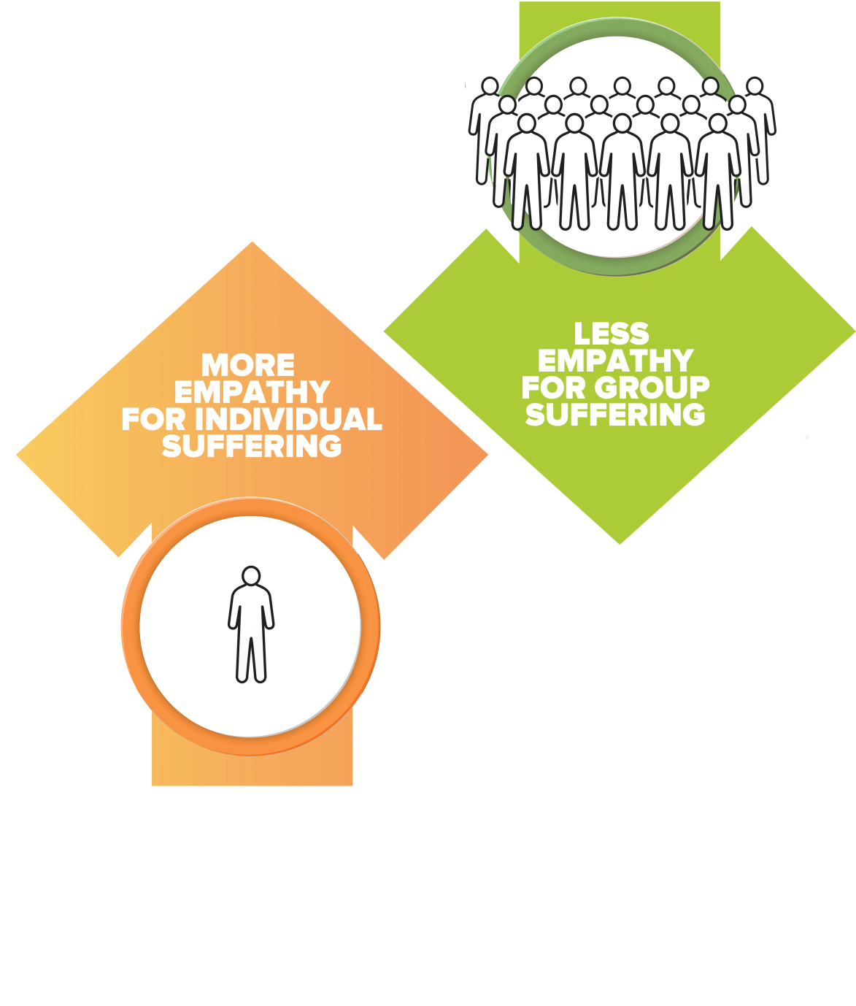
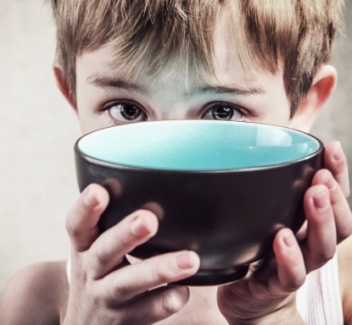
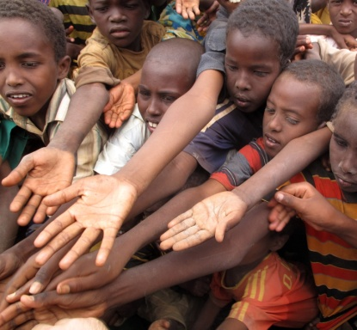
Thinking Trap: One Over Many
Notes:
Empathy also does not scale appropriately. This is a Thinking Trap we will call Over Over Many. This is what Yale Psychologist Paul Bloom calls Innumeracy. Research has shown that we experience the greatest empathy when only a single individual is in danger, in need, or suffering. Oddly, if we increase this to two people in need, our empathic response goes down rather than up. If we increase it to hundreds, thousands, or millions, we have an even weaker empathic response. This decrease in empathy makes no sense, because if the need is greater, our empathic response should also be greater.

Slide 10
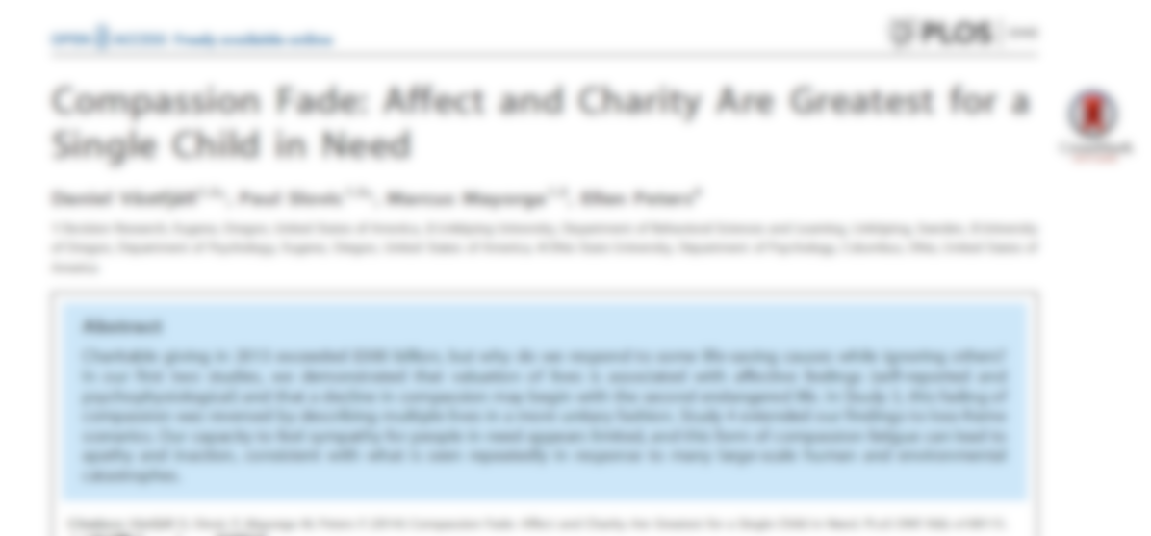
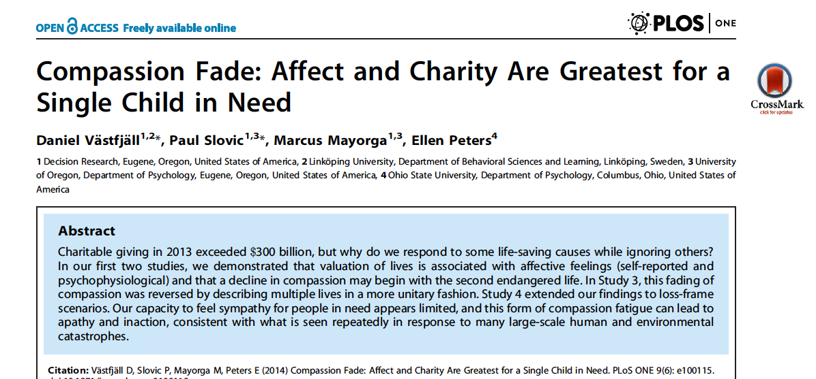
“Our capacity to feel sympathy for people in need appears limited, and this form of compassion fatigue can lead to apathy and inaction, consistent with what is seen repeatedly in response to many large-scale human and environmental catastrophes.”

Slide 11
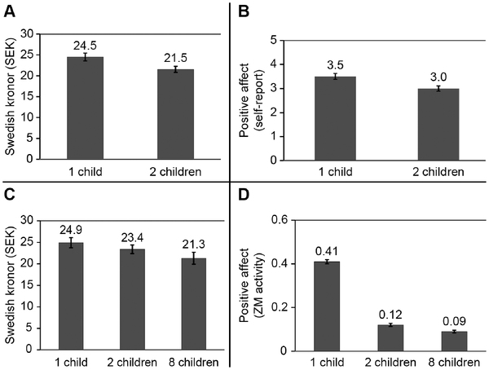

Figure 2. Real donations, self-report, and psychophysiological measures of affect for 1, 2, and 8 children.
Västfjäll D, Slovic P, Mayorga M, Peters E (2014) Compassion Fade: Affect and Charity Are Greatest for a Single Child in Need. PLOS ONE 9(6): e100115. https://doi.org/10.1371/journal.pone.0100115
https://journals.plos.org/plosone/article?id=10.1371/journal.pone.0100115

Slide 12
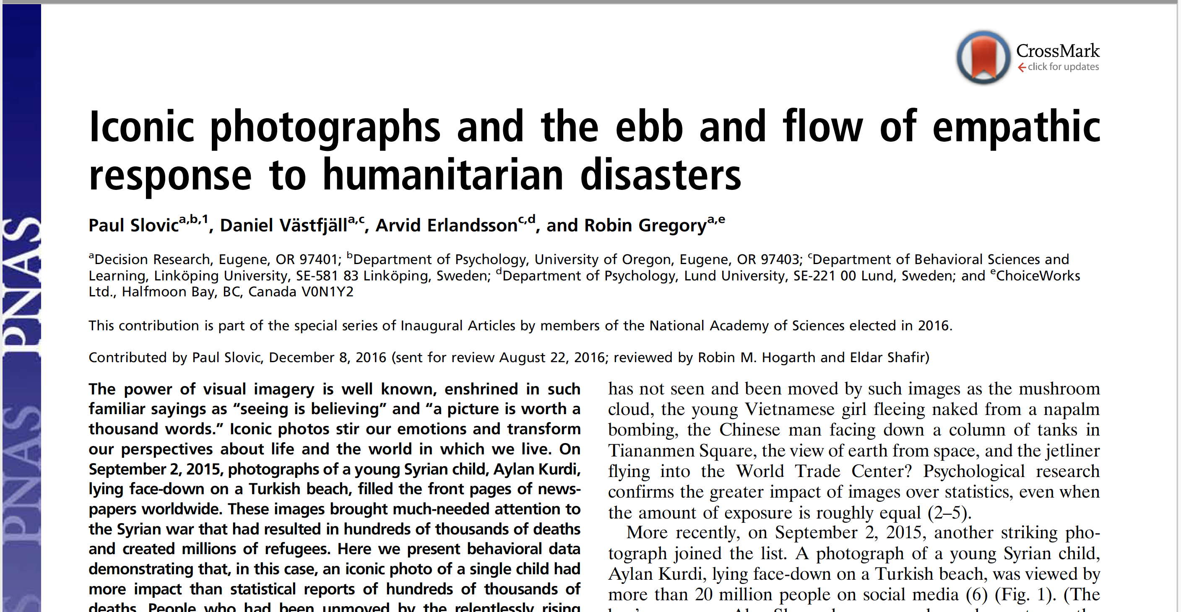
Notes:
Alan Kurdi, initially reported as Aylan Kurdi, was a three-year-old Syrian boy of Kurdish ethnic background whose image made global headlines after he drowned on September 2, 2015 in the Mediterranean Sea. He and his family were Syrian refugees trying to reach Europe amid the European refugee crisis.

Slide 13
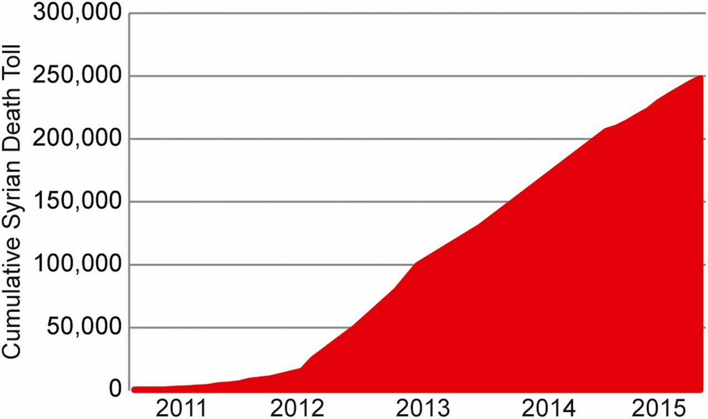

Cumulative Syrian death toll (data from the Jerusalem Center for Genocide Prevention and the Syrian Observatory for Human Rights).
Paul Slovic et al. PNAS 2017;114:4:640-644
©2017 by National Academy of Sciences
Notes:
There had already been hundreds of thousands of deaths as a result of the Syrian crisis by the time of Aylan’s death.

Slide 14
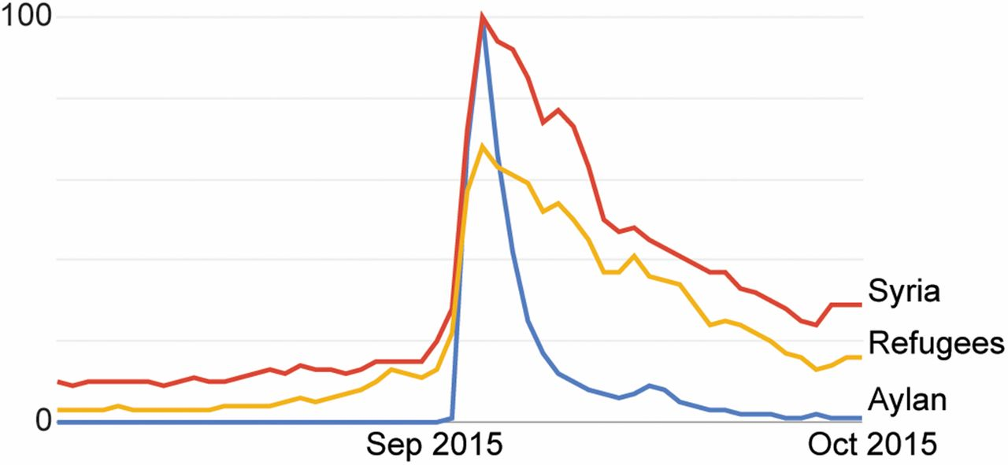
Google Trend data on the relative popularity of search terms “Syria,” “refugees,” and “Aylan,” August–September 2015.
Paul Slovic et al. PNAS 2017;114:4:640-644
©2017 by National Academy of Sciences
Notes:
Google Trend data on the relative popularity of search terms “Syria,” “refugees,” and “Aylan,” August–September 2015. Note that Google Trends does not provide numbers of search requests; rather, the maximum number in the figure is scaled to 100, and the other values are proportional to that.

Slide 15
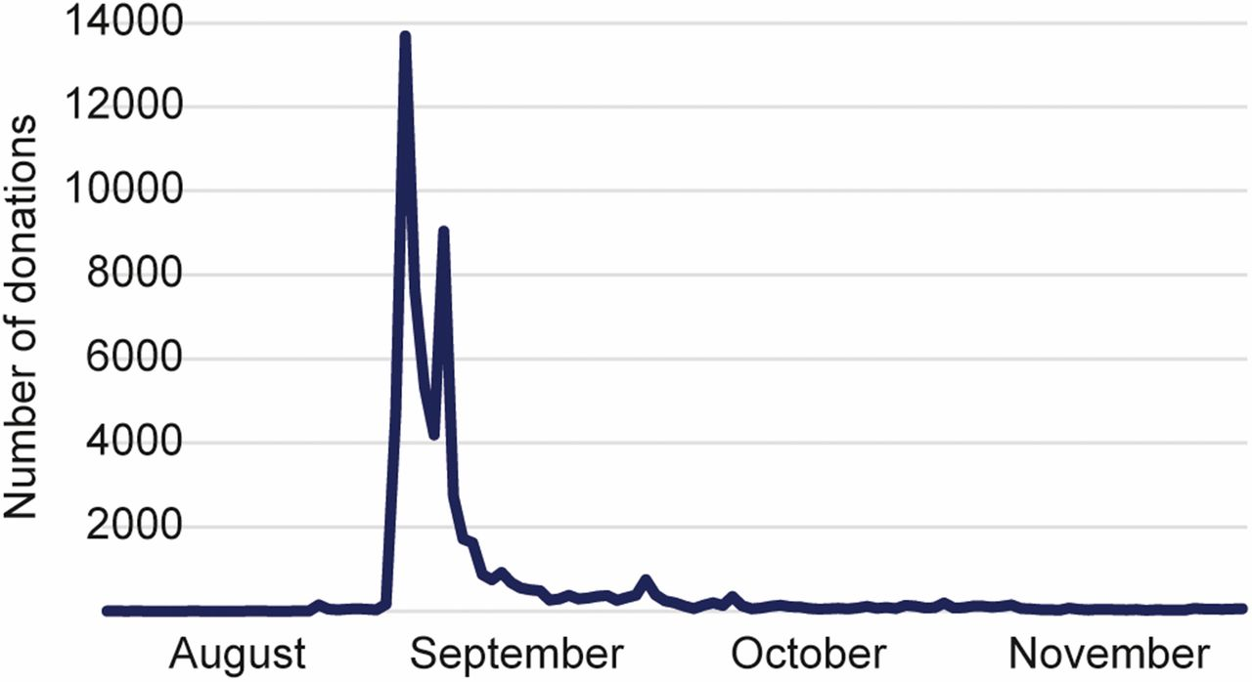
Number of daily donations to a Swedish Red Cross campaign designated specifically for aiding Syrian refugees in Sweden.
Paul Slovic et al. PNAS 2017;114:4:640-644
©2017 by National Academy of Sciences
Notes:
Number of daily donations to a Swedish Red Cross campaign designated specifically for aiding Syrian refugees in Sweden.

Slide 16
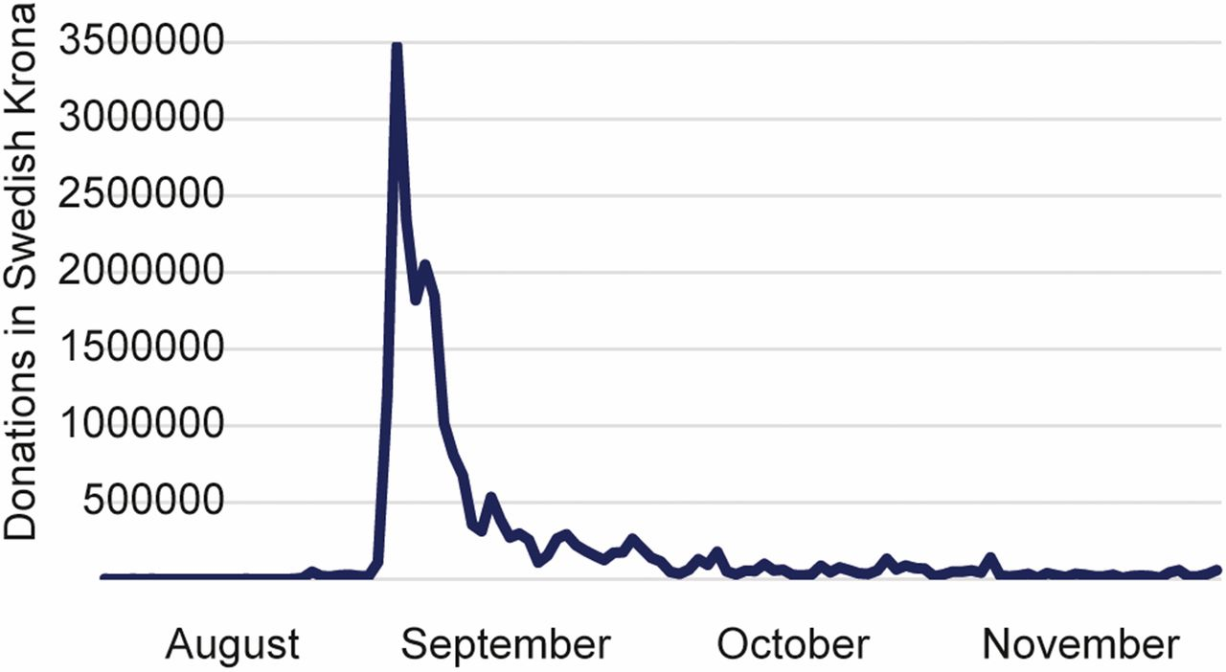
Daily donation amounts to the Swedish Red Cross campaign.
Paul Slovic et al. PNAS 2017;114:4:640-644
©2017 by National Academy of Sciences
Notes:
Daily donation amounts to the Swedish Red Cross campaign.

Slide 17
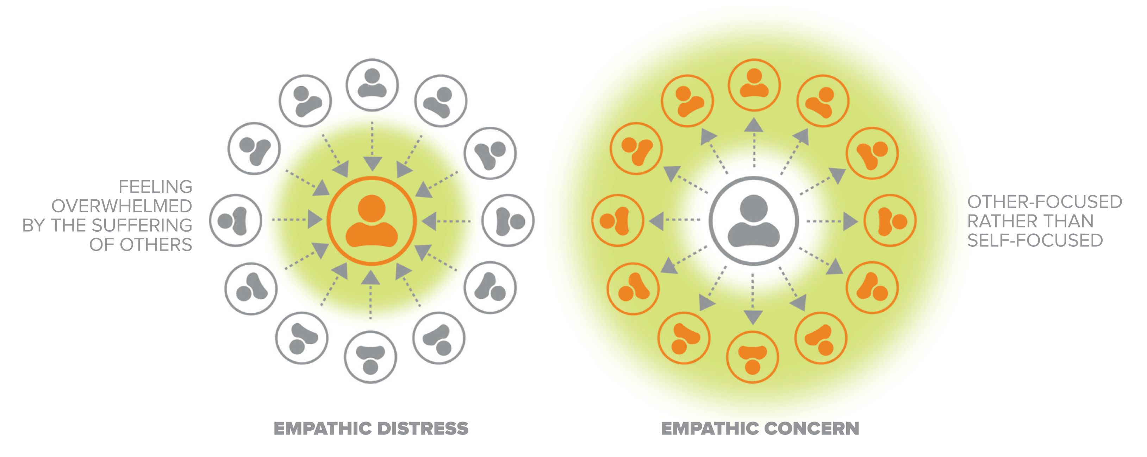
Thinking Trap: Empathic Distress
Empathic Distress vs. Empathic Concern
Notes:
Empathic distress is a Thinking Trap that occurs when one feels overwhelmed by the suffering of another. This occurs because it is naturally distressing for us to see others in pain, especially those we resonate with, such as vulnerable individuals like children and animals, or close loved ones. To combat empathic distress, we have to have strong resilience and an ability to deal with suffering ourselves, as well as a sense of hope. These all come from the practice of self-compassion, described earlier. Through self-compassion we understand that change is possible, we develop a realistic and hopeful outlook, and we also understand how to navigate our own emotions so that they do not overwhelm us. Dealing with the suffering of others may then still cause us a degree of distress, but we learn to better manage that distress so that it does not overwhelm us. In this way we manage to direct our empathy toward empathic concern and compassion, rather than empathic distress. If we do not learn to do this, we may find that empathic distress only leads to burnout. With empathic concern, however, we are focused on the other more than ourselves. This is the kind of empathy we are trying to cultivate in this module and leads directly to compassion.

Slide 18
Reflective Writing &
Mindful Dialogue
Notes:
Be totally present for the other person. We rarely have someone’s undivided attention during a conversation. It is a gift. This presence can manifest through maintaining eye contact and verbal and nonverbal gestures that let your partner know that you are following what he or she is saying. Please turn off any electronic devices to prevent unexpected distractions and interruptions.
Try not to ask questions. Although we are not always conscious of it, questions have a tendency to drive a conversation in the direction the questioner wants it to go, rather than where the responder wants to take it. If you feel you must ask a question, make it something like, “Is there anything more you would like to add?”
Try not to give advice. The purpose of these conversations is to allow your partner to vocalize important experiences or insights, and to have someone honor them by listening attentively and without judgment. Often, instead of truly listening, we spend time thinking about what we would give. While this urge can be motivated by compassion, it can also interfere with our ability to actually be fully present to what the person is saying.
Keep everything your partner says in total confidence. Nothing creates safe space more effectively than trust. Knowing that each of you will keep everything you hear confidential will build that trust.

Slide 19

Empathic Joy
Sympathetic Joy
Thinking Trap: Envy
Notes:
It is important to recognize that empathy is not limited to another person’s suffering. We can also feel empathy for others’ joy. This is called “sympathetic joy” or “symhedonia.” It may be easier for participants to remember this as Empathic Joy, although this term technically means the pleasant feelings one experiences from altruistic behavior. The ability to rejoice in another ’s good fortune is very important and can be surprisingly difficult to practice at first. Often when we see another experiencing something positive, we get caught by the Thinking Traps of jealousy or envy, instead of joy, and this can happen even if it is someone close to us. Parents can even feel jealousy over the success of their children. If we reflect, however, we may find that our envy is connected to our belief that external circumstances lead to happiness, something we explored earlier in CIT. We may also reflect on whether envy and jealousy are things we want in our lives or whether their presence actually decreases our happiness. We may also subtly believe that another’s success is somehow our loss, when in reality this is rarely the case. If we do find that envy and jealousy are problematic, then we can determine to gradually minimize them by cultivating sympathetic joy and actively rejoicing in the good fortune of others. Although difficult at first, like anything, this can become second-nature through repeated practice. As our ability to rejoice in others’ good fortune increases, it is only natural that we will also begin to feel closer to them. That in turn will reduce our sense of loneliness and isolation and will increase our happiness, health and well-being.

Slide 20

Contemplative Practice
Notes:
”Sympathetic Joy” or “Empathy” Practice from the Facilitator Guide.

Slide 21

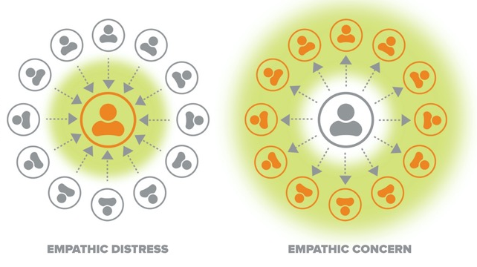

Thinking Traps
In-group Bias
One Over Many
Empathic Distress
Jealousy
Notes:
To review, the Thinking Traps we have covered in this skill are In-group Bias, Innumeracy, Empathic Distress, and Jealousy or Envy. The practices we will do for this skill will help us overcome these traps.

Slide 22
COMPASSIONATE INTEGRITY TRAINING
Center for Compassion, Integrity and Secular Ethics
Life University
© 2020 Brendan Ozawa-de Silva, Michael Karlin and Life University
COMPASSIONATE INTEGRITY TRAINING
SERIES II: RELATING TO OTHERS
SKILL 7: EMPATHIC CONCERN

