Slide 1
COMPASSIONATE INTEGRITY TRAINING
Center for Compassion, Integrity and Secular Ethics
Life University
© 2018 Brendan Ozawa-de Silva, Michael Karlin and Life University
COMPASSIONATE INTEGRITY TRAINING SERIES III: ENGAGING IN SYSTEMS SKILL 9: APPRECIATING INTERDEPENDENCE

Slide 2
COMPASSIONATE INTEGRITY TRAINING
SERIES I: SELF-CULTIVATION
Calming Body and Mind
Ethical Mindfulness
Emotional Awareness
Self-Compassion
SERIES II: RELATING TO OTHERS
Impartiality and Common Humanity
Forgiveness and Gratitude
Empathic Concern
Compassion
SERIES III: ENGAGING IN SYSTEMS
Appreciating Interdependence
Engaging with Discernment
COMPASSIONATE INTEGRITY TRAINING SERIES III: ENGAGING IN SYSTEMS SKILL 9: APPRECIATING INTERDEPENDENCE
Notes:
Content:
Participants will learn about the radical interdependence of the world, which includes ourselves.
Participants will learn about the importance of context in systems thinking.
Participants will learn about the way identity is constructed in a contingent and fluid way.
Participants will learn about “structural inequality,” “structural violence” and “cultural violence.”
Participants will learn that, due to interdependence, any truly compassionate solution must be sustainable and account for collective flourishing.
Participants will learn to approach dilemmas through the lens of critical inquiry.
Practice:
Participants will practice evaluating ethical dilemmas through the larger context of interdependence.
Participants will familiarize themselves increasingly with interdependence by analyzing how objects, situations and actions come to be.

Slide 3
COMPASSIONATE INTEGRITY TRAINING
SERIES I: SELF-CULTIVATION
Calming Body and Mind
Ethical Mindfulness
Emotional Awareness
Self-Compassion
SERIES II: RELATING TO OTHERS
Impartiality and Common Humanity
Forgiveness and Gratitude
Empathic Concern
Compassion
SERIES III: ENGAGING IN SYSTEMS
Appreciating Interdependence
Engaging with Discernment
COMPASSIONATE INTEGRITY TRAINING SERIES III: ENGAGING IN SYSTEMS SKILL 9: APPRECIATING INTERDEPENDENCE

Slide 4
Why do we need to understand systems?
Compassion
Wisdom
Discernment
Compassion is a motivation
Compassion doesn’t tell us what to do
Compassion can lead to harm
Compassion can benefit one group but harm another
Notes:
Just as a bird cannot fly with one wing, compassion is not effective without the “wing” of wisdom or discernment to enable us to determine the best course of action to alleviate the suffering of others.

Slide 5
Interdependence
Individuals are part of a vast ecosystem where they are dependent on other individuals, institutions, and the environment to survive and thrive and where individual actions similarly affect others.
Notes:
The first step in discernment is appreciating interdependence and understanding systems.

Slide 6
Interdependence
“Understanding interdependence is essential to meet the global challenges of our age” (Positive Peace Report 2017).
Notes:
The first step in discernment is appreciating interdependence and understanding systems.

Slide 7
Notes:
This audio is from Dr. Martin Luther King, Jr.’s Christmas Sermon delivered at Ebenezer Baptist Church in Atlanta on December 24, 1967. It would be his final Christmas Sermon before he was assassinated.

Slide 8
Break Out Groups
Notes:
“Exploring the Nature of Systems Part I: What is a System?” Critical Insight Activity from Facilitator Guide.

Slide 9
Why is a systems perspective important?
Hungry

Slide 10
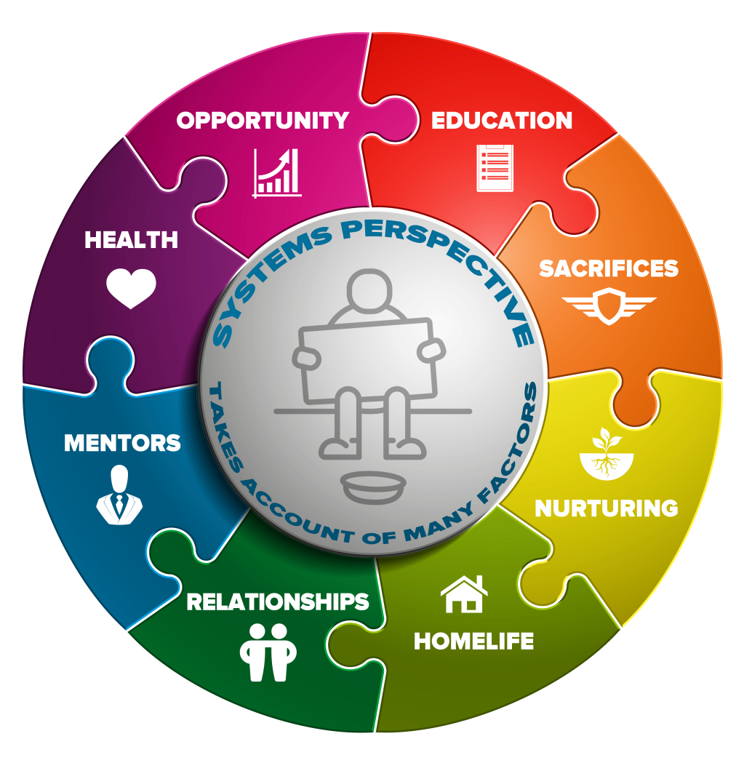
Why is a systems perspective important?
To focus on causes not symptoms
To recognize everything arises from multiple causes and conditions
To see where there might be unintended consequences to our intervention
To help us see the humanity of the system. Systems are a reflection of the values of a society. It can help support the cultivation of inner values
Hungry
Notes:
Everything happens within a set of interrelated and mutually constituted systems, such as economic, political, social and criminal justice

Slide 11
Break Out Groups
Notes:
“Exploring the Nature of Systems Part II: Multiple Levels of Harm and Benefit” Critical Insight Activity from Facilitator Guide.

Slide 12
Direct Violence
Direct Violence
The intentional use of force (physical or psychological) that results in injury, death, psychological harm or deprivation. (Institute for Economics and Peace, 2015 pg. 9)
Notes:
Looking at the concept of violence or harm from a peace studies and conflict transformation perspective, direct violence is only the tip of the iceberg. Ask, “How would you define direct violence?”

Slide 13
Structural Violence
Direct Violence
Structural Violence
Social structures that promote or perpetuate harm and inequity, such as laws, policies and institutions.
Notes:
Beneath direct violence, in this metaphor, structural violence is the next level down, beneath the surface. Structural violence is a form of harm wherein some social structure, such as laws, policies and institutions, prevents one from meeting their basic needs. as proposed by peace studies scholar Johan Galtung. Ask for examples of structural violence.

Slide 14
Cultural Violence
Direct Violence
Structural Violence
Cultural Violence
Beliefs, practices, values and other aspects of culture that justify or legitimize direct or structural violence, such as devaluation, stigmatization, prejudice, or ideology.
Notes:
"Cultural violence”, also proposed by Galtung, refers to aspects of a culture that can be used to justify or legitimize direct or structural violence. Examples include religion, ideology, art, music, film, language, and science. Ask for examples of cultural violence.

Slide 15
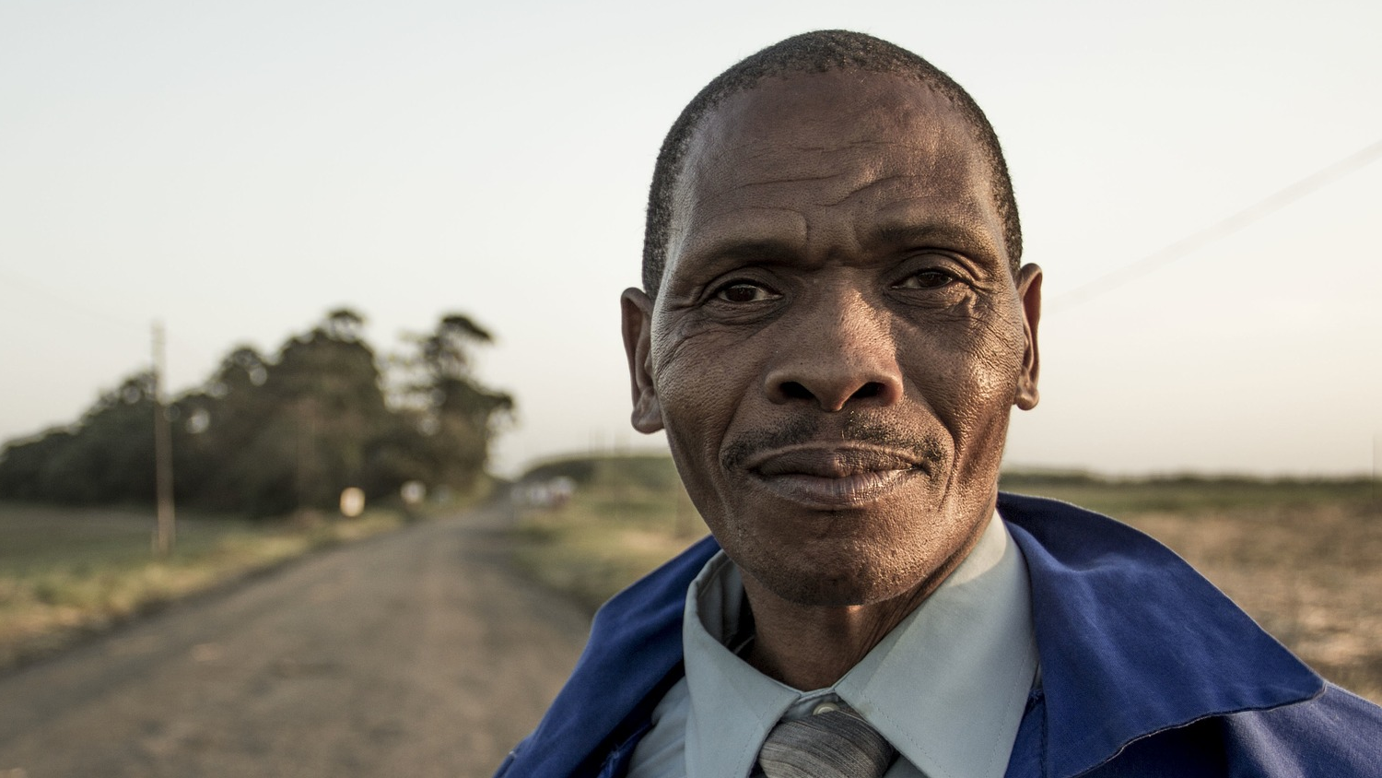
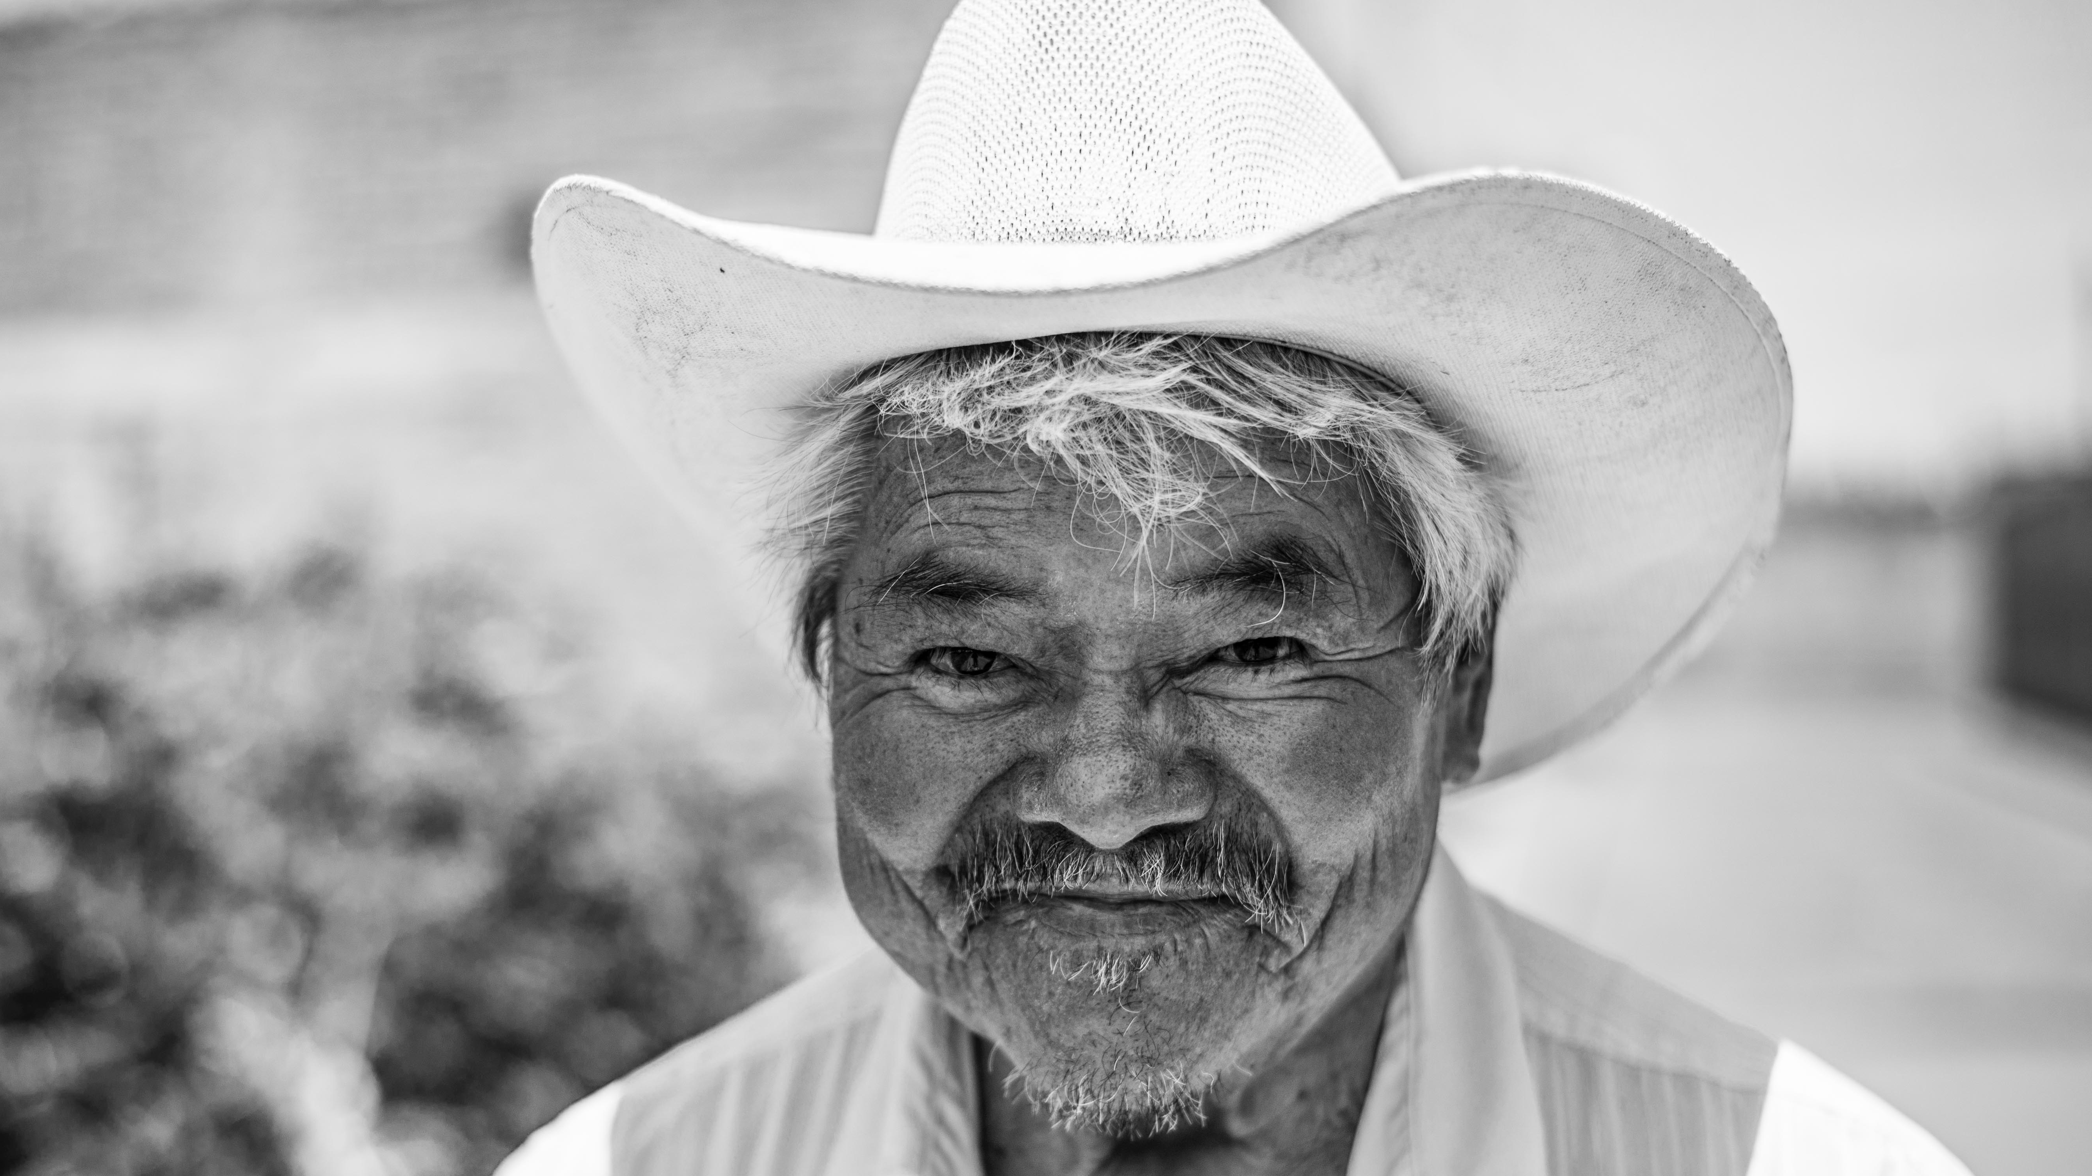
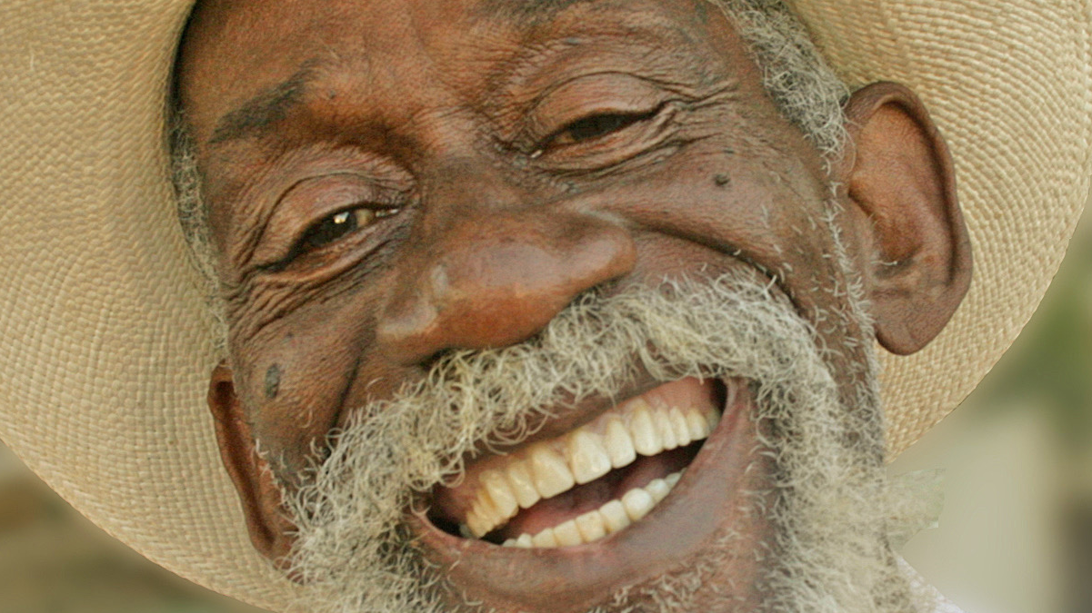
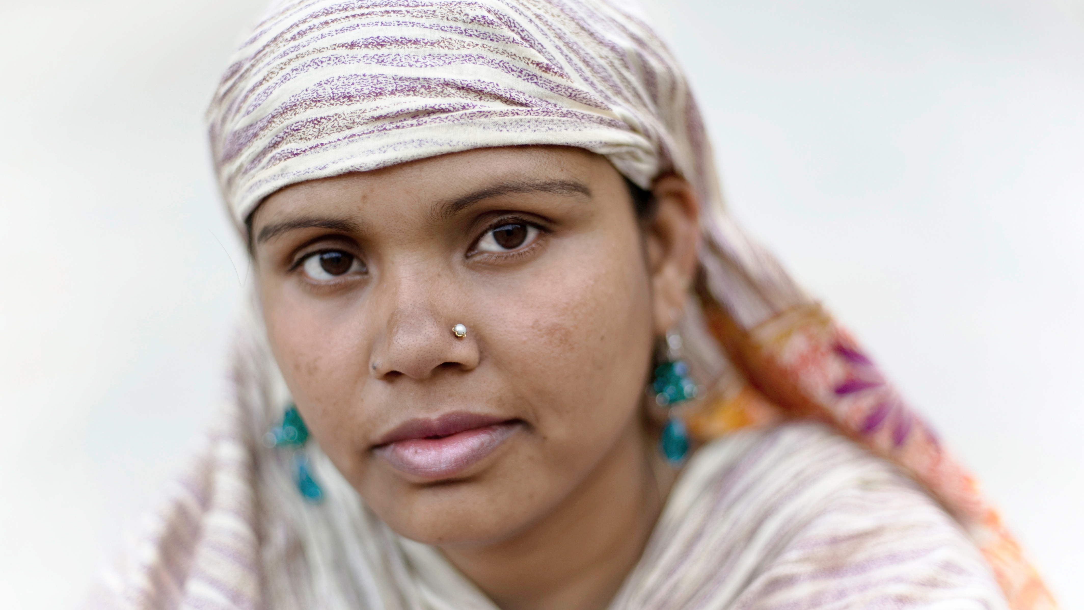
What might Direct, Structural and Cultural Peace Look Like?
Positive Peace?
Notes:
Although we often look at systems we want to change and focus on negative or harmful aspects, it is wise to look at how these systems benefit us and others in order to decide on the best way to improve them.

Slide 16
“The presence of behaviors, attitudes, institutions, and structures that create and sustain peaceful societies.”
Notes:
This diagram, depicting the Eight Pillars of Positive Peace. and quote in this slide are from the “Positive Peace Report” (Institute for Economics and Peace, 2015 p. 9). “The Positive Peace Index (PPI) measures the level of Positive Peace in 163 countries. The PPI is composed of 24 indicators to capture the eight Pillars of Positive Peace. Each of the indicators was selected based on the strength of its statistically significant relationship with the GPI.”
“The Global Peace Index (GPI), produced annually by IEP, ranks 163 independent states and territories according to their level of peacefulness and stands as the world’s leading measure of global peacefulness. The GPI is composed of 23 qualitative and quantitative indicators from highly respected sources, covering 99.7 per cent of the world’s population. The index gauges global peace using three broad themes: the level of safety and security in society; the extent of domestic or international conflict; and the degree of militarisation” (pg. 8).

Slide 17
Reflective Writing & Mindful Dialogue
Notes:
Be totally present for the other person. We rarely have someone’s undivided attention during a conversation. It is a gift. This presence can manifest through maintaining eye contact and verbal and nonverbal gestures that let your partner know that you are following what he or she is saying. Please turn off any electronic devices to prevent unexpected distractions and interruptions.
Try not to ask questions. Although we are not always conscious of it, questions have a tendency to drive a conversation in the direction the questioner wants it to go, rather than where the responder wants to take it. If you feel you must ask a question, make it something like, “Is there anything more you would like to add?”
Try not to give advice. The purpose of these conversations is to allow your partner to vocalize important experiences or insights, and to have someone honor them by listening attentively and without judgment. Often, instead of truly listening, we spend time thinking about what we would give. While this urge can be motivated by compassion, it can also interfere with our ability to actually be fully present to what the person is saying.
Keep everything your partner says in total confidence. Nothing creates safe space more effectively than trust. Knowing that each of you will keep everything you hear confidential will build that trust.

Slide 18
COMPASSIONATE INTEGRITY TRAINING
Center for Compassion, Integrity and Secular Ethics
Life University
© 2018 Brendan Ozawa-de Silva, Michael Karlin and Life University
COMPASSIONATE INTEGRITY TRAINING SERIES III: ENGAGING IN SYSTEMS SKILL 9: APPRECIATING INTERDEPENDENCE

