Slide 1
COMPASSIONATE INTEGRITY TRAINING
Center for Compassion, Integrity and Secular Ethics
Life University
© 2020 Brendan Ozawa-de Silva, Michael Karlin and Life University
COMPASSIONATE INTEGRITY TRAINING SERIES II: RELATING TO OTHERS SKILL 8: COMPASSION

Slide 2
COMPASSIONATE INTEGRITY TRAINING
SERIES I: SELF-CULTIVATION
Calming Body and Mind
Ethical Mindfulness
Emotional Awareness
Self-Compassion
SERIES II: RELATING TO OTHERS
Impartiality and Common Humanity
Forgiveness and Gratitude
Empathic Concern
Compassion
SERIES III: ENGAGING IN SYSTEMS
Appreciating Interdependence
Engaging with Discernment
COMPASSIONATE INTEGRITY TRAINING SERIES II: RELATING TO OTHERS SKILL 8: COMPASSION

Slide 3
COMPASSIONATE INTEGRITY TRAINING
SERIES I: SELF-CULTIVATION
Calming Body and Mind
Ethical Mindfulness
Emotional Awareness
Self-Compassion
SERIES II: RELATING TO OTHERS
Impartiality and Common Humanity
Forgiveness and Gratitude
Empathic Concern
Compassion
SERIES III: ENGAGING IN SYSTEMS
Appreciating Interdependence
Engaging with Discernment
COMPASSIONATE INTEGRITY TRAINING SERIES II: RELATING TO OTHERS SKILL 8: COMPASSION
Notes:
Content:
Participants will learn that compassion is not weakness. Instead participants will learn that compassion is the motivation to alleviate the suffering of another, which takes great strength and gives us strength.
Participants will learn the three necessary components of compassion – seeing needs, having empathic concern for the one suffering and feeling confident that one has the ability to do something to help the other.
Participants will learn that suffering and needs occur on multiple levels, not just obvious ones.
Practice:
Participants will increase their ability to resolve to extend compassion by experiencing wishing, aspirational and engaged compassion.
Participants will increase their awareness in the universality of needs and suffering and thereby extend their compassion beyond in-groups.

Slide 4
Compassion
The wish to alleviate the suffering of another.
Notes:
You may ask, “How do you define compassion?” We can also ask, “what negative associations might come with compassion?”
“What do you think are the concerns people have when they hear the word compassion?”
Compassion refers to our orientation toward the other – cognitively, affectively and motivationally – but it does not tell us what action is best in any given situation. For that, we need to complement compassion with discernment, critical thinking, knowledge and understanding. What compassion does do, is that it guarantees that our sense of concern is genuinely other-oriented and that we are seeking to meet the others’ needs, not our own. Because of this, compassion is essential to ethical action and to leading a life of integrity.

Slide 5
Biologically Based
Notes:
Like all skills we have practiced in CIT, compassion is biologically based, but is biased towards our in-group.

Slide 6
Thinking Trap: In-Group Bias
Notes:
As we discussed in previous skills, In-Group Bias is a pervasive Thinking Trap that can get in the way of extending our values to strangers and enemies.

Slide 7
Extended Compassion
Notes:
The ultimate goal is to cultivate our compassion beyond our in-group. What would the world look like if we had more extended compassion?

Slide 8
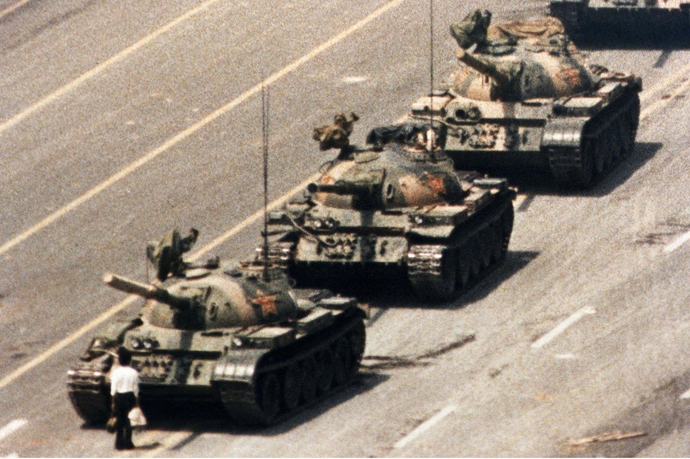
Thinking Trap:
Compassion as Weakness
Compassion as Strength
Notes:
This anonymous man halted an entire column of Chinese tanks on June 5, 1989 during the Tiananmen Square protests. This act of compassion for his fellow students, was an act of extreme courage and strength.
The belief that compassion is a weakness is a Thinking Trap. In our society, we are often told that compassion makes us “doormats” or “pushovers.” If we are compassionate, people may say we will not get what we want and need for ourselves, and others will take advantage of us. Moreover, we may lack the strength to bring about positive change in our relationships and in the world. All this rests on a misunderstanding of compassion. Our desire to give in to others, regardless of whether this will be truly beneficial or not, typically comes from empathic distress, not compassion. On the contrary, compassion is other-oriented, and therefore is a form of inner strength and requires courage. It does not mean simply giving others what they want, but recognizing on a deeper level what they need. Compassion can require that we have to be very tough with certain individuals and hold our ground, recognizing that to give in would be harmful to others and to ourselves. For example, imagine a friend who comes to us who is addicted to a drug but is going through a rehab process. That person pleads with us to give them access to drugs. If our response is empathic distress, we may be so troubled by their pain that we give in and accommodate them, even though we know what we are doing is wrong. Compassion, however, dictates that we remain strong and do what is in their genuine best interest, and not what makes us feel better in the short-term. That may mean kindly saying no to them and explaining why we cannot do what they are asking of us. Parenting serves as a good example for this kind of other-oriented care and concern. A good parent does not simply give in to whatever their child wants. They have to set boundaries and even discipline their child at times in order to enable them to grow up into a healthy, responsible adult who can lead a happy life. If a child in a grocery store is throwing a temper tantrum because he or she wants candy, the compassionate thing to do may be to refuse the child’s outbursts. If the parent’s desire is to help the child learn self-control and to eat healthier, this refusal would be focused on the child’s benefit and his or her long-term needs. Giving in to the tantrum, in this case, might simply be giving in to empathic distress, which would be about meeting the needs of the parent, not the child.

Slide 9
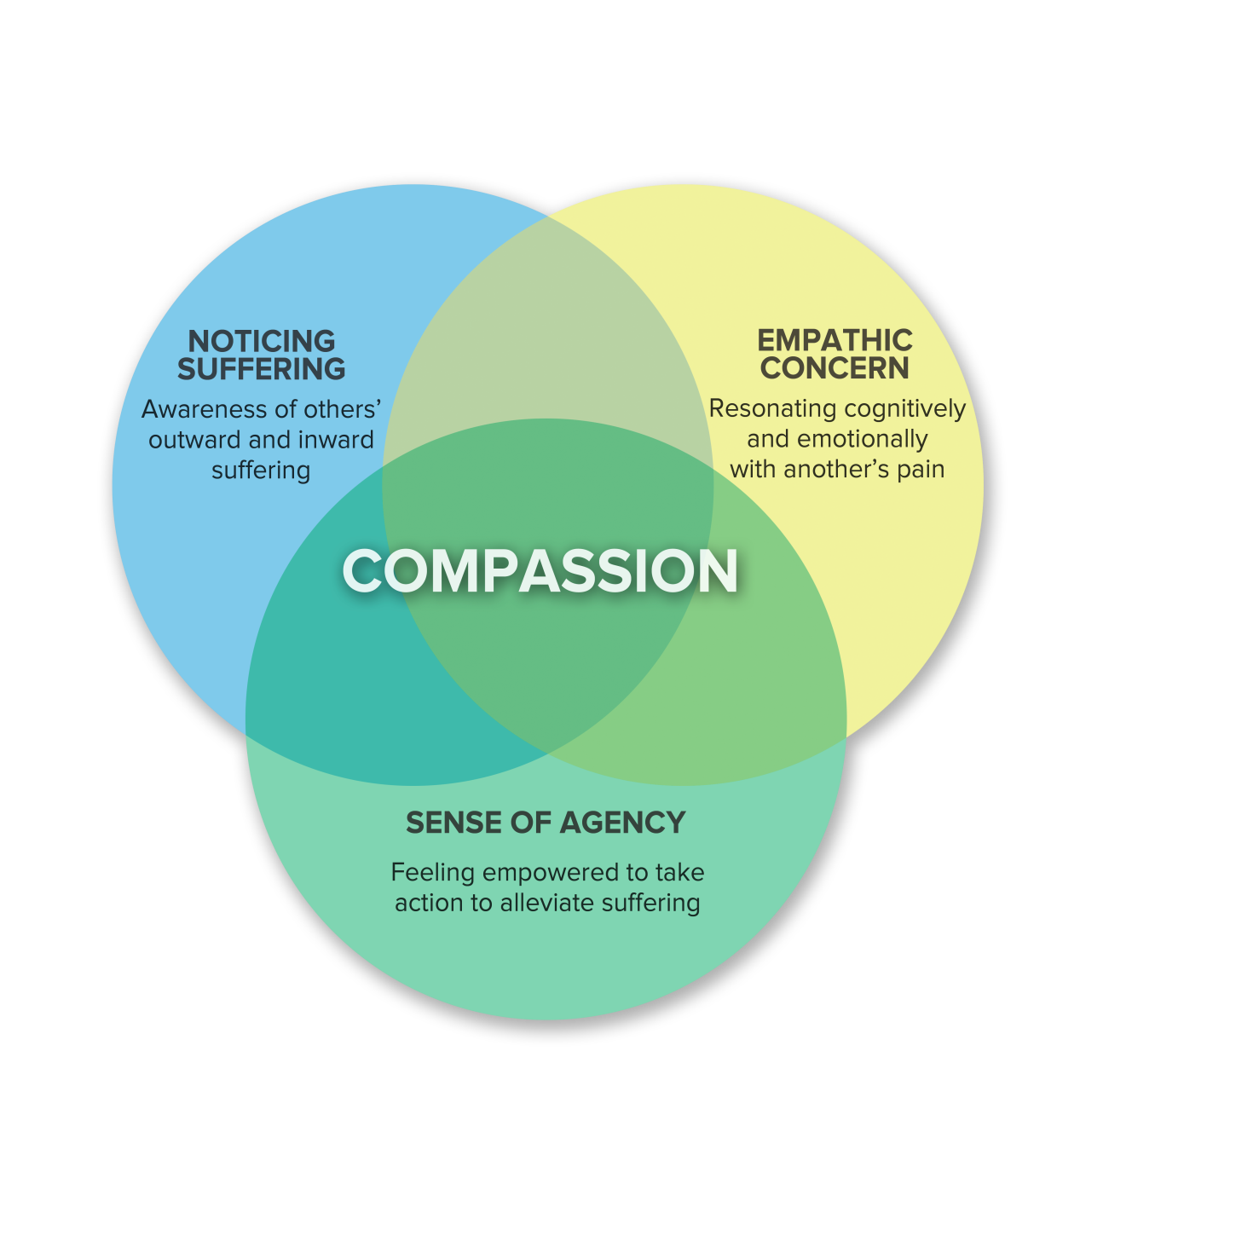
Three Components of Compassion
Noticing suffering
Notes:
The first component of compassion, recognizing the needs of others, can be quite subtle. While it is often easy to see obvious forms of outward suffering, such as someone crying or bleeding from a wound, often people are suffering or have needs in ways that are less noticeable.

Slide 10
Thinking Trap: Not Seeing Common Humanity
Notes:
The Thinking Trap of Not Seeing Common Humanity can be an impediment to seeing other people’s suffering. Referring back to common humanity and self-compassion, all human beings suffer and have needs. By virtue of merely being alive, we all face emotional pain and distress, we all encounter sickness, we are all aging, and we will all die. On the surface, a person may appear to have no problems whatsoever, but if we take time to investigate, we will doubtless discover that they do indeed experience emotional pain, relationship issues, financial worries, non-obvious physical ailments, or any of countless forms of suffering that are not readily obvious to an outsider. Even if they are not suffering now, we know that as a human being they are vulnerable to suffering just by being alive on this earth. We may need to reflect repeatedly in order to gain and strengthen this insight. It is essential for feeling empathic concern and therefore also compassion, because without seeing a need, we will feel no need to address it. Noticing suffering in this way helps us overcome the Thinking Trap of Not Seeing Common Humanity.

Slide 11
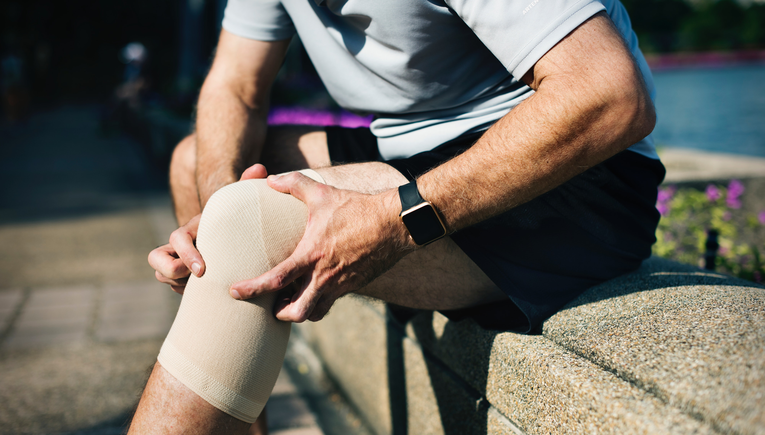
Status
Insignificance
Financial Gain
Financial Loss
Praise
Blame
Pleasure
Pain
Notes:
Recall the eight worldly concerns from Skill 4. All people are susceptible to being afflictively attached or averse to at lease some of these eight, causing inner struggles.

Slide 12
Three Components of Compassion
Noticing suffering
Experiencing empathic concern
Notes:
The second component of compassion is empathic concern itself, the ability to care about and resonate with the other person. As discussed in the last module, we have a great deal of empathic concern for our loved ones, but far less for strangers, and often very little for those we dislike. Therefore, noticing suffering and needs is not enough; we must care and have empathic concern. The same Thinking Traps, discussed in Skill 7, of In-Group Bias, One Over Many, and Empathic Distress can cause us to not experience Empathic Concern.

Slide 13
Three Components of Compassion
Noticing suffering
Experiencing empathic concern
Feeling empowered to act to alleviate the suffering
Notes:
Lastly, without a sense of self-confidence in our ability to take action, our compassion will hit a brick wall and we will feel helpless, powerless and eventually apathetic – a result of empathic distress. We have to believe that we have the ability to do something constructive, however small. We have to think creatively also about what this constructive action could be. Often there is no immediate solution to the problems that face us, but that does not mean we are powerless to do anything.

Slide 14
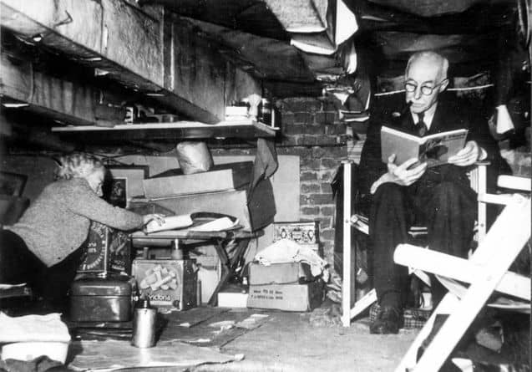
Notes:
This is an image of a Jewish couple hiding in the attic of non-Jewish friends during the Holocaust.
An incredibly powerful example of how important is a sense of agency is highlighted in the work of Samuel and Pearl Oliner, who interviewed rescuers of Jews in Nazi Europe during the Holocaust. Among other factors, one of the distinguishing differences among those who chose to rescue Jews and those who did not was an internal sense of efficacy or agency. In other words, those who rescued believed that their actions, even in the midst of chaos, destruction, and the Nazi war machine, however small, actually could make a difference. By contrast, non-rescuers and bystanders reported that they didn’t believe their actions (small or large) could or would make any difference against the forces that were too great, so they didn’t bother to act at all. Thus a sense of internal self-confidence in their ability to make some difference allowed the rescuers to see a choice to act where others perceived only compliance--and believed they could succeed where others only saw failure.

Slide 15
Thinking Trap: Powerlessness
Notes:
The Thinking Trap of Powerlessness hinders us from having a sense of agency. Even small acts can help alleviate the suffering of another. Until we move to discernment, we will not know what we can do, but a sense of agency is necessary to move to this step.

Slide 16
Compassion
Discernment
Leads to Discernment
Notes:
We will move into this topic in detail starting next session, but we should recall that compassion is about motivation; discernment and wisdom are about which action to take. You need both wings for the bird to fly. Moving to Discernment is a way of escaping the Thinking Trap of Powerlessness.

Slide 17
Break Out Groups
Notes:
“What is Compassion Skits” Critical Insight Activity from the Facilitator Guide

Slide 18
Three Components of Compassion
Noticing suffering
Experiencing empathic concern
Feeling empowered to act to alleviate the suffering
Notes:
Image to use for “What is Compassion Skits” Critical Insight Activity from the Facilitator Guide

Slide 19
Reflective Writing & Mindful Dialogue
Notes:
Be totally present for the other person. We rarely have someone’s undivided attention during a conversation. It is a gift. This presence can manifest through maintaining eye contact and verbal and nonverbal gestures that let your partner know that you are following what he or she is saying. Please turn off any electronic devices to prevent unexpected distractions and interruptions.
Try not to ask questions. Although we are not always conscious of it, questions have a tendency to drive a conversation in the direction the questioner wants it to go, rather than where the responder wants to take it. If you feel you must ask a question, make it something like, “Is there anything more you would like to add?”
Try not to give advice. The purpose of these conversations is to allow your partner to vocalize important experiences or insights, and to have someone honor them by listening attentively and without judgment. Often, instead of truly listening, we spend time thinking about what we would give. While this urge can be motivated by compassion, it can also interfere with our ability to actually be fully present to what the person is saying.
Keep everything your partner says in total confidence. Nothing creates safe space more effectively than trust. Knowing that each of you will keep everything you hear confidential will build that trust.

Slide 20
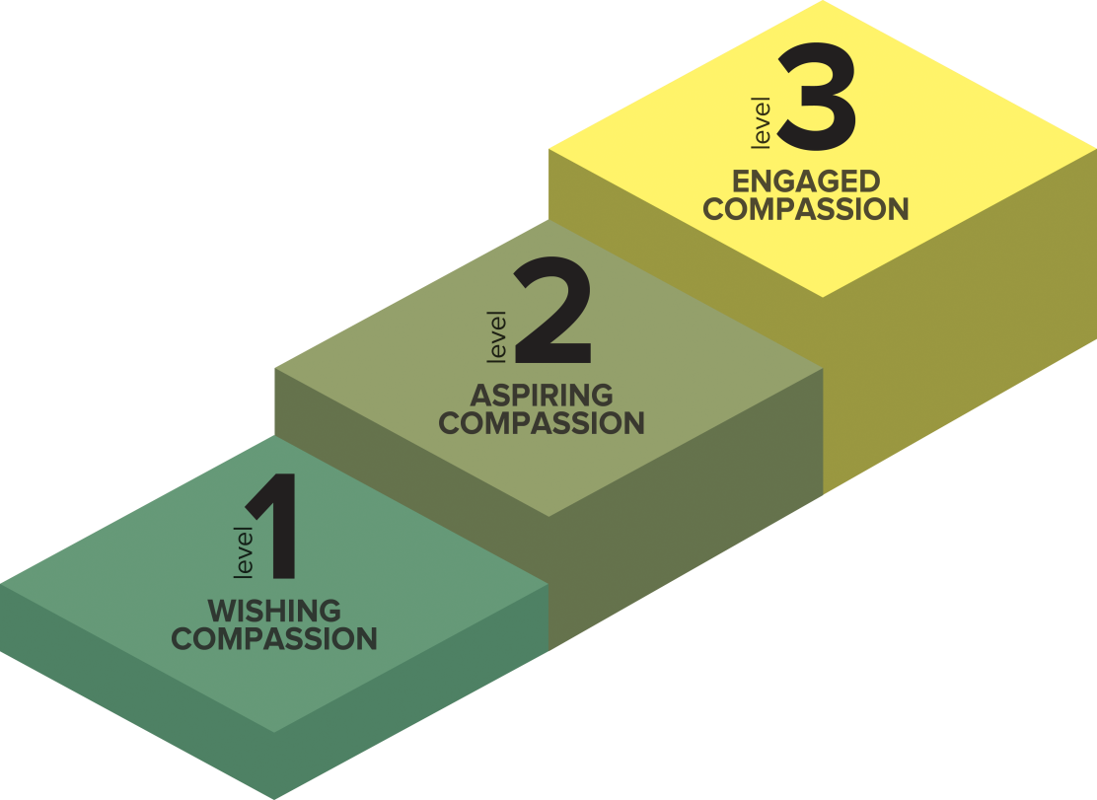
Three Levels of Compassion
Each level relates to a different level of agency and commitment
Engaged Compassion
Taking personal responsibility to reduce the suffering of others
Aspiring Compassion
More urgency and immediacy
Little personal responsibility
Wishing Compassion
Wishing others would not suffer
No personal responsibility
Notes:
Although Wishing and Aspiring Compassion are similar, with Aspiring there is greater urgency that may also lead to a greater sense of agency and ultimately some action, even if there is no personal responsibility.

Slide 21
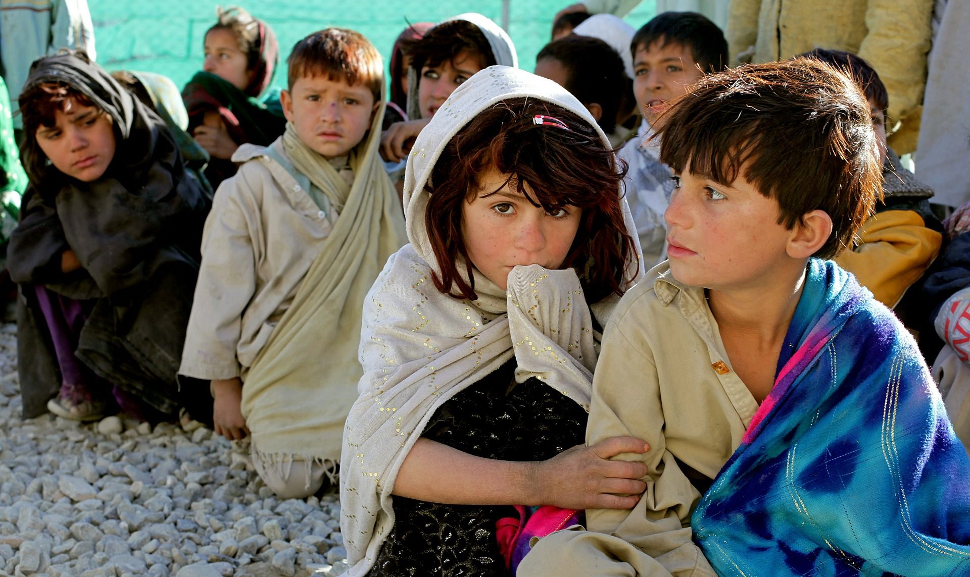
Three Levels of Compassion
Engaged Compassion
“This must end. I am going to do whatever I can to help end this crisis.”
Aspiring Compassion
“This is a tragedy. It would be so wonderful for this to end. Maybe I will send in a small donation or write a letter.”
Wishing Compassion
“This is terrible. I wish those refugees would be free from suffering.”
Notes:
Example: A person hears about the refugee crisis. This is what he says to himself …

Slide 22
Contemplative Practice
Notes:
“Compassion” Practice from the Facilitator Guide

Slide 23
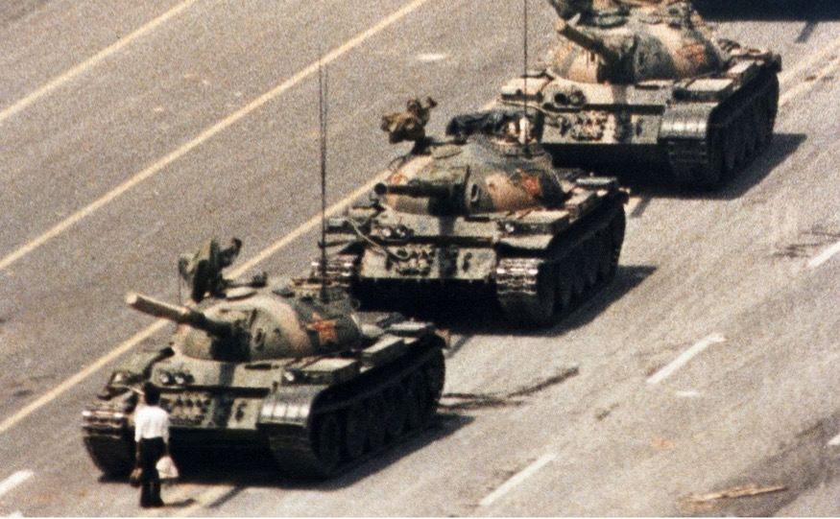
Thinking Traps
In-group Bias
Compassion as Weakness
Not Seeing Common Humanity
Powerlessness
Notes:
To review, the Thinking Traps we have covered in this skill are In-group Bias, Compassion as Weakness, Not Seeing Common Humanity, and Powerlessness. The practices we will do for this skill will help us overcome these traps.

Slide 24
COMPASSIONATE INTEGRITY TRAINING
Center for Compassion, Integrity and Secular Ethics
Life University
© 2019 Brendan Ozawa-de Silva, Michael Karlin and Life University
COMPASSIONATE INTEGRITY TRAINING SERIES II: RELATING TO OTHERS SKILL 8: COMPASSION

