Slide 1
COMPASSIONATE INTEGRITY TRAINING
Center for Compassion, Integrity and Secular Ethics
Life University
© 2020 Brendan Ozawa-de Silva, Michael Karlin and Life University
COMPASSIONATE INTEGRITY TRAINING SERIES II: RELATING TO OTHERS SKILL 6: FORGIVENESS AND GRATITUDE

Slide 2
COMPASSIONATE INTEGRITY TRAINING
SERIES I: SELF-CULTIVATION
Calming Body and Mind
Ethical Mindfulness
Emotional Awareness
Self-Compassion
SERIES II: RELATING TO OTHERS
Impartiality and Common Humanity
Forgiveness and Gratitude
Empathic Concern
Compassion
SERIES III: ENGAGING IN SYSTEMS
Appreciating Interdependence
Engaging with Discernment
COMPASSIONATE INTEGRITY TRAINING SERIES II: RELATING TO OTHERS SKILL 6: FORGIVENESS AND GRATITUDE

Slide 3
COMPASSIONATE INTEGRITY TRAINING
SERIES I: SELF-CULTIVATION
Calming Body and Mind
Ethical Mindfulness
Emotional Awareness
Self-Compassion
SERIES II: RELATING TO OTHERS
Impartiality and Common Humanity
Forgiveness and Gratitude
Empathic Concern
Compassion
SERIES III: ENGAGING IN SYSTEMS
Appreciating Interdependence
Engaging with Discernment
COMPASSIONATE INTEGRITY TRAINING SERIES II: RELATING TO OTHERS SKILL 6: FORGIVENESS AND GRATITUDE
Notes:
Content:
Participants will learn the benefits of forgiveness for one’s health, peace of mind and relationships.
Participants will learn to distinguish forgiveness from condoning, excusing, forgetting or reconciling.
Participants will learn specific strategies for cultivating forgiveness.
Participants will learn the benefits of gratitude.
Participants will explore interdependence.
Participants will learn that it is possible to be grateful even for the harm that someone abstains from doing to them.
Practice:
Participants will get increasingly better at noticing the ways others benefit them and recalling past benefit.
Participants will cultivate the ability to recognize how they often focus on transgressions rather than the benefits others do for them.
Participants will develop an increasingly greater appreciation for forgiveness and ability to forgive.
Participants will gain an increasing ability to see the positive in people, objects and experiences that were previously taken for granted.

Slide 4
Forgiveness
The releasing of anger and resentment towards one who has harmed us and a replacement of those with beneficial mental states.
Notes:
Before you begin, please remind participants that forgiveness can be a very emotionally difficult topic. They should practice the forgiveness strategies you will suggest first for people who have only caused them minor irritations or disappointments, not for the people who have harmed them the most. They can test out the strategies with these people for whom it will be easy to find forgiveness to see how the strategies work and to gain confidence in their efficacy, before eventually moving on to tackle more difficult people.
After that warning, you may ask, “What is forgiveness?” Make sure to add, if it does not arise in conversation, forgiving is not condoning, forgetting, or even reconciling. You may ask, “When might we want to forgive but be unwilling or unable reconcile?”

Slide 5
Forgiveness is a gift you give to yourself
Notes:
Our resentment or unwillingness to forgive is itself a Thinking Trap. It is like drinking poison and expecting the other person to die, as the saying goes. This reluctance can be related to the idea that forgiving is condoning, forgetting, or reconciling. We may feel that forgiving someone means we are benefiting them, when they should be punished instead. We might feel that by holding on to resentment, we are “teaching them a lesson.” Yet, forgiveness is a gift we give ourselves, since letting go of anger primarily helps oneself.

Slide 6
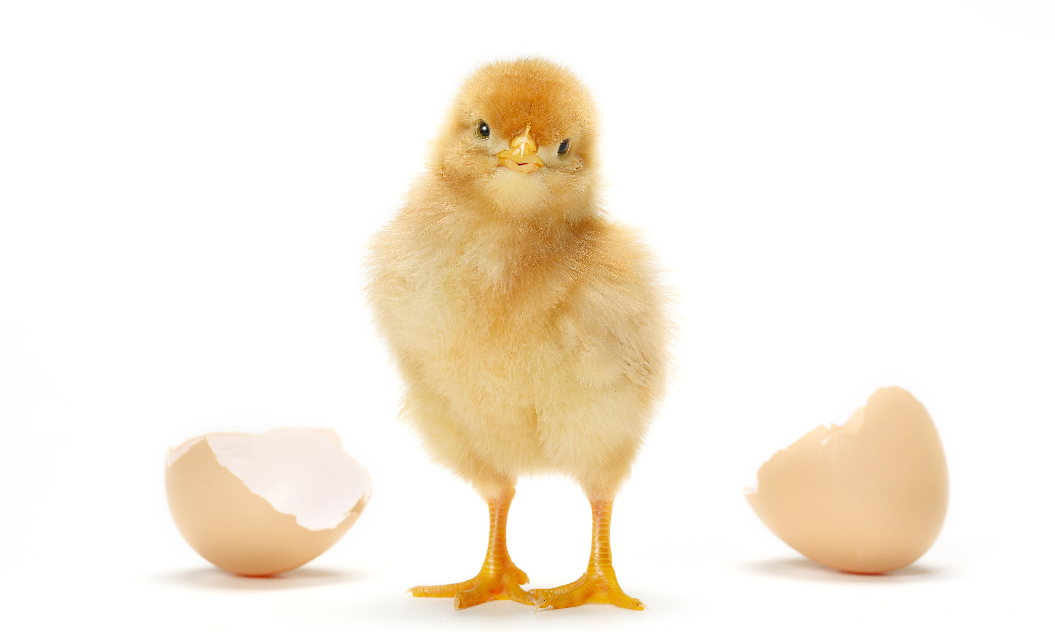
Break Out Groups
Notes:
“The Benefits of Forgiveness” Critical Insight Activity from the Facilitator Guide

Slide 7
I am learning and putting into practice how to genuinely forgive, not with just my mouth, but with my whole heart as well. I am learning that in order to forgive, one has to have compassion for others and self-compassion for oneself. Forgiveness frees me from the bondage of not being able to live a fully engaged, happy life. Forgiving others, I am learning, is one of the greatest acts of self-compassion that I have yet to experience. Forgiveness frees you, in spite of your physical location, from a world that is dictated and controlled by hurtful, unhealthy emotions that stunts your growth mentally, spiritually and emotionally, and can very well affect you physically. I refuse to continue polluting my system with the cup of poison: unforgiveness. It’s like slowly committing suicide. I’m not ready to die. I love my life in spite of where I currently am….

Slide 8
I am not happy about the horrific childhood abuse that I had to endure, nor can I ever forget it. However, I am grateful to be in a position to counsel, console, encourage young adults here who have gone through and endured such trauma. I’ve broken the shameful silence that had me bound for so long by sharing my story of trauma and survived, which has been liberating for me. I really do believe that gratitude is the moral memory of mankind.

Slide 9
OVER-GENERAL-IZATION
REDUCTIVE THINKING
NOT SEEING COMMON HUMANITY
NEGATIV-ITY BIAS
Notes:
If forgiveness is a gift we give ourselves, what are some strategies for finding forgiveness?
One strategy is to try and separate the actor from the action. We make this distinction for ourselves all the time. We do something wrong to someone. When we recognize this wrongdoing, we may apologize, but we tend not to condemn ourselves forever for each and every mistake we have ever made, nor do we quickly reach the conclusion that we are an evil person. Similarly, if we examine someone to whom we feel anger or resentment, we may recognize that we are failing to extend the same understanding toward them. Are they necessarily evil or a bad person because they made a mistake or did something harmful? Are we condemning them more harshly than we would ourselves or those we love? Have we lost sight of our common humanity with them?
Separating the Action from the Actor works against the Thinking Traps of Overgeneralization. With Overgeneralization we take a one or two instances of a behavior and abstract from there to a general rule about a person or group of people. This is similar to the essentialism we discussed in Skill 5, which is the belief that the act a person did to harm us represents the totality of who that person is or the person’s unchanging, fundamental essence.
Another strategy is Understanding the Causes and Conditions. When someone harms us, we often want to reduce the cause of the transgression to that person alone, rather than recognize that the person acted as a result of a multitude of causes and conditions that gave rise to the act. These causes and conditions could include the person’s family of origin, education, socio-economic status, friends, and genes, just to name a few. Understanding the Causes and Conditions works against the Thinking Traps of Reductive Thinking and Fatal Attribution Error. Reductive Thinking is mistakenly assuming things happen from one cause, instead of a multiplicity of causes and conditions. Fatal Attribution Error is the tendency to attribute someone’s behavior to internal factors, such as one’s character, rather than external factors, such as the context, environment or historical factors.
Another strategy is to Focus on Our Common Humanity. When we have a lot of anger or resentment toward an individual or group of individuals, we don’t want to see them as like ourselves. It is easier to be angry at someone who we have decided is “nothing like me.” Yet if we do focus on the similarities, it can have the effect of diminishing our anger. We can do this by contemplating, “Just like me, this person seeks happiness and doesn’t want suffering. Yet just like me, they lack genuine lasting happiness and still experience various forms of suffering. They are vulnerable to sickness, illness and, one day, death. They struggle with all sorts of issues. They have doubts and fears, as well as hopes and aspirations. In this way, they are very similar to me.” If we can see the other as a fallible human being, just like ourselves, and not hold him or her to an unrealistic standard, we can often find it easier to forgive them. Recognizing Common Humanity works against the Thinking Trap of Not Seeing Common Humanity.
Cultivating Gratitude works against the Thinking Trap of Negativity Bias, which will be discussed more in the next section. All these strategies also work to reduce the effects of the Thinking Trap of Personalization. Personalization is when we take a person’s speech or action, or lack thereof, as a personal attack. In many cases, we think others are implying or trying to tell us something or sending us signals, when in reality they are not thinking about us at all. As we can see from the strategies, even when someone does intend to do harm, we do not have to take it personally.

Slide 10
Gratitude
Recognizing the benefits one has received from others, where the other may be one or more people, other aspects of nature or a supernatural being or force.
Notes:
Like forgiveness, gratitude is also an act of self-compassion, because it increases our happiness and well-being powerfully at no cost to ourselves whatsoever. Scientific research suggests grateful people are happier, have more positive relationships, cope better with adversity and exhibit more pro-social tendencies. The greater the gratitude that people have in their lives, the more it will impact their connections and relationships with others.
You may ask, “How do you define gratitude?” Gratitude can be an emotion or a trait. This definition defines gratitude as an emotion. Trait gratitude refers to a persons disposition toward gratitude. A person high in trait gratitude would experience gratitude more easily and more frequently. In CIT, we aspire to cultivate greater trait gratitude.

Slide 11
Reflective Writing & Mindful Dialogue
Notes:
Be totally present for the other person. We rarely have someone’s undivided attention during a conversation. It is a gift. This presence can manifest through maintaining eye contact and verbal and nonverbal gestures that let your partner know that you are following what he or she is saying. Please turn off any electronic devices to prevent unexpected distractions and interruptions.
Try not to ask questions. Although we are not always conscious of it, questions have a tendency to drive a conversation in the direction the questioner wants it to go, rather than where the responder wants to take it. If you feel you must ask a question, make it something like, “Is there anything more you would like to add?”
Try not to give advice. The purpose of these conversations is to allow your partner to vocalize important experiences or insights, and to have someone honor them by listening attentively and without judgment. Often, instead of truly listening, we spend time thinking about what we would give. While this urge can be motivated by compassion, it can also interfere with our ability to actually be fully present to what the person is saying.
Keep everything your partner says in total confidence. Nothing creates safe space more effectively than trust. Knowing that each of you will keep everything you hear confidential will build that trust.

Slide 12
NEGAT-IVITY BIAS
SELF SUFFIC-IENCY
NEGAT-IVITY BIAS
NEGAT-IVITY BIAS
NEGAT-IVITY BIAS
Notes:
Most of these strategies help us overcome the Thinking Trap of Negativity Bias. Unfortunately, due to our biologically-wired negativity bias, our minds often play tricks on us, leading us to believe that others do more to harm us than to benefit us, when in most cases the opposite is true. To escape this Trap we can employ various strategies. The first and most obvious is to Focus on What One Has Received from others. This is a particularly effective strategy for friends and loved ones, who are doing things every day to benefit us, although we often take these things for granted.
Another strategy is to Focus on What One Has Learned Through the Experience. Perhaps we have benefited from the negative interaction with the person who has harmed us. For example, often a break-up in a relationship may lead to positive outcomes or losing one job leads to other opportunities. We also learn a great deal about ourselves and develop resilience through going through difficult circumstances, as in the case of “post-traumatic growth.” Sometimes all we can say from watching another person’s bad behavior is that that person taught us how not to behave. That too is valuable.
Another technique that can be very powerful for generating gratitude is to Focus on What Others Have Not Done. We tend to think that gratitude can only arise by thinking of the things others have done intentionally to benefit us, but this is not true. In order to drive safely on the street, we need others to cooperate by also driving safely. If they drove recklessly, it would cause great problems for us and would make it hard for us to reach any destination without injury. So when others drive in a reasonable way, they are protecting us from harm by the simple act of their conscientious driving. If we reflect on this, we can feel grateful when we see others doing things like driving in a reasonable way. Similarly, when we are around others, most of the time they are not abusing us physically or verbally, nor are they stealing from us or lying to us. We normally take this for granted, but we can actually use it to generate gratitude, because to refrain from harming another is actually a form of ethical behavior. Consider if everyone acted like that all the time? There would be no threat of violence, verbal abuse, being lied to or being stolen from. The world would be a wonderful place. Therefore, when we see people acting in this way and refraining from harming us, we can recognize this good behavior and feel grateful toward them, since their actions are protecting us from harm, even though prior to this reflection, we saw them as doing nothing special at all.
Another strategy is to Practice Naikan. In this practice, we bring to mind a person in our life, usually beginning with our primary caregiver, such as our mother. We then ask three questions: “What have I received from this person?”, “What have I given in return?”, and “What trouble have I caused them?” We do not ask, “What trouble have they caused me?” This question we typically already think about naturally and too often. Although Naikan is traditionally practiced all day for seven days straight, which leads to powerful memory recall, it can be done effectively in shorter sessions over a longer period of time, such as 20-30 minutes a day for several weeks or months. Naikan uses memory along these structured questions to help us see how much we take for granted and how much support we have received from others over the course of our life.
A final strategy that is particularly useful for cultivating gratitude for strangers is the Recognition of Interdependence. We often think of ourselves as relatively self-sufficient and independent. When we do recognize our dependence on others, it may be on only a few people, such as our spouse, our employer, a parent or a caregiver. But to what extent is this true? Isn’t it true that everything we need in life in fact comes to us from dependence on other people? Every day, every moment, we are inextricably connected with millions of others who enable us to live the way we do. We can certainly regard their actions as acts of kindness, even though they are strangers to us, because they enable us to survive and provide us with countless things we need to live and to be happy. Recognizing Interdependence can help us escape the Thinking Trap of Self-Sufficiency, where we see ourselves as independent and fundamentally separate from others and the environment.

Slide 13
Break Out Groups
Notes:
“Interdependence Drawing” Critical Insight Activity from the Facilitator Guide

Slide 14
Interdependence Map
Notes:
These slides may be used as an example of how to do this activity.

Slide 15
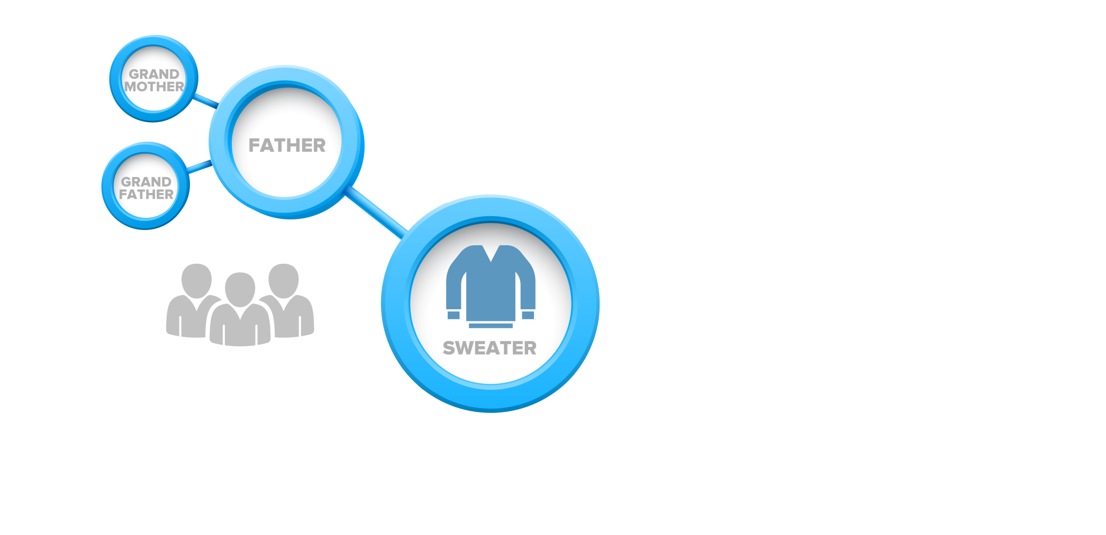
Interdependence Map

Slide 16
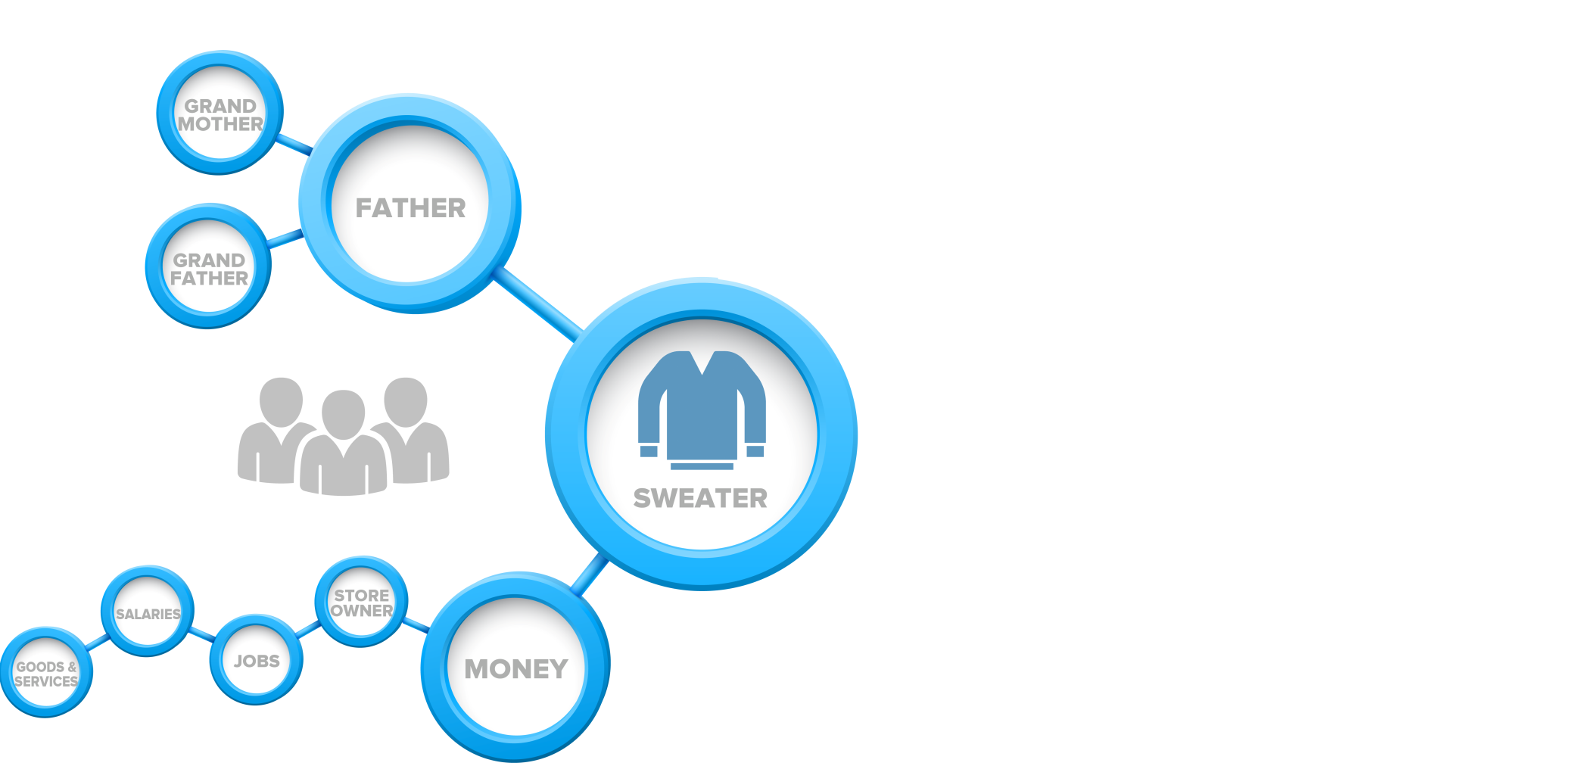
Interdependence Map

Slide 17
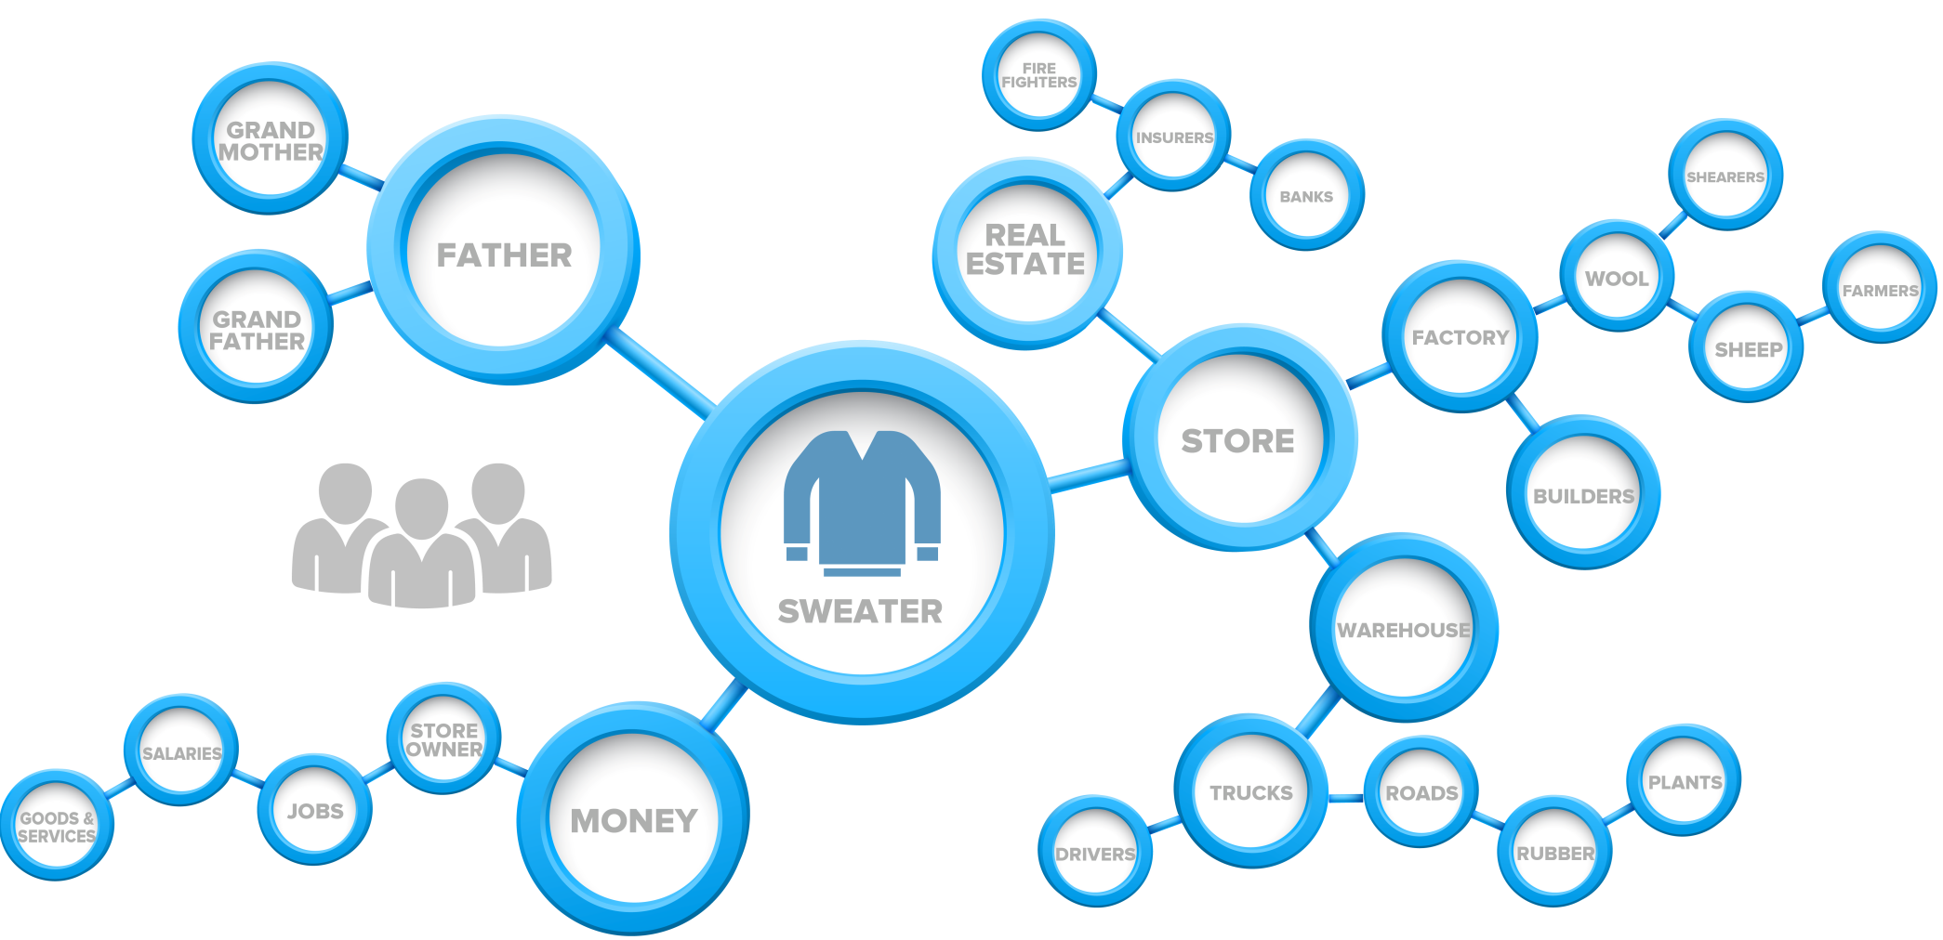
Interdependence Map

Slide 18
Notes:
“Gratitude” by Louie Schwartzberg
You may also show this on YouTube at: https://www.youtube.com/watch?v=2egMSliB8DE

Slide 19
Contemplative Practice
Notes:
“Forgiveness,” “Finding Forgiveness,” or “Gratitude” Practice from the Facilitator Guide

Slide 20
Thinking Traps
NEGATIV-ITY BIAS
OVER-GENERAL-IZATION
REDUCTIVE THINKING
NOT SEEING COMMON HUMANITY
SELF SUFFIC-IENCY
Notes:
To review, the Thinking Traps we have covered with Forgiveness and Gratitude are Overgeneralization, Reductive Thinking, Negativity Bias, Not Seeing Common Humanity, and Self-sufficiency. Remember, these cognitive biases are not always traps. They can be beneficial at times, but we can get caught by them when trying to be more forgiving and grateful, so the the practices for Skill 6 and previous skills are designed to help us escape these traps.

Slide 21
COMPASSIONATE INTEGRITY TRAINING
Center for Compassion, Integrity and Secular Ethics
Life University
© 2020 Brendan Ozawa-de Silva, Michael Karlin and Life University
COMPASSIONATE INTEGRITY TRAINING SERIES II: RELATING TO OTHERS SKILL 5: FORGIVENESS AND GRATITUDE

