Slide 1
COMPASSIONATE INTEGRITY TRAINING
Center for Compassion, Integrity and Secular Ethics
Life University
© 2020 Brendan Ozawa-de Silva, Michael Karlin and Life University
COMPASSIONATE INTEGRITY TRAINING SERIES I: SELF-CULTIVATION SKILL 3: EMOTIONAL AWARENESS

Slide 2
COMPASSIONATE INTEGRITY TRAINING
SERIES I: SELF-CULTIVATION
Calming Body and Mind
Ethical Mindfulness
Emotional Awareness
Self-Compassion
SERIES II: RELATING TO OTHERS
Impartiality and Common Humanity
Forgiveness and Gratitude
Empathic Concern
Compassion
SERIES III: ENGAGING IN SYSTEMS
Appreciating Interdependence
Engaging with Discernment
COMPASSIONATE INTEGRITY TRAINING SERIES I: SELF-CULTIVATION SKILL 3: EMOTIONAL AWARENESS

Slide 3
COMPASSIONATE INTEGRITY TRAINING
SERIES I: SELF-CULTIVATION
Calming Body and Mind
Ethical Mindfulness
Emotional Awareness
Self-Compassion
SERIES II: RELATING TO OTHERS
Impartiality and Common Humanity
Forgiveness and Gratitude
Empathic Concern
Compassion
SERIES III: ENGAGING IN SYSTEMS
Appreciating Interdependence
Engaging with Discernment
COMPASSIONATE INTEGRITY TRAINING SERIES I: SELF-CULTIVATION SKILL 3: EMOTIONAL AWARENESS
Notes:
Learning Outcomes - Content:
Participants will investigate whether the nature of thoughts and feelings is permanent or transitory.
Participants will learn to differentiate between what they consider potentially harmful mental states and potentially beneficial mental states for themselves.
Practice:
Participants will cultivate equanimity toward their mental states, learning how to observe mental states with less attachment or aversion.
Participants will learn to create more space between thoughts and speech/action in order to have greater mental balance and be less reactive.

Slide 4
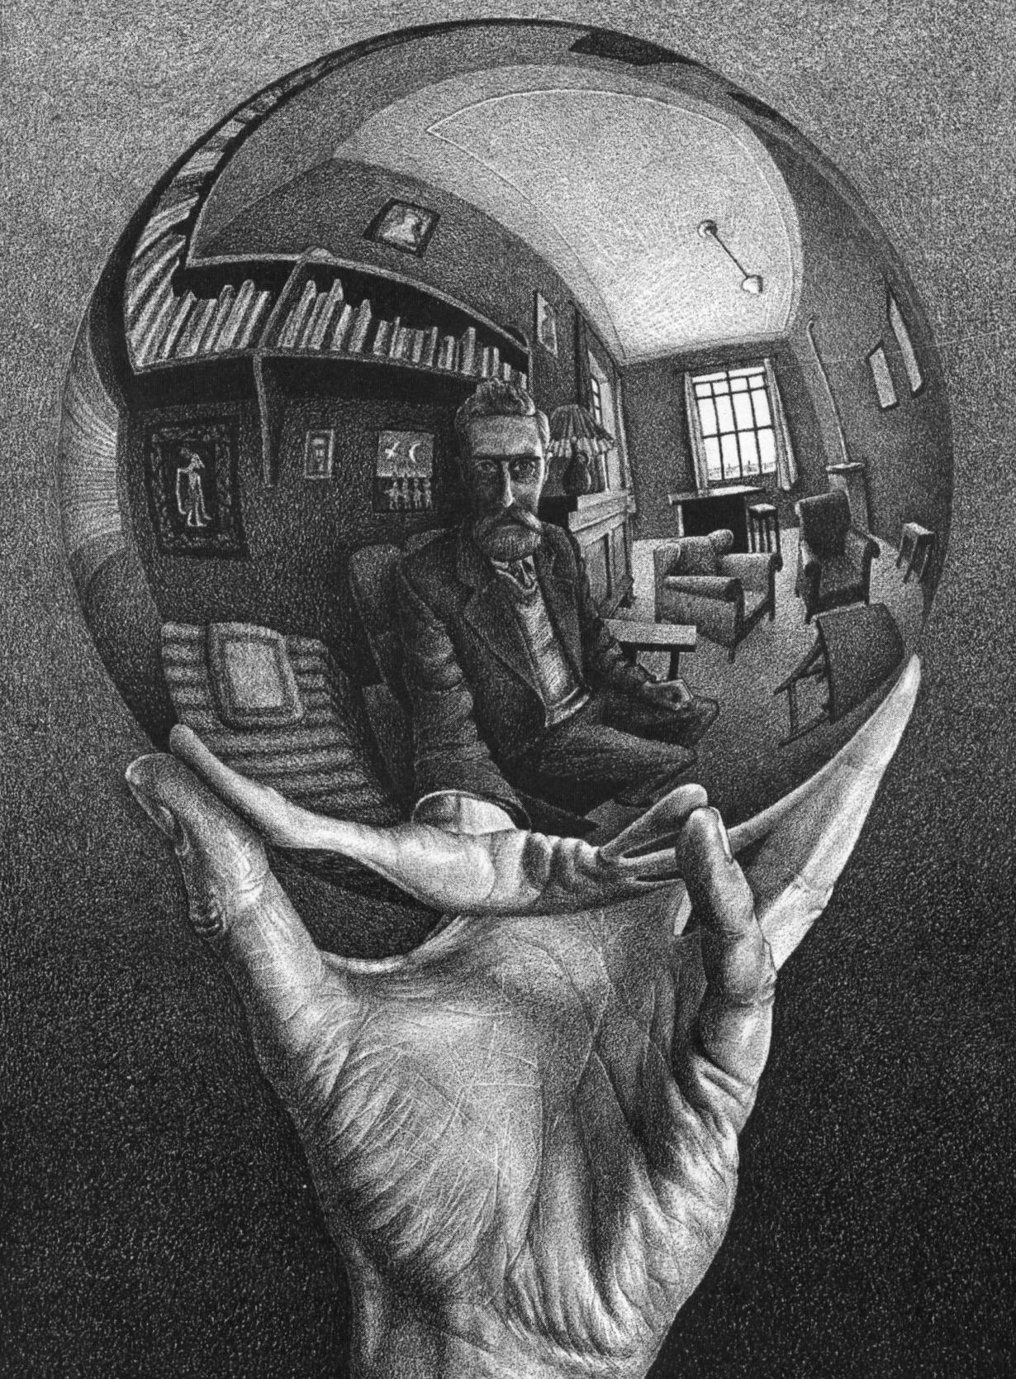
Notes:
How do you think this image relates to the idea of emotional awareness? This is only a conversation starter. There are no wrong answers.

Slide 5
Emotional Awareness
The ability to be aware of the rising and falling of our mental experiences on a moment-to-moment basis and to understand the difference between beneficial and harmful mental states.

Slide 6
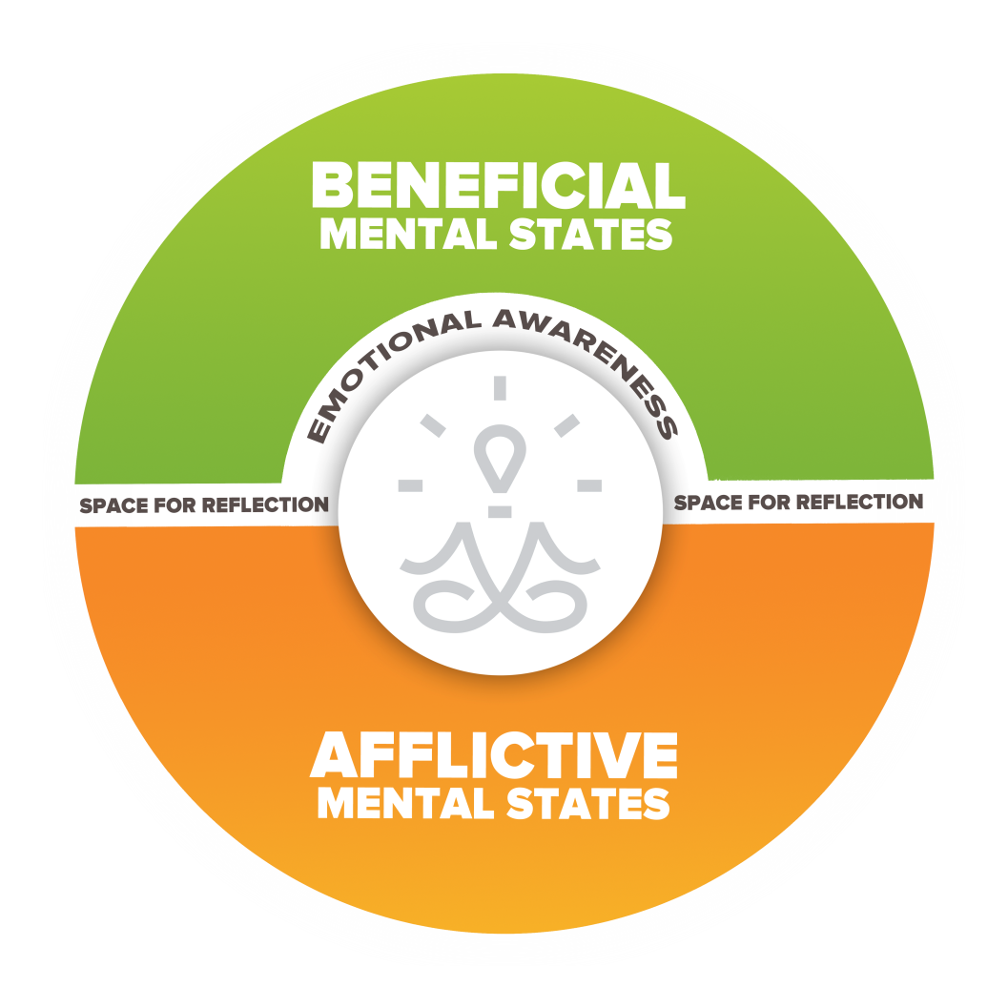
Notes:
What we are cultivating in this skill is the space for reflection between beneficial and afflictive mental states shown on this image, so we can begin to see them more clearly.

Slide 7
Beneficial mental states lead to genuine happiness for ourselves and others

Slide 8
Harmful mental states distort reality and lead to suffering for ourselves and others

Slide 9
Compassion
Patience
Gratitude
Fear
Equanimity
Forgiveness
Anger
Jealousy
Impatience
Hatred
Fear
Notes:
Ask the group for examples of afflictive mental states, then click to show them the examples of afflictive mental states. Ask how these distort reality and lead to suffering for ourselves and others. It is important participants understand how afflictive mental states distort reality. Next, ask the group for examples of beneficial mental states, then click and show them the examples. Ask how these help us see reality more clearly and lead to greater well-being for ourselves and others. With the final click, show how whether a mental state is beneficial or afflictive can depend on the context and whether it is distorting reality or not. Fear or cautiousness is an excellent example of a mental state that can be beneficial or afflictive.

Slide 10
Why?
Notes:
Why is it important to distinguish between these two types of mental states? One mental states leads to the next. Usually a beneficial state leads to the next beneficial state, and a harmful mental state leads to the next harmful mental state. The initial sensation or mental state can be like a spark that leads to a forest fire. By learning not to get caught by our harmful mental states, we can learn to interrupt the seemingly uncontrollable process of going from the spark to the forest fire.

Slide 11
Notes:
A forest fire starts with just a spark but can soon grow to become out of control. While a spark or small fire can easily be put out by anyone, a raging inferno such as the one pictured takes thousands of people a long periods of time to extinguish. Similarly, destructive emotions like hatred, jealousy and greed cause harm to ourselves and others if we don’t catch and defuse them in time. Can you think of a time when a spark led to a forest fire in your life?

Slide 12
STEP 1
STEP 2
STEP 3
STEP 4
STEP 5
EVENT
PHYSICAL CHANGE
BENEFICIAL
ACTION
PRE-CONDITION
POST-CONDITION
TRIGGER
STATE
HARMFUL
ACTION
PERCEPTION DATABASE
PSYCHOLOGICAL
CHANGE
Selective Filtering Period
Ekman, P. and Ekman, E., The Atlas of Emotions
Notes:
In this video we will present a useful psychological model to help explain what we experience when we go from a spark to a forest fire. Although this is not an exact replica of what happens in reality, this model can be used to better understand your experience and gain greater emotional awareness. This graphic is based on the Atlas of Emotions by Paul and Eve Ekman. Each time you see [CLICK], advance the slide and it will build the next part of the model.
[CLICK] Every experience begins with a context or pre-condition. This is the state of your body and mind just prior to an event.
Next, [CLICK] is an event or simply put the next experience you have. This could be an external event or even an internal event, such as a thought or a sensation in your body. Every event is experienced through your [CLICK] Perception Database, a set of universal ways of responding to stimuli that is shaped by your own unique personal history. Because every person’s history is different, every person’s experience of an event will be unique to them. Most of what makes up our unique Perception Database is unconscious to us, but that does not lessen its impact on the way we see the world.
[CLICK] The event, perception database, and pre-condition all combine to produce the Trigger, or in our language, the spark.
The Spark, or Trigger, next causes [CLICK] an automatic emotional response, such as anger or frustration, that has associated [CLICK] physiological changes in the body, such as an elevated heart rate or increased body temperature. There are also [CLICK] psychological changes, such as thoughts and feelings, evaluations of the emotion and related physiological changes.
[CLICK] This new emotional state results [CLICK] in either a beneficial action or thought or a harmful action or thought. Remember, beneficial actions and thoughts tend to lead us toward greater well-being and harmful actions and thoughts distort reality and tend to lead us toward greater suffering.
Although the movement from Step 3 to 4, from State to Action, seems at times automatic and uncontrolled and it can seem we go from spark to forest fire in an instant, there is a [CLICK] Selective Filtering Process possible at this moment where we can exert greater control over whether we choose a beneficial or harmful action. This is the moment when the spark can either begin to become a fire or when it can be stamped out. This is also where the skill of Emotional Awareness and equanimity come in. It is important to note that like all CIT skills, we all already have the capacity for emotional awareness and are putting out potential forest fires on a regular basis. We simply want to strengthen this skill..
As you will see when you start to apply this model to your own experiences, [CLICK] the steps from a pre-condition to a post condition are happening in subtle and not so subtle ways in rapid succession in your life. Every experience is impermanent, shifting from moment to moment, even if only slightly. You will learn to break down your experiences into smaller and smaller units to see the way you can intervene in your experience earlier and earlier to gain greater emotional awareness.

Slide 13
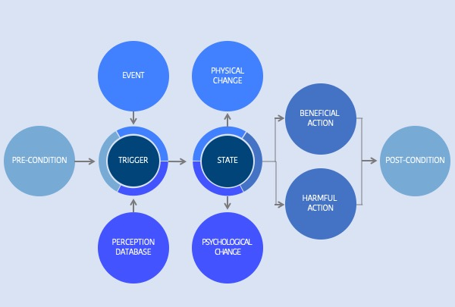
Time
Notes:
This animated slide depicts how this process repeats itself as mental proliferation over time potentially leading from a spark to a forest fire.

Slide 14
Group Activity
Notes:
“From Spark to Forest Fire Improv” Critical Insight Activity from the Facilitator Guide

Slide 15
Reflective Writing & Mindful Dialogue
Notes:
Be totally present for the other person. We rarely have someone’s undivided attention during a conversation. It is a gift. This presence can manifest through maintaining eye contact and verbal and nonverbal gestures that let your partner know that you are following what he or she is saying. Please turn off any electronic devices to prevent unexpected distractions and interruptions.
Try not to ask questions. Although we are not always conscious of it, questions have a tendency to drive a conversation in the direction the questioner wants it to go, rather than where the responder wants to take it. If you feel you must ask a question, make it something like, “Is there anything more you would like to add?”
Try not to give advice. The purpose of these conversations is to allow your partner to vocalize important experiences or insights, and to have someone honor them by listening attentively and without judgment. Often, instead of truly listening, we spend time thinking about what we would give. While this urge can be motivated by compassion, it can also interfere with our ability to actually be fully present to what the person is saying.
Keep everything your partner says in total confidence. Nothing creates safe space more effectively than trust. Knowing that each of you will keep everything you hear confidential will build that trust.

Slide 16
Equanimity
Notes:
The skill we want to cultivate in this session is equanimity. What do you think we mean by the term “equanimity” as it relates to emotional awareness? Why would equanimity be beneficial as it relates to the discussion we just had about sparks leading to forest fires?

Slide 17
Resting the Mind in its Natural State
Notes:
The practice we will do to cultivate equanimity is called Resting the Mind in the Natural State. The rest of the slides explain this practice.
What does “resting the mind in its natural state” mean?
Resting the mind in its natural state means settling the mind by allowing thoughts, emotions and bodily sensations to arise and dissipate according to their own natural rhythms. As we observe the mind nonjudgmentally, we may find that we get less caught up in the thoughts, feelings and emotions that arise. To do this, we simply observe these thoughts, feelings and emotions and let them come and go naturally, without clinging on to them and without pushing them away. We observe our minds with an open curiosity, without trying to manipulate or change anything. At the same time, this practice is not like daydreaming, because in daydreaming we do become caught up in our thoughts and lose the awareness that we are daydreaming. The technical name for this “awareness of awareness” that we are cultivating is meta-cognitive awareness. We do not have to push things away to clear the mind. Like a vase filled with sand and water, if you keep stirring the water, the sand (the different thoughts, feelings, emotions, and sensations that appear in the space of the mind) will never settle to allow for clear, calm water (the natural state of the mind). By simply stopping the stirring (observing the objects of the mind without grasping or pushing away), the sand will settle (and the mind can become clearer).

Slide 18
Notes:
In this practice we will relate to the mind as an expansive blue sky. The sky does not prevent clouds, bird, planes, etc. from appearing in the space of the sky, nor does it hold onto any of these things. It simply allows whatever appears in the sky to be there and stay there until it passes through in its natural course. The clear, calm sky is always present even if we can’t see it. Similarly, in this practice we will attempt to simply allow our thoughts, feelings, emotions and sensations to simply arise and pass without getting attached to them or pushing them away. We are cultivating our equanimity towards our mental experiences. Equanimity is the ability to just observe.
One realization we may come to through this observation is that the moment-to-moment experience of the mind and body are constantly changing, just like the clouds in this short video. In Skill 4, we will introduce the idea of Thinking Traps, which are cognitive distortions that can lead us to afflictive mental states. Seeing our circumstances, the world around us, others and ourselves as permanent, when everything is, in fact, in constant flux, can be a Thinking Trap. Furthermore, change occurs largely due to causes and conditions beyond our control. We can explore this firsthand during this practice, as sensations in the body, sounds, thoughts, emotions all arise and pass away, without us having scripted them. We will go into this further in Skill 4.

Slide 19
Notes:
Another metaphor is the ocean, which can be tumultuous and choppy on the surface…

Slide 20
Notes:
…and calm under the surface. With this metaphor, we can also see impermanence. The weather systems affecting the sea, like our experiences, are constantly changing in subtle and not-so-subtle ways.

Slide 21
Contemplative Practice
Notes:
“Resting the Mind in Its Natural State” Contemplative Practice

Slide 22
COMPASSIONATE INTEGRITY TRAINING
Center for Compassion, Integrity and Secular Ethics
Life University
© 2020 Brendan Ozawa-de Silva, Michael Karlin and Life University
COMPASSIONATE INTEGRITY TRAINING SERIES I: SELF-CULTIVATION SKILL 3: EMOTIONAL AWARENESS

