Slide 1



COMPASSIONATE INTEGRITY TRAINING
Center for Compassion, Integrity and Secular Ethics
Life University
© 2020 Brendan Ozawa-de Silva, Michael Karlin and Life University
COMPASSIONATE INTEGRITY TRAINING
SERIES I: SELF-CULTIVATION
SKILL 2: ETHICAL MINDFULNESS

Slide 2
COMPASSIONATE INTEGRITY TRAINING
SERIES I:
SELF-CULTIVATION
Calming Body and Mind
Ethical Mindfulness
Emotional Awareness
Self-Compassion
SERIES II:
RELATING TO OTHERS
Impartiality and Common Humanity
Forgiveness and Gratitude
Empathic Concern
Compassion
SERIES III:
ENGAGING IN SYSTEMS
Appreciating Interdependence
Engaging with Discernment
COMPASSIONATE INTEGRITY TRAINING
SERIES I: SELF-CULTIVATION
SKILL 2: ETHICAL MINDFULNESS

Slide 3
COMPASSIONATE INTEGRITY TRAINING
SERIES I:
SELF-CULTIVATION
Calming Body and Mind
Ethical Mindfulness
Emotional Awareness
Self-Compassion
SERIES II:
RELATING TO OTHERS
Impartiality and Common Humanity
Forgiveness and Gratitude
Empathic Concern
Compassion
SERIES III:
ENGAGING IN SYSTEMS
Appreciating Interdependence
Engaging with Discernment
COMPASSIONATE INTEGRITY TRAINING
SERIES I: SELF-CULTIVATION
SKILL 2: ETHICAL MINDFULNESS
Notes:
Learning Outcomes - Content:
Participants will learn the importance of attentional stability.
Participants will learn to become heedful of their capacity to do harm to self (first, and then others) through their speech and actions.
Participants will learn to be mindful of the reasons why harmful speech and action cause harm to themselves and others.
Practice:
Participants will increase awareness of the present moment in order to become more cognizant of their speech and actions in order to reduce their propensity to do harm to self and other.

Slide 4
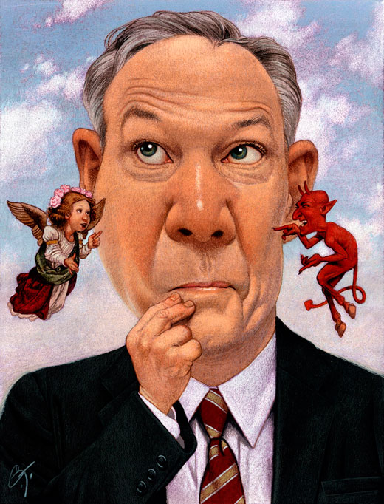
Ethical Mindfulness
The ability to keep in mind one’s identity and core values and speak and act accordingly.
Notes:
Ethical Mindfulness is based, like all of the CIT skills, on the foundational concept of the First Fundamental Shift: Compassion at the Core. In this sense then, ”one’s identity and core values” in the definition above refers to one’s fundamental need to receive and give care and compassion and the necessity of working cooperatively with others to survive and thrive.

Slide 5

Heedfulness
The vigilance to protect oneself and others from the harm that can be caused by one’s speech and actions.
Notes:
Heedfulness is the vigilance to protect ourselves and others from the harm that can be caused through our speech and actions.
Oftentimes we are unaware that things we say and do cause harm to ourselves and others, and, therefore, we show little care or concern regarding such speech and actions. Often it is only in hindsight that we recognize that we were careless.
The first step in the process of ethical mindfulness requires that we think about what actions we do that endanger ourselves and others, recognize and identify these actions clearly, and then resolve to avoid them and treat them with a sense of caution. Our heedfulness is a great strength that we want to continue to build through the practice of ethical mindfulness.

Slide 6
Mindfulness
Recalling and maintaining attention on one’s values
Notes:
In CIT, mindfulness is defined as intentionally bringing something into working memory and maintaining one’s attention on this object so that it becomes familiar and hard to forget. Within the context of Ethical Mindfulness this means being aware of and remembering one’s values — what one wants to cultivate and what one wants to avoid. By cultivating mindfulness, we can develop the ability to remember our ethical values and not forget them in situations of stress, distraction or temptation. The more often we bring our values to mind, the more effortlessly they will come to mind and become second nature.

Slide 7
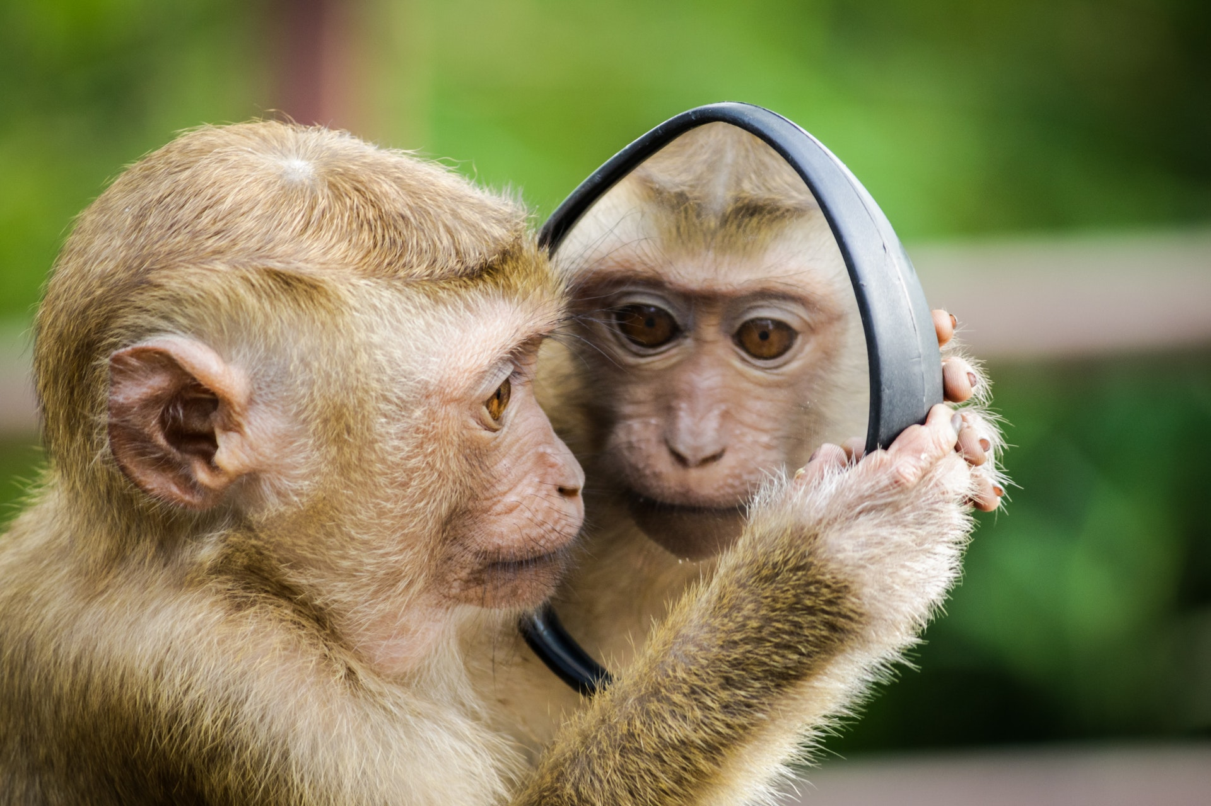
Awareness
The ability to be conscious of our moment-to-moment thoughts, speech, and actions.
Notes:
Awareness is present moment consciousness of our speech and actions. People with heedfulness and mindfulness can still cause harm to themselves and others by not being aware of their present state and activities. With awareness, we can better know when to stop ourselves from speaking or acting in a way that will harm ourselves or others. It can also help us know when to act to help ourselves and others. With Skill 3: Emotional Awareness, we will expand this awareness to our mental states, including thoughts, feelings and emotions.

Slide 8
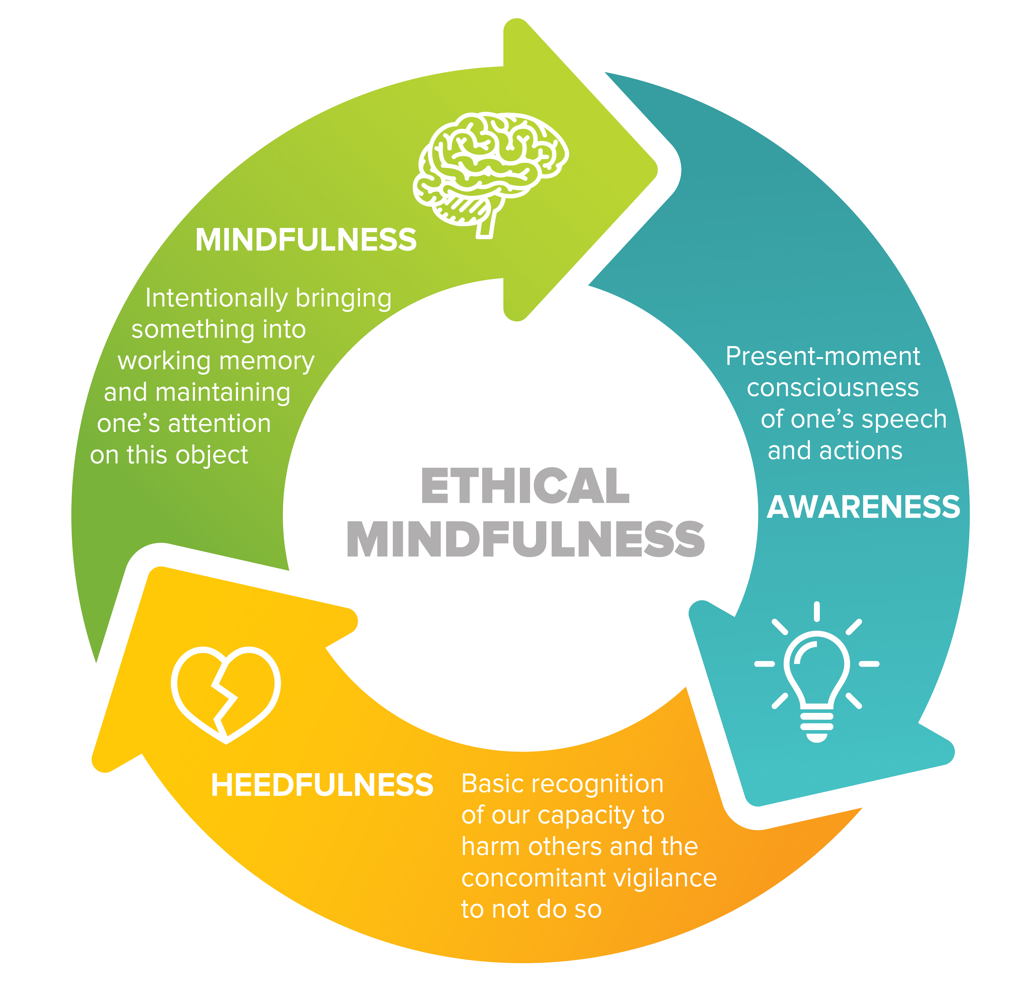
Notes:
Without all three components of ethical mindfulness, we will continue to have a lack of self-restraint. Since actions that cause harm to others also tend to endanger ourselves, developing this kind of restraint is the beginning of the ethical journey and a major step in enhancing our personal well-being.

Slide 9

Break Out Groups
Notes:
“Heedfulness, Mindfulness and Awareness Skits” from Facilitator Guide

Slide 10
Reflective Writing &
Mindful Dialogue
Notes:
Be totally present for the other person. We rarely have someone’s undivided attention during a conversation. It is a gift. This presence can manifest through maintaining eye contact and verbal and nonverbal gestures that let your partner know that you are following what he or she is saying. Please turn off any electronic devices to prevent unexpected distractions and interruptions.
Try not to ask questions. Although we are not always conscious of it, questions have a tendency to drive a conversation in the direction the questioner wants it to go, rather than where the responder wants to take it. If you feel you must ask a question, make it something like, “Is there anything more you would like to add?”
Try not to give advice. The purpose of these conversations is to allow your partner to vocalize important experiences or insights, and to have someone honor them by listening attentively and without judgment. Often, instead of truly listening, we spend time thinking about what we would give. While this urge can be motivated by compassion, it can also interfere with our ability to actually be fully present to what the person is saying.
Keep everything your partner says in total confidence. Nothing creates safe space more effectively than trust. Knowing that each of you will keep everything you hear confidential will build that trust.

Slide 11

Group Activity
Notes:
“Counting Your Thoughts” Critical Insight Activity from Facilitator Guide

Slide 12

Training the Mind
Metacognitive
Awareness
Object of Attention
Mindfulness
Mind
Notes:
This metaphor describes the goal of the practices for Ethical Mindfulness. This metaphor has been adapted from an ancient Indian metaphor for training the mind. The puppy represents the mind, which has the power to go where it wants when it wants with seemingly little or no control by its owner. If we sit for only a few seconds and attempt to focus our mind on one thing, we quickly realize that our mind goes where it wants and does not stay still. The fact that our mind tends not to obey our wishes creates problems for us – for instance, when we are trying to fall asleep at night but can’t stop thinking or worrying about something. In the metaphor of training the puppy, the puppy is on a leash and its owner holds a ball in her hand. She chides the puppy when it wanders away from her. The ball represents our object of attention, namely what we are focusing on. The leash is our capacity for mindfulness or attention. Just as the rope holds the puppy to the focus on the ball, so does our attention keep our mind on its object. When the puppy begins to roam, or move away from the owner, she recognizes that the puppy is beginning to wander and calls to the puppy, reminding her to stay. Similarly, when our mind begins to wander, we need metacognition, also called introspective awareness, which allows us to recognize when we have moved off or away from our object of focus.

Slide 13

Stability
Clarity
Notes:
The purpose of these practices is to cultivate certain capacities of the mind. In the focused attention practice we will do for Ethical Mindfulness, we are trying to cultivate stability and clarity. Stability is the ability for the mind to stay and remain where we focus it (i.e., our breath or any other object). The opposite of stability is distraction.
In addition, we are cultivating clarity. If we are going to engage in a task, we want our mind to be clear with a sense of brightness, vividness and awareness. It is possible to cultivate stability but lose clarity. This could happen if we are engaging in a practice and become very focused on your object. At the same time, we start to become lethargic and sleepy. Sometimes this will result in actually nodding off, slumping or drooling. These are signs that we are lacking clarity of mind. In that case, we need to revivify our mind, open our eyes and bring greater clarity to our practice.

Slide 14

Notes:
Each time we lose our object of focus or get distracted, and then bring our mind back to the object of focus, it is like we are strengthening the muscle of attention in our mind. This action is similar to going to the gym and doing pushups or pullups. We needn’t feel distressed that we got distracted, just as we don’t need to worry when we lower a weight; instead, we just need to lift that weight back up and build the muscle. So each moment of losing our attention is an opportunity to bring the mind back and strengthen our muscle of attention.

Slide 15

Notes:
Each time we lose our object of attention and recognize it, it is like doing another scale in the conservatory as we strengthen our muscles of mindfulness and metacognition.

Slide 16

Contemplative Practice
Notes:
Focused Attention Practice

Slide 17
COMPASSIONATE INTEGRITY TRAINING
Center for Compassion, Integrity and Secular Ethics
Life University
© 2020 Brendan Ozawa-de Silva, Michael Karlin and Life University
COMPASSIONATE INTEGRITY TRAINING
SERIES I: SELF-CULTIVATION
SKILL 2: ETHICAL MINDFULNESS

