Slide 1
COMPASSIONATE INTEGRITY TRAINING
Center for Compassion, Integrity and Secular Ethics
Life University
© 2019 Brendan Ozawa-de Silva, Michael Karlin and Life University
COMPASSIONATE INTEGRITY TRAINING SERIES III: ENGAGING IN SYSTEMS SKILL 10: ENGAGING WITH DISCERNMENT

Slide 2
COMPASSIONATE INTEGRITY TRAINING
SERIES I: SELF-CULTIVATION
Calming Body and Mind
Ethical Mindfulness
Emotional Awareness
Self-Compassion
SERIES II: RELATING TO OTHERS
Impartiality and Common Humanity
Forgiveness and Gratitude
Empathic Concern
Compassion
SERIES III: ENGAGING IN SYSTEMS
Appreciating Interdependence
Engaging with Discernment
COMPASSIONATE INTEGRITY TRAINING SERIES III: ENGAGING IN SYSTEMS SKILL 10: ENGAGING WITH DISCERNMENT
Notes:
Content:
Participants will learn that compassion must be complemented with insight and understanding for decisions to lead to the most positive outcomes.
Participants will learn to use common sense, personal experience and scientific evidence as a foundation for discernment.
Participants will learn to check their personal motivation when facing a dilemma
Participants will learn the concept of epistemic humility.
Practice:
Participants will practice examining an issue in context from multiple perspectives, considering the viewpoints of each group involved and debating the pros and cons of multiple sides.
Participants will practice accessing creativity and imagination, problem solving capacities and other practical skills necessary for engaged action within their community and the world.

Slide 3
COMPASSIONATE INTEGRITY TRAINING
SERIES I: SELF-CULTIVATION
Calming Body and Mind
Ethical Mindfulness
Emotional Awareness
Self-Compassion
SERIES II: RELATING TO OTHERS
Impartiality and Common Humanity
Forgiveness and Gratitude
Empathic Concern
Compassion
SERIES III: ENGAGING IN SYSTEMS
Appreciating Interdependence
Engaging with Discernment
COMPASSIONATE INTEGRITY TRAINING SERIES III: ENGAGING IN SYSTEMS SKILL 10: ENGAGING WITH DISCERNMENT

Slide 4
Break Out Groups
Notes:
“Exploring the Nature of Systems Part III: The Veil of Ignorance” Critical Insight Activity from Facilitator Guide.

Slide 5
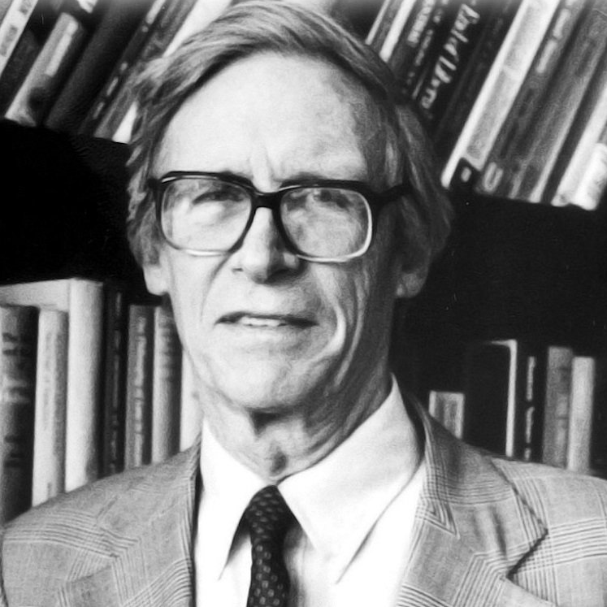
“The principles of justice are chosen behind a veil of ignorance.” ― John Rawls, A Theory of Justice
Notes:
John Rawls (1921-2002) was moral and political philosopher who taught at Harvard and Oxford Universities. The “veil of ignorance,” is found in his 1977 book, A Theory of Justice.
Spencer Maxcy, in Ethical School Leadership (2202), explains the veil of ignorance in this way: “Imagine that you have set for yourself the task of developing a totally new social contract for today’s society. How could you do so fairly? Although you could never actually eliminate all of your personal biases and prejudices, you would need to take steps at least to minimize them. Rawls suggests that you imagine yourself in an original position behind a veil of ignorance. Behind this veil, you know nothing of yourself and your natural abilities, or your position in society. You know nothing of your sex, race, nationality, or individual tastes. Behind such a veil of ignorance all individuals are simply specified as rational, free, and morally equal beings. You do know that in the ‘real world,’ however, there will be a wide variety in the natural distribution of natural assets and abilities, and that there will be differences of sex, race, and culture that will distinguish groups of people from each other.”

Slide 6
Break Out Groups
Notes:
“Exploring the Nature of Systems Part IV: Engaging in Systems with Compassion” Critical Insight Activity from Facilitator Guide.

Slide 7
Reflective Writing & Mindful Dialogue
Notes:
Be totally present for the other person. We rarely have someone’s undivided attention during a conversation. It is a gift. This presence can manifest through maintaining eye contact and verbal and nonverbal gestures that let your partner know that you are following what he or she is saying. Please turn off any electronic devices to prevent unexpected distractions and interruptions.
Try not to ask questions. Although we are not always conscious of it, questions have a tendency to drive a conversation in the direction the questioner wants it to go, rather than where the responder wants to take it. If you feel you must ask a question, make it something like, “Is there anything more you would like to add?”
Try not to give advice. The purpose of these conversations is to allow your partner to vocalize important experiences or insights, and to have someone honor them by listening attentively and without judgment. Often, instead of truly listening, we spend time thinking about what we would give. While this urge can be motivated by compassion, it can also interfere with our ability to actually be fully present to what the person is saying.
Keep everything your partner says in total confidence. Nothing creates safe space more effectively than trust. Knowing that each of you will keep everything you hear confidential will build that trust.

Slide 8
Engaging with Discernment
Check your motivations by asking,
“Do I truly have the others’ well-being at heart or am I under the sway of any afflictive mental states, such as greed, anger, or jealousy?”
Notes:
These are the four steps to engaging with discernment. They are based on a passage about discernment from Beyond Religion by His Holiness the Dalai Lama.

Slide 9
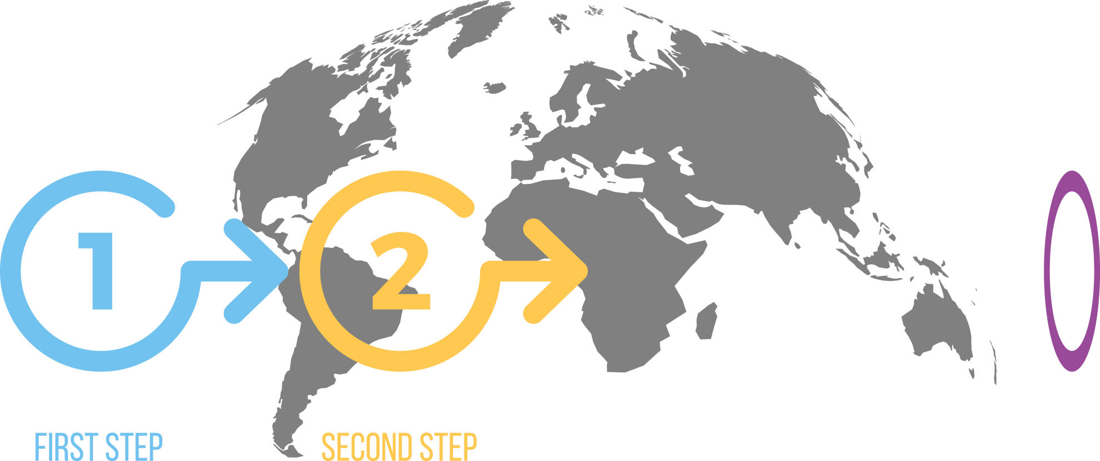
Engaging with Discernment
Check your motivations by asking,
“Do I truly have the others’ well-being at heart or am I under the sway of any afflictive mental states, such as greed, anger, or jealousy?”
If your motivations are sound bring to mind your understanding of interdependence, and ask:
“What is the broader context of the problem? What are the various causes and conditions that have given rise to the problem?”

Slide 10
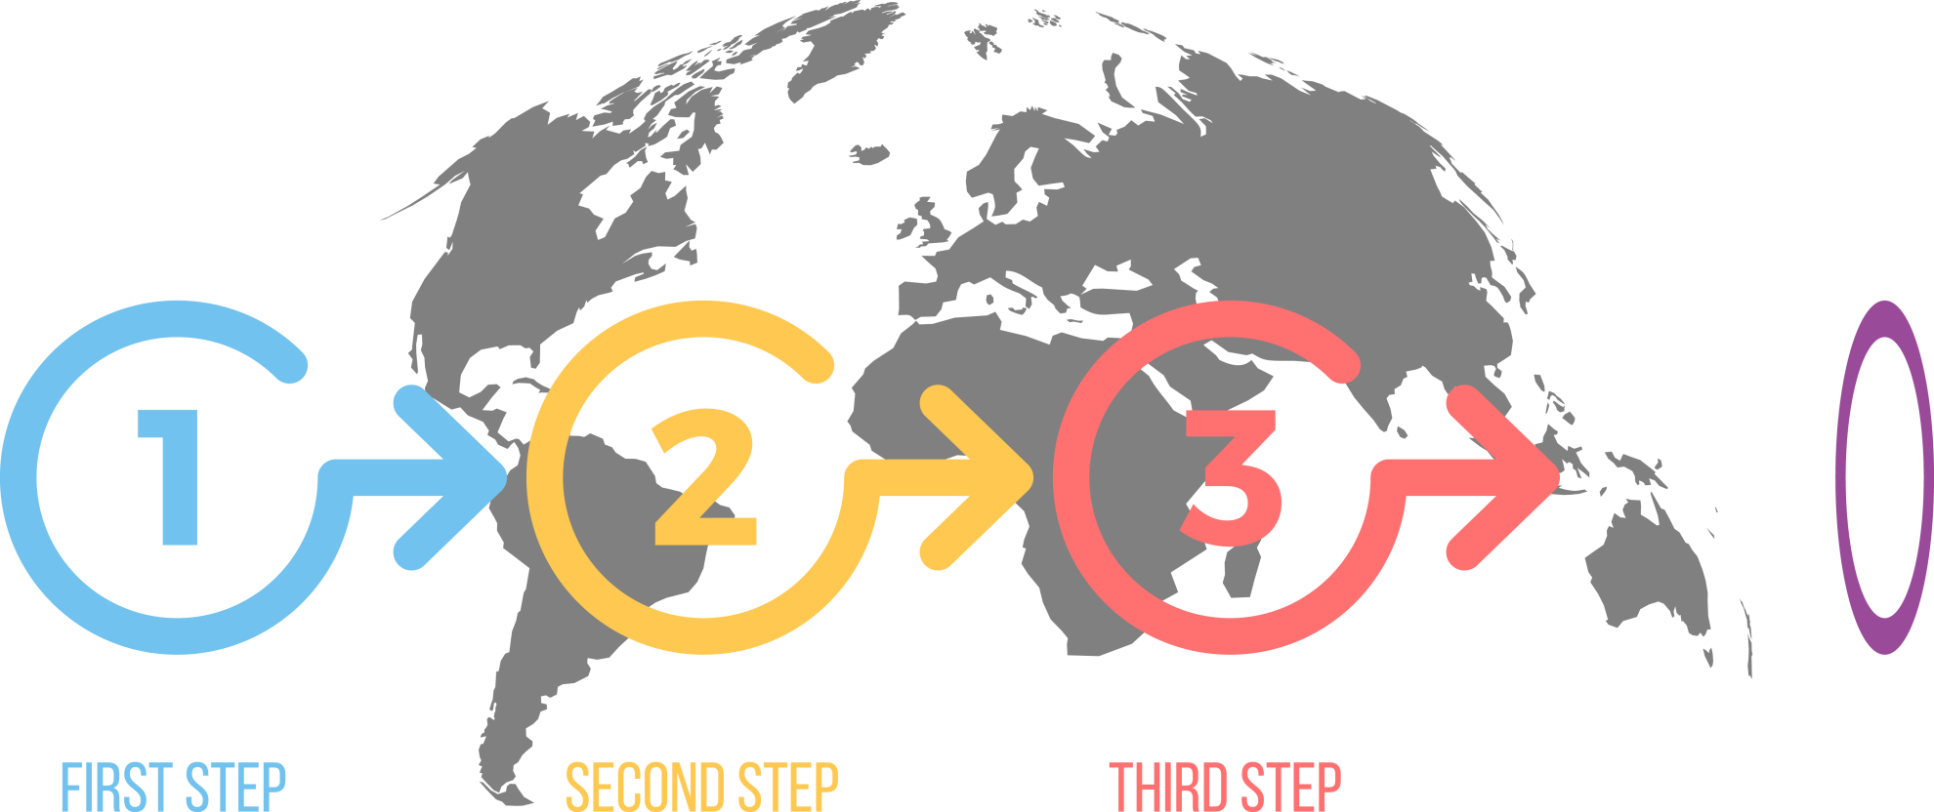
Engaging with Discernment
Check your motivations by asking,
“Do I truly have the others’ well-being at heart or am I under the sway of any afflictive mental states, such as greed, anger, or jealousy?”
If your motivations are sound bring to mind your understanding of interdependence, and ask:
“What is the broader context of the problem? What are the various causes and conditions that have given rise to the problem?”
Based on this broader understanding, ask:
“What choices do I have and what are the likely outcomes of each choice?”

Slide 11
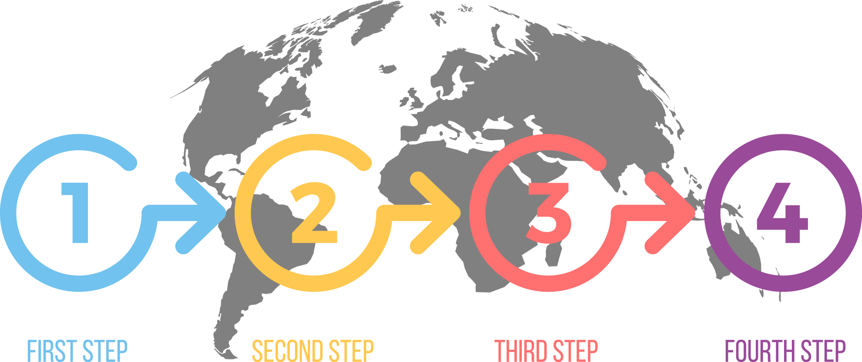
Engaging with Discernment
Check your motivations by asking,
“Do I truly have the others’ well-being at heart or am I under the sway of any afflictive mental states, such as greed, anger, or jealousy?”
If your motivations are sound bring to mind your understanding of interdependence, and ask:
“What is the broader context of the problem? What are the various causes and conditions that have given rise to the problem?”
Based on this broader understanding, ask:
“What choices do I have and what are the likely outcomes of each choice?”
Finally ask yourself:
“Which solution will cause the least harm and enable the greatest amount of well-being?”

Slide 12
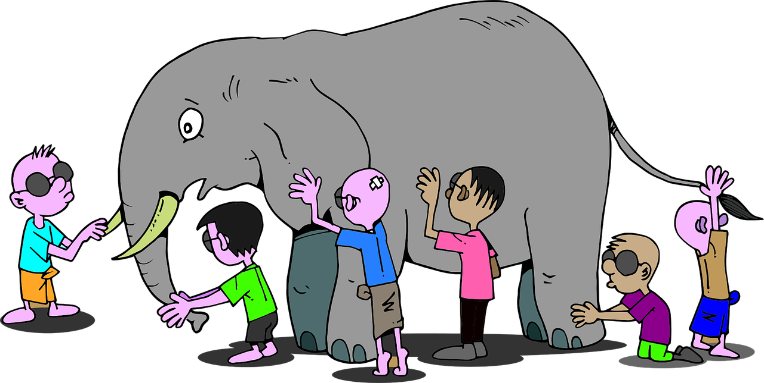
Epistemic Humility
Recognition that we can only see part of the picture and even that is grounded in our own perspective.
Openness to new ideas or opinions and seeing other solutions.
Notes:
You may choose to read all or a portion of the poem upon which this image is based.
The Blind Men and the Elephant (1872)
By John Godfrey Saxe
It was six men of Indostan /To learning much inclined,/Who went to see the Elephant/(Though all of them were blind)/That each by observation/Might satisfy his mind.
The First approached the Elephant/And happening to fall/Against his broad and sturdy side/At once began to bawl/“God bless me!—but the Elephant/Is very like a wall!"
The Second, feeling of the tusk/Cried: "Ho!—what have we here/So very round and smooth and sharp?/To me 't is mighty clear/This wonder of an Elephant/Is very like a spear!”
The Third approached the animal/And happening to take/The squirming trunk within his hands/Thus boldly up and spake:/"I see," quoth he, "the Elephant/Is very like a snake!"
The Fourth reached out his eager hand/And felt about the knee./“What most this wondrous beast is like/Is mighty plain," quoth he/“’T is clear enough the Elephant/Is very like a tree!"
The Fifth, who chanced to touch the ear/Said: "E'en the blindest man/Can tell what this resembles most/Deny the fact who can/This marvel of an Elephant/Is very like a fan!"
The Sixth no sooner had begun/About the beast to grope/Than, seizing on the swinging tail/That fell within his scope/“I see," quoth he, "the Elephant/Is very like a rope!”
And so these men of Indostan/Disputed loud and long/Each in his own opinion/Exceeding stiff and strong/Though each was partly in the right/And all were in the wrong!

Slide 13
Compassion and discernment are not guarantees of positive results, but together they provide the best path forward for individual and collective well-being.

Slide 14
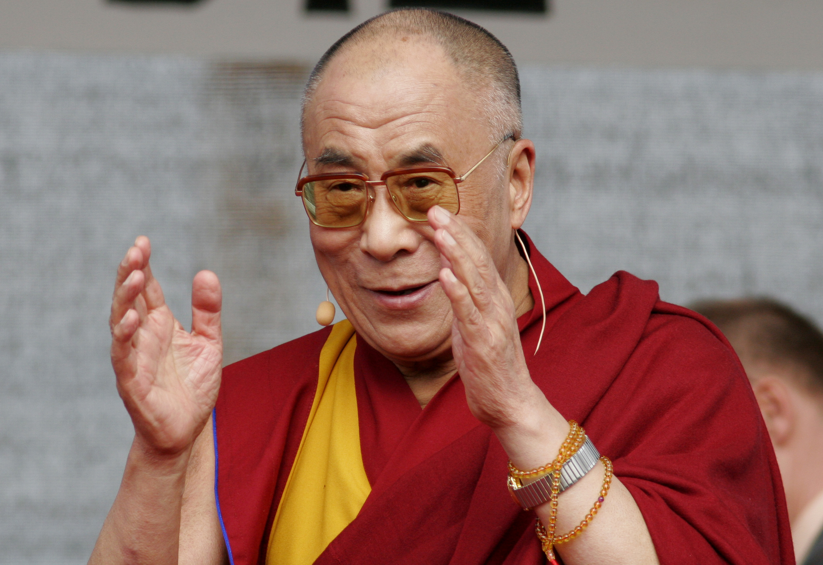
If you want to be happy, practice compassion.
If you want others to be happy, practice compassion.
Editorial credit: vipflash / Shutterstock.com

Slide 15
COMPASSIONATE INTEGRITY TRAINING
Center for Compassion, Integrity and Secular Ethics
Life University
© 2019 Brendan Ozawa-de Silva, Michael Karlin and Life University
COMPASSIONATE INTEGRITY TRAINING SERIES III: ENGAGING IN SYSTEMS SKILL 10: ENGAGING WITH DISCERNMENT

