Slide 1
COMPASSIONATE INTEGRITY TRAINING
Center for Compassion, Integrity and Secular Ethics
Life University
© 2020 Brendan Ozawa-de Silva, Michael Karlin and Life University
COMPASSIONATE INTEGRITY TRAINING SERIES I: SELF-CULTIVATION SKILL 1: CALMING BODY AND MIND

Slide 2
COMPASSIONATE INTEGRITY TRAINING
SERIES I: SELF-CULTIVATION
Calming Body and Mind
Ethical Mindfulness
Emotional Awareness
Self-Compassion
SERIES II: RELATING TO OTHERS
Impartiality and Common Humanity
Forgiveness and Gratitude
Empathic Concern
Compassion
SERIES III: ENGAGING IN SYSTEMS
Appreciating Interdependence
Engaging with Discernment
COMPASSIONATE INTEGRITY TRAINING SERIES I: SELF-CULTIVATION SKILL 1: CALMING BODY AND MIND

Slide 3
COMPASSIONATE INTEGRITY TRAINING
SERIES I: SELF-CULTIVATION
Calming Body and Mind
Ethical Mindfulness
Emotional Awareness
Self-Compassion
SERIES II: RELATING TO OTHERS
Impartiality and Common Humanity
Forgiveness and Gratitude
Empathic Concern
Compassion
SERIES III: ENGAGING IN SYSTEMS
Appreciating Interdependence
Engaging with Discernment
COMPASSIONATE INTEGRITY TRAINING SERIES I: SELF-CULTIVATION SKILL 1: CALMING BODY AND MIND
Notes:
Learning Outcomes - Content:
Participants will learn about the autonomic nervous system (ANS) and the difference between its fight or flight response (sympathetic activation) and its rest and digest response (parasympathetic activation).
Participants will learn about the three zones their body can be in (high, low and resilient) as a useful heuristic for understanding the ANS.
Practice:
Participants will learn how to both return to the resilient zone when they move outside of it and to expand their resilient zone through practice.

Slide 4
Shifting Attitudes
Conventional
People are bad.
People need to be punished.
People just don’t care.
We need to stop making excuses for people.
What is wrong with you?
Trauma-Informed
People are suffering.
People need an effective intervention.
Many people care but lack understanding and skills.
We need to learn how trauma impacts a child’ s and adult’s development.
What happened to you?
Resiliency-Informed
People are resilient.
People need our compassion as they learn new skills.
Any person can learn self-regulation skills based on science
We need to learn how skills of well-being can reduce suffering.
What is right with you? What are your strengths?
Adapted by Elaine Miller Karas from a slide by Jane Stevens (ACES Connection)
Notes:
CIT is a resiliency-informed program. What does that mean? From a conventional perspective, when observing someone who is behaving badly, we would ask, ”What is wrong with you?”, assuming the person is somehow bad and needs to be punished. From a trauma-informed perspective, we would ask, “What happened to you?”, recognizing that the person may have experienced something traumatic in their life and need an effective intervention. Although it is very important to acknowledge and treat trauma, in CIT we focus on resilience and helping people build upon their strengths. From this perspective, we are asking, “What is right with you?” and “What are your strengths?”, appreciating that every person is resilient and has strengths that have enabled them to survive and thrive. We can all learn from each other’s strengths. CIT offers additional skills to enable people to achieve greater well-being and reduce suffering.

Slide 5
Group Activity
Notes:
“Sensation Words” Critical Insight Activity from the Facilitator Guide

Slide 6
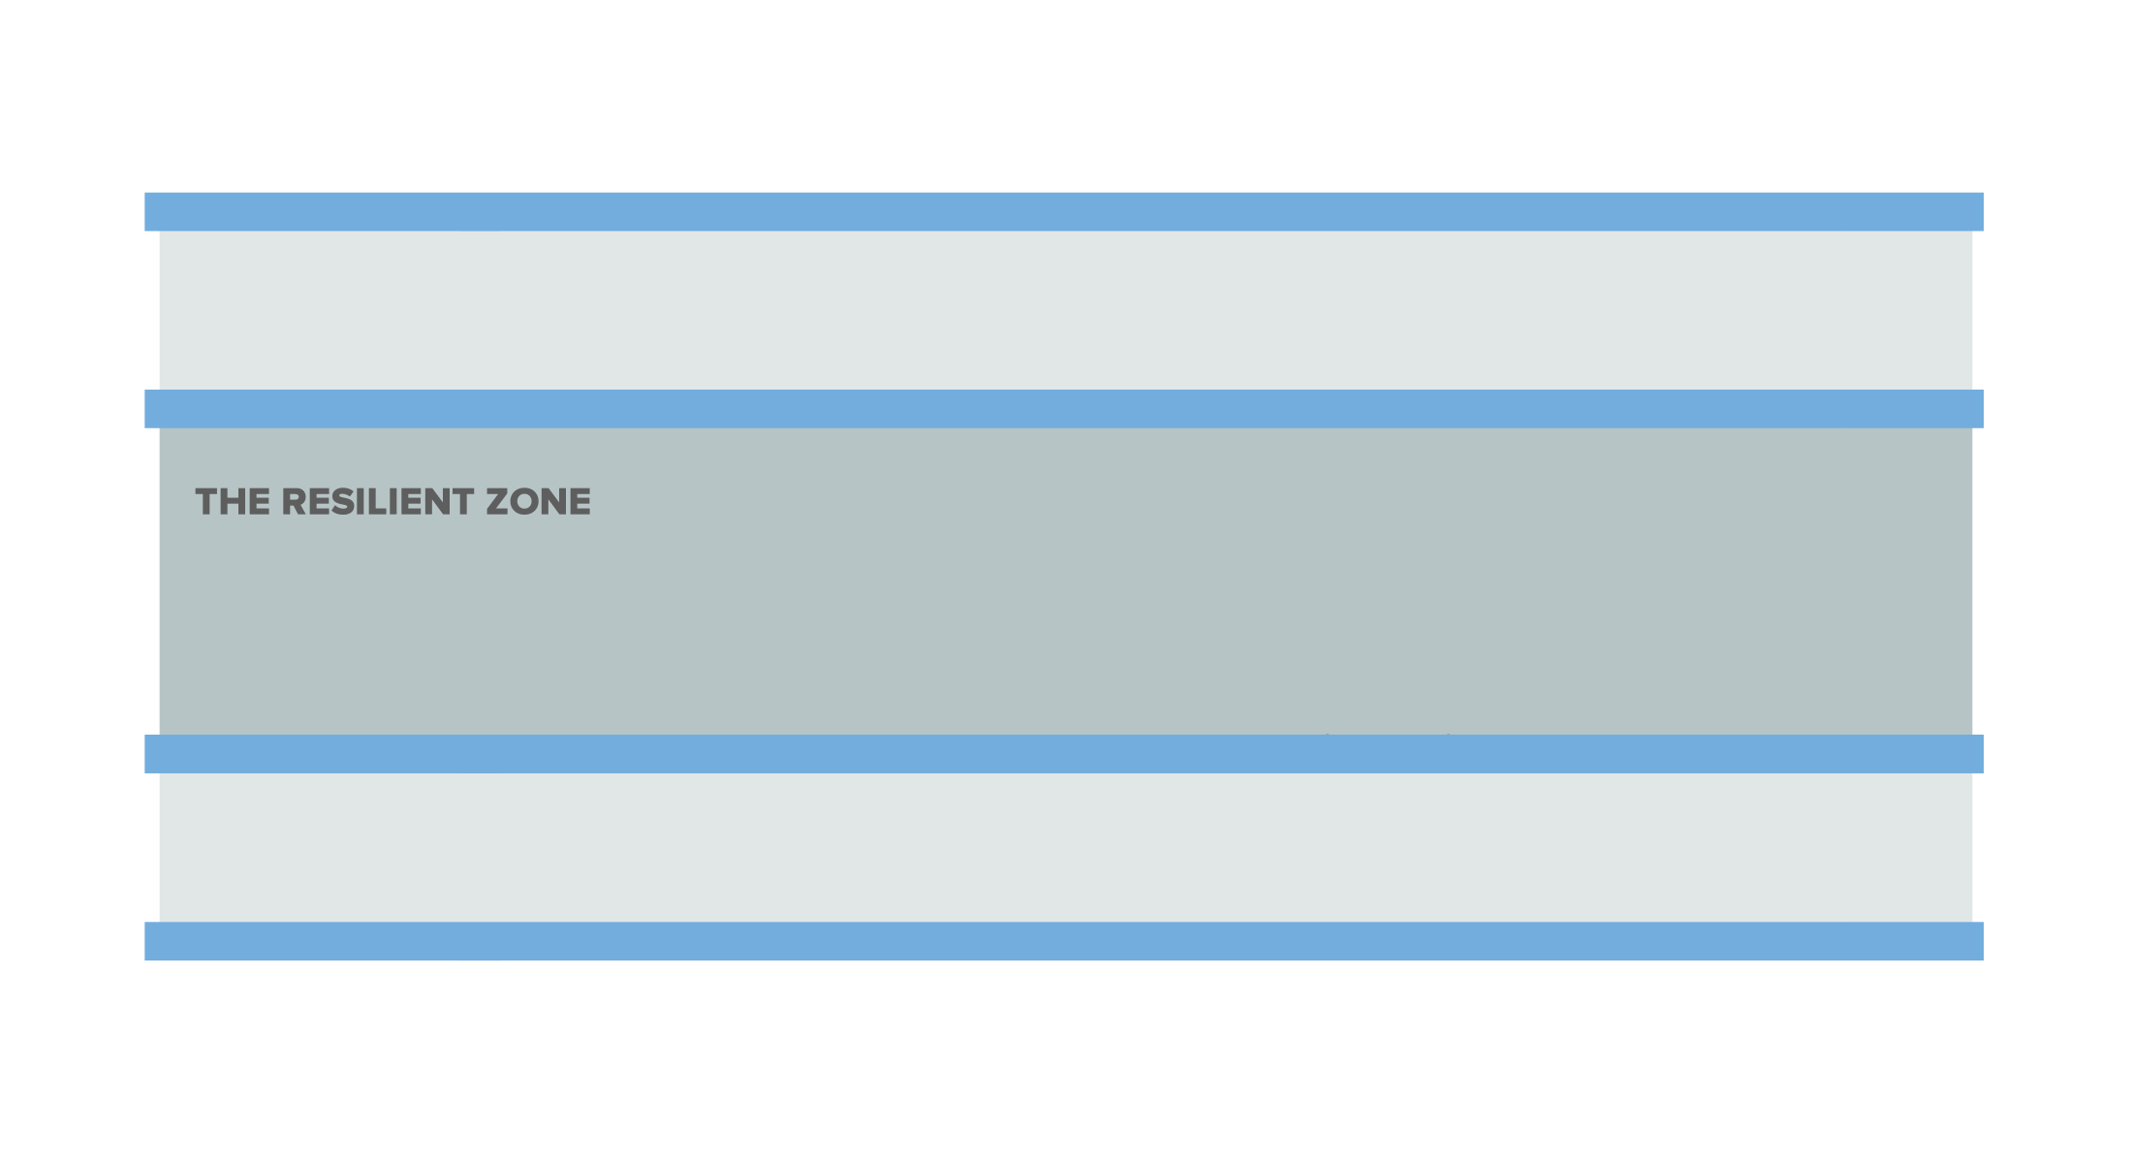
The Resilient Zone
Notes:
You may ask the group, “What does resilience mean to you?” Based on that conversation, You may ask the group, “What might a Resilient Zone be?”

Slide 7
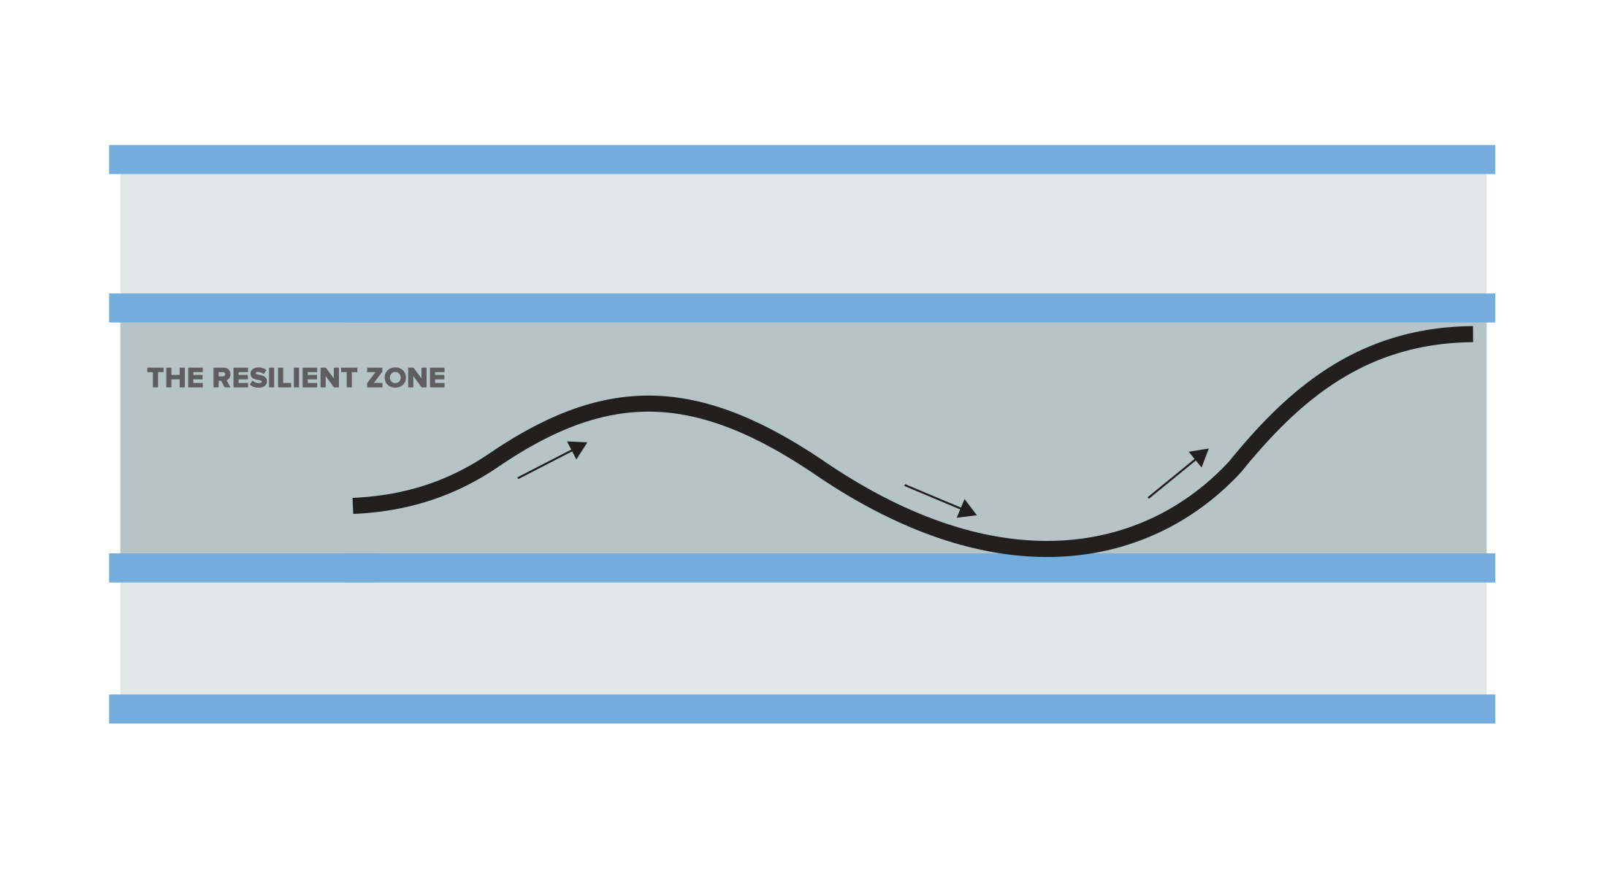
The Resilient Zone
Notes:
As this wave depicts, in the Resilient Zone, one experiences the full range of emotions. The key is whether the emotion and associated body sensations causes one to think clearly and make good decisions for themselves and others. The Resilient Zone should not be described as “our happy place,” since one can also be sad and be resilient and clear minded. You may also call it the “Okay Zone.”

Slide 8
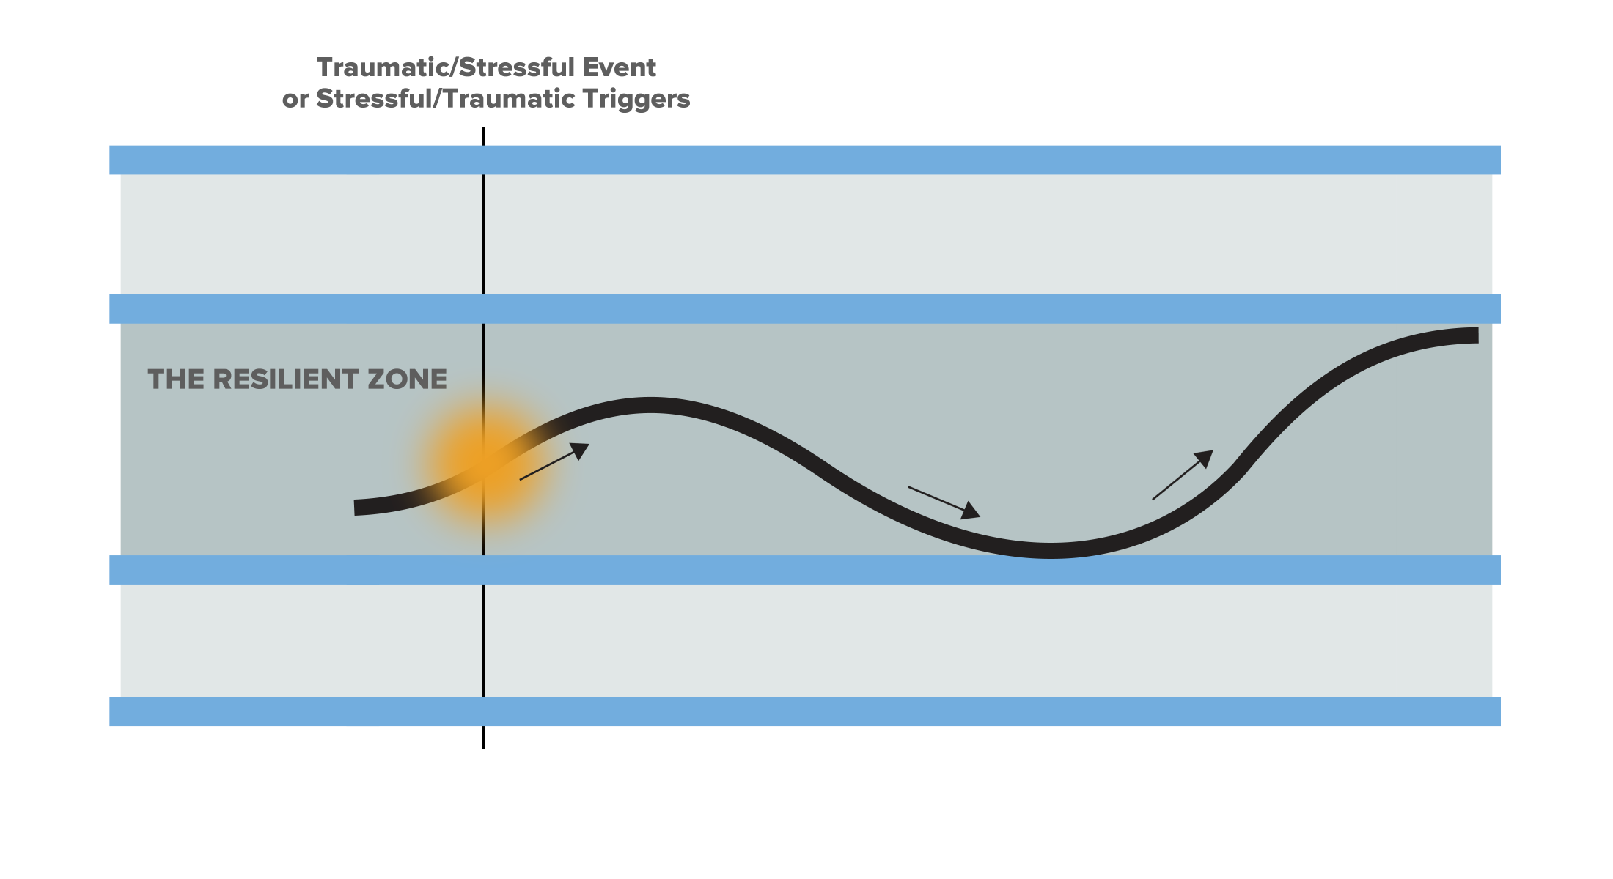
The Resilient Zone
Notes:
Stressful events or triggers are inevitable, and sometimes when these happen, we can get knocked out of our Resilient Zone. You may ask the group, “I know I don’t always live in my Resilient Zone. Anyone else get triggered throughout the day?”

Slide 9
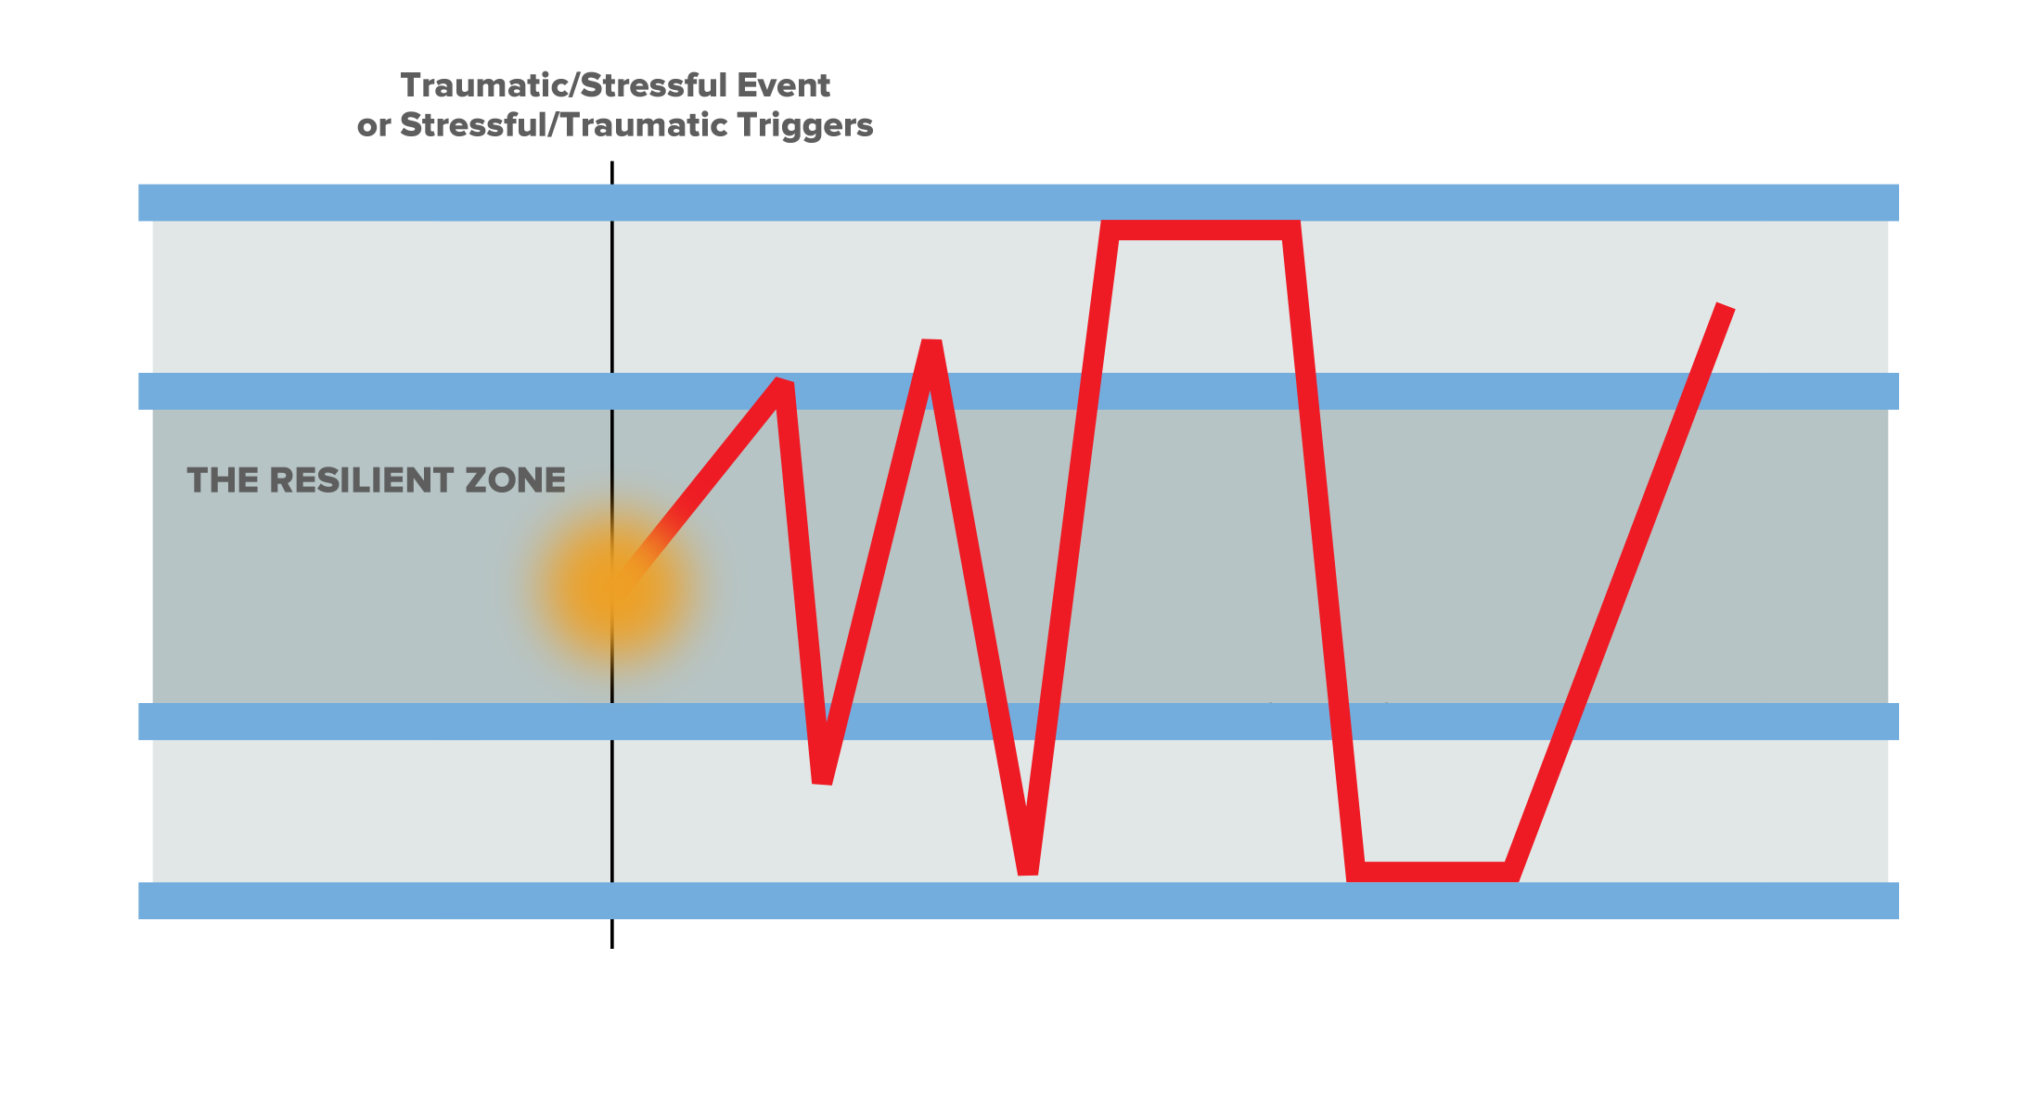
The Resilient Zone
Edginess
Irritability
Anxiety & Panic
Angry Outbursts
Mania
Pain
Stuck in High Zone
Stuck in Low Zone
Depression
Sadness
Isolation
Exhaustion
Fatigue
Numbness
Notes:
Then, we may look more like this image than the smooth, wavy line. When we are stuck in the High Zone, we may experience some of the sensations, emotions, or behaviors listed on the top of the slide. You may ask the group, “What else might one experience when they are knocked up high?” When we are stuck in the Low Zone, we may experience some of the sensations, emotions, or behaviors listed on the bottom of the slide. You may ask the group, “What else might one experience when they are knocked down low?”

Slide 11
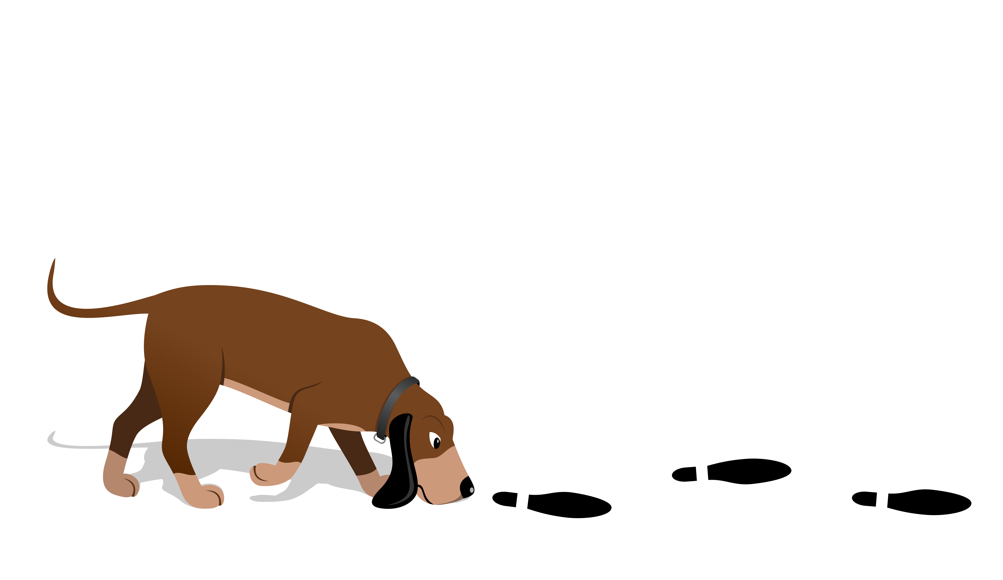
Tracking
Noticing or paying attention to what is happening inside your body at the present moment
Determining if the sensation is pleasant, unpleasant or neutral
Sitting or staying with sensations that are pleasant or neutral
Notes:
Compassionate Integrity Training
A Secular Ethics Approach to Cultivating Personal, Social and Environmental Flourishing
© 2018 Brendan Ozawa-de Silva, Michael Karlin and Life University
____________________________________________________________________________________________________________________________________________________________________________________________________________________________________________________________________________________________________________________________________________________________________________________________________________________________________________________________________________________________________________________________________________________________________________________________________________________________________________________________________________________________________________________________________
Presenter Notes:
As we learn about our bodies, we develop“ body literacy.” We notice that our bodies are experiencing a whole host of sensations at every moment. Each sensation is giving us information about the state of our body. Interestingly, if we attend to unpleasant sensations and keep our attention on them, they have the potential to send us into the high or low zone. It is as if the body is sensing danger, and we are focusing on the threat. However, if we attend to neutral or pleasant sensations and remain with them, they have the potential to regulate our bodies and move us back into the resilient zone. When we do this, it is as if we are letting our bodies know that things are safe and okay. Tracking, therefore, is the act of noticing the physical sensations that are occurring within the body in the present moment. It also involves recognizing if they are pleasant, unpleasant or neutral. As mentioned, if the sensation is pleasant or neutral, we can simply notice the sensation and then remain with it for a few moments. This period of remaining with the sensation helps our body recognize well-being. If the sensation is unpleasant, then we can redirect our attention, finding a place in the body that is pleasant, neutral or just somewhere that is less unpleasant than the original sensation. If we have chronic pain or discomfort across the body, there may be no place in the body that is pleasant or neutral, but there might be places in the body that are less unpleasant than other places, and we can place our attention there.

Slide 12
Resourcing
A Resource is any person, place, thing, memory or part of yourself that makes you feel calm, pleasant, peaceful, strong or resilient.
Notes:
© 2018 Brendan Ozawa-de Silva, Michael Karlin and Life University
____________________________________________________________________________________________________________________________________________________________________________________________________________________________________________________________________________________________________________________________________________________________________________________________________________________________________________________________________________________________________________________________________________________________________________________________________________________________________________________________________________________________________________________________________
Compassionate Integrity Training
A Secular Ethics Approach to Cultivating Personal, Social and Environmental Flourishing
Presenter Notes:
One effective way to move into or stay within the resilient zone is to come up with an external, internal or imagined resource that brings about a state of greater well-being, safety or security. Resources can be unique to each of us, and we can have multiple resources. To practice resourcing, one brings the resource to mind as vividly as possible. The more detail that can be attributed to the resource, the stronger its effect. Recalling smells, sounds, tastes, physical sensations and colors will allow the resource to grow and strengthen. Once the resource is vivid, keep it in mind and engage in tracking — that is, notice what is happening inside the body in the present moment. Oftentimes, people mistakenly think resourcing involves thinking about how you felt when the event in your memory took place. But this practice involves noticing what is happening in one’s body in the very moment that one is thinking of the resource. Resources should be things that make us feel a bit better or safer when we think of them. But it’s also possible that when we think of a resource, we experience unpleasant sensations. If this occurs, we can shift to a place in the body that feels more pleasant or neutral.

Slide 13
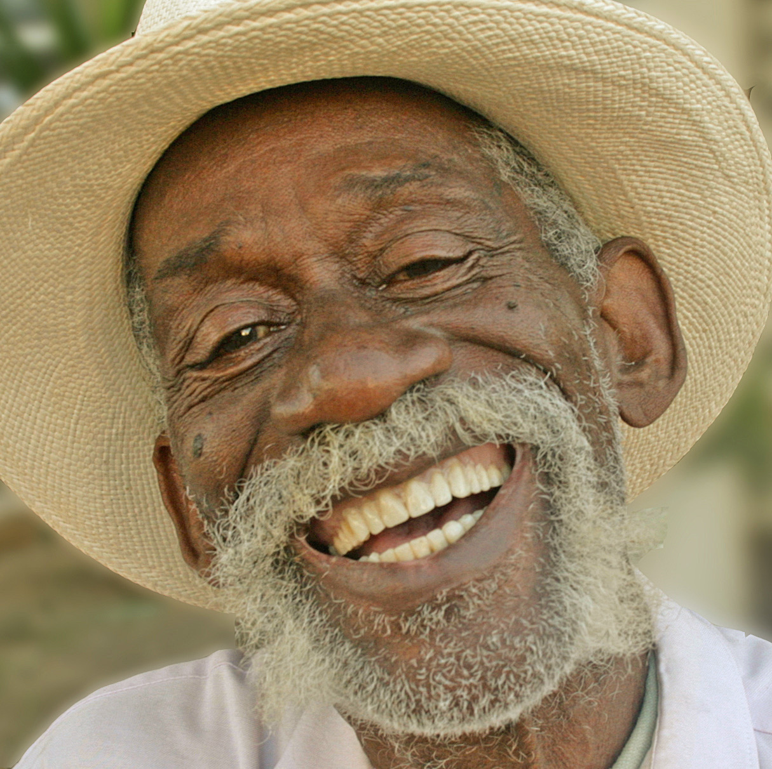
A Resource can be real or imagined...
Notes:
© 2018 Brendan Ozawa-de Silva, Michael Karlin and Life University
____________________________________________________________________________________________________________________________________________________________________________________________________________________________________________________________________________________________________________________________________________________________________________________________________________________________________________________________________________________________________________________________________________________________________________________________________________________________________________________________________________________________________________________________________
Compassionate Integrity Training
A Secular Ethics Approach to Cultivating Personal, Social and Environmental Flourishing
Presenter Notes:

Slide 14
…internal or external.
Notes:
External resources can be a memory, place or person that makes you feel better, or an activity such as jogging, biking or swimming, that gives you a sense of greater well-being while you are engaging in it. Internal resources can be a part of oneself, like a characteristic one has (such as a sense of humor) or a part of one’s body that is strong or healthy.
© 2018 Brendan Ozawa-de Silva, Michael Karlin and Life University
____________________________________________________________________________________________________________________________________________________________________________________________________________________________________________________________________________________________________________________________________________________________________________________________________________________________________________________________________________________________________________________________________________________________________________________________________________________________________________________________________________________________________________________________________
Compassionate Integrity Training
A Secular Ethics Approach to Cultivating Personal, Social and Environmental Flourishing
Presenter Notes:

Slide 15
Resourcing
Notes:
Remember to let participants know that resources can sometimes “split.” In other words, a resource that originally helps a person feel calm, happy or strong can turn to a memory or thought of sadness or unpleasantness. For example, if one brings to mind a deceased relative, this may initially bring pleasant sensations, but if the memory of this person also reminds the person of the sadness of the loss, it could begin to elicit unpleasant sensations. If this occurs, one can focus on the part of the resource that gives a pleasant sensation or choose a different resource.
© 2018 Brendan Ozawa-de Silva, Michael Karlin and Life University
____________________________________________________________________________________________________________________________________________________________________________________________________________________________________________________________________________________________________________________________________________________________________________________________________________________________________________________________________________________________________________________________________________________________________________________________________________________________________________________________________________________________________________________________________
Compassionate Integrity Training
A Secular Ethics Approach to Cultivating Personal, Social and Environmental Flourishing
Presenter Notes:

Slide 16
Reflective Writing & Mindful Dialogue
Notes:
Be totally present for the other person. We rarely have someone’s undivided attention during a conversation. It is a gift. This presence can manifest through maintaining eye contact and verbal and nonverbal gestures that let your partner know that you are following what he or she is saying. Please turn off any electronic devices to prevent unexpected distractions and interruptions.
Try not to ask questions. Although we are not always conscious of it, questions have a tendency to drive a conversation in the direction the questioner wants it to go, rather than where the responder wants to take it. If you feel you must ask a question, make it something like, “Is there anything more you would like to add?”
Try not to give advice. The purpose of these conversations is to allow your partner to vocalize important experiences or insights, and to have someone honor them by listening attentively and without judgment. Often, instead of truly listening, we spend time thinking about what we would give. While this urge can be motivated by compassion, it can also interfere with our ability to actually be fully present to what the person is saying.
Keep everything your partner says in total confidence. Nothing creates safe space more effectively than trust. Knowing that each of you will keep everything you hear confidential will build that trust.

Slide 17
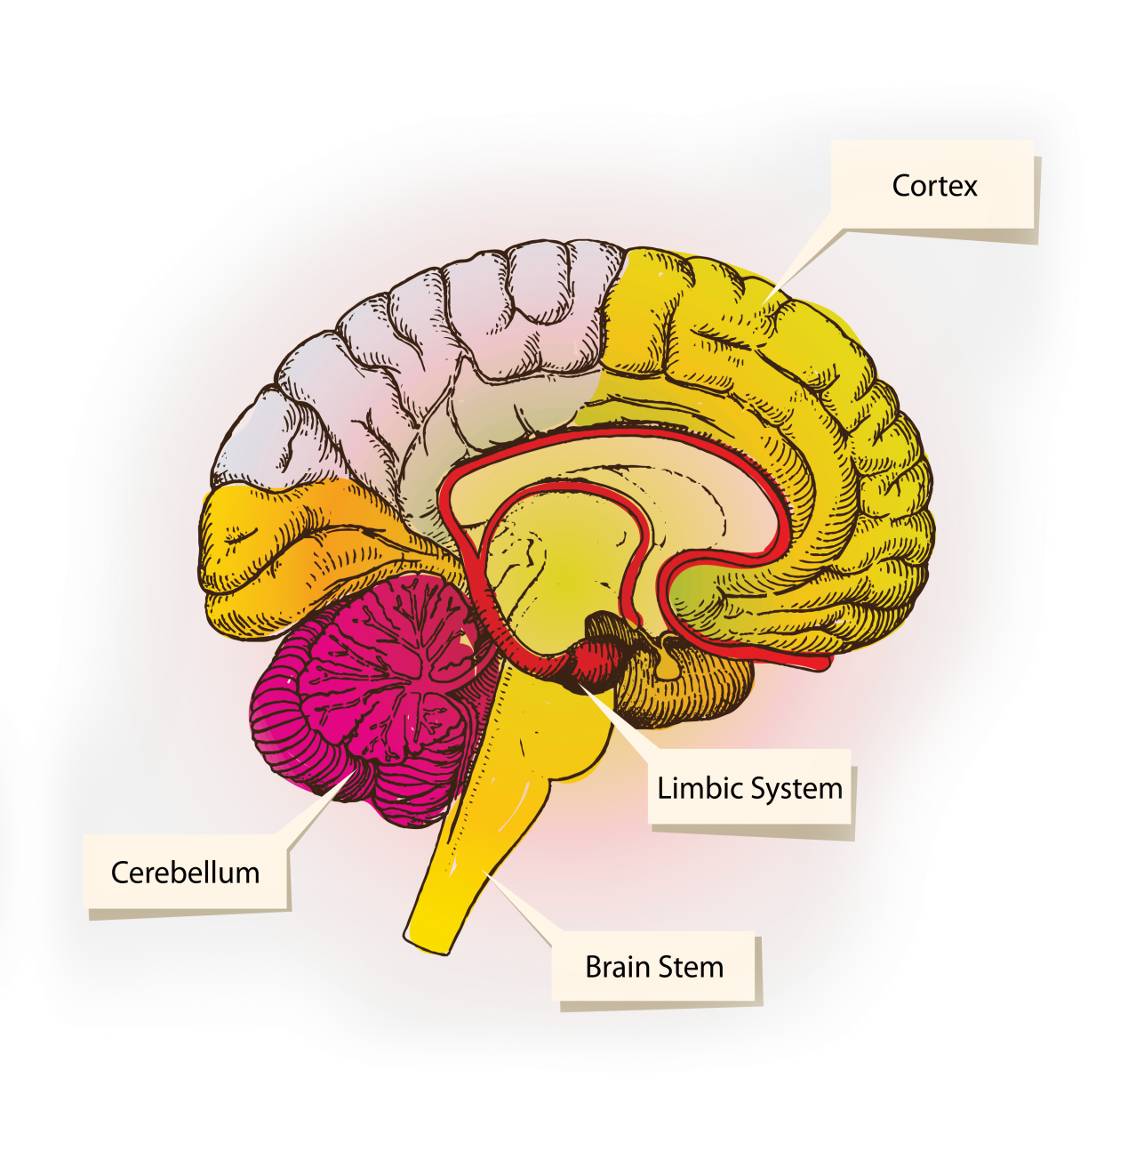
Three Parts of the Brain
CORTEX: Thinking
Integrates input from all parts
Cognition, beliefs, language, thought speech
LIMBIC AREA: Emotional
Memories of pleasant and unpleasant experiences
Assesses risk
Expression and mediation of emotions and feelings
SURVIVAL BRAIN: Instinctual
Carries out “fight, flight, and freeze” responses
Functions largely unconsciously
Digestion, reproduction, circulation, breathing – responds to sensation
Notes:
Adapted from slide prepared by Elaine Miller-Karas, The Trauma Resource Institute
Although an oversimplification, this triune model of the brain is helpful for understanding how the nervous system relates to our resilient zone. The Survival Brain contains the cerebellum and brain stem. The limbic area contains, among other things, the amygdala, hippocampus, and hypothalamus. The amygdala has been likened to a smoke detector, an early warning sign of danger. The amygdala sounds the alarm for the rest of the body to react to perceived threats, such as the fight, flight or freeze responses. This response is shaped by trauma and can lead to the amygdala frequently sounding false alarms. When we are in our Resilient Zone, all three parts of the brain are working together. When we get knocked up high or down low, we “flip our lid”, and the cortex seemingly goes offline. Then we are only operating from our emotions and sensations.

Slide 18
The Autonomic Nervous System
Sympathetic
Parasympathetic
Notes:
The autonomic nervous system (ANS) is located in the survival brain and receives direction from the limbic brain. A useful metaphor for understanding the ANS is provided by Bessel van der Kolk who likens the sympathetic nervous system to the accelerator of a car, providing a burst of energy in times of stress, and the parasympathetic nervous system to a car’s brakes, calming the body down after danger (or perceived danger) has passed. In a healthy individual, the body naturally cycles back and forth between sympathetic and parasympathetic activation throughout the day, with brief periods of sympathetic activation (such as waking from sleep), followed by periods of relaxation. The problem comes when the body becomes dysregulated because one system is activated for too long or too much (i.e., too intensely). For example, while the “fight or flight” response is evolutionarily adaptive when a saber-toothed tiger is about to attack, it can be quite debilitating when it remains activated for extended periods of time due to workday stress, relationship issues or financial crisis. As social beings, our bodies seem not to distinguish between physical threat and psychological or social threats. Therefore, fear of embarrassment, failure or social rejection can be just as threatening to us as physical danger.

Slide 19
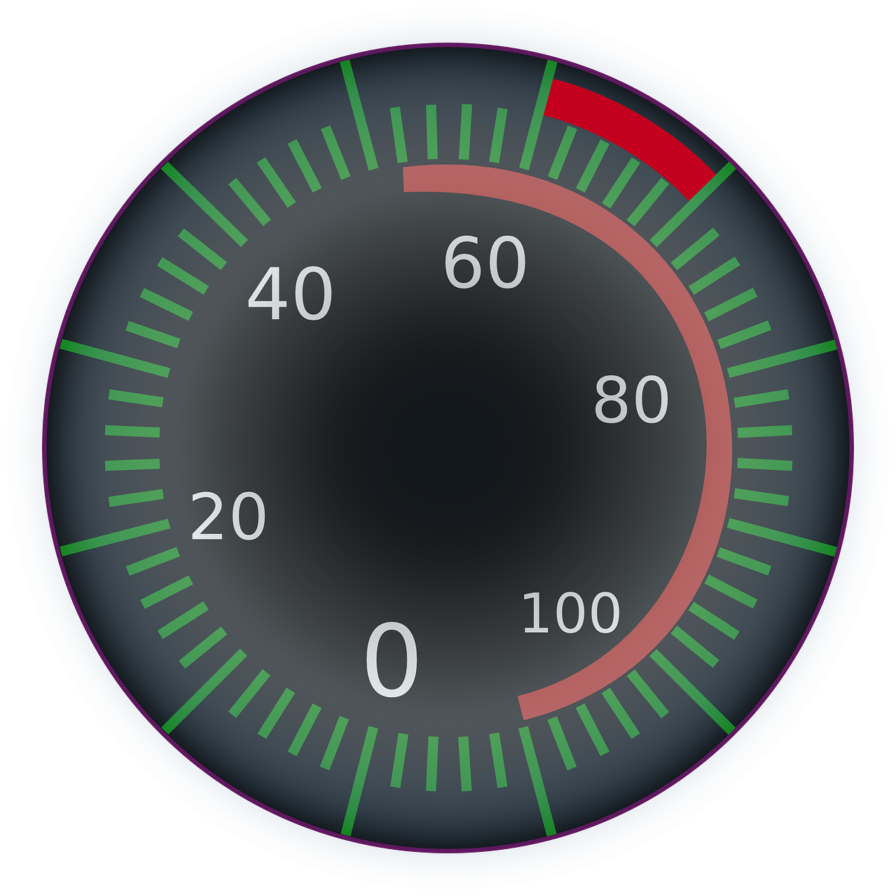
SNS: Preparing for Action
Breathing Rate
Heart Rate
Pupil Dilation
Blood Pressure
Sweating
Stress Hormones
Digestion
Saliva
Notes:
To extend the metaphor of the SNS being like the accelerator, this image shows the needle on the speedometer going from zero to 100 with the associated changes in the body when the SNS is activated. You may ask the group, “What kinds of sensations might you experience if you were in this state?” and “Why would the body react to a threat in this way?” Be sure to connect this slide with being knocked up high.

Slide 20
PNS: Preparing for Rest
Digestion
Saliva
Breathing Rate
Heart Rate
Pupil Dilation
Blood Pressure
Sweating
Stress Hormones
Notes:
To extend the metaphor of the PNS being like the brake in a car, this image shows the needle on the speedometer quickly going from 100 to zero with the associated changes in the body when it does. You may ask the group similar questions here about what sensations they might experience in this state and why we might react to the absence of threat in this way. Be sure to connect this slide with being knocked down low.

Slide 21
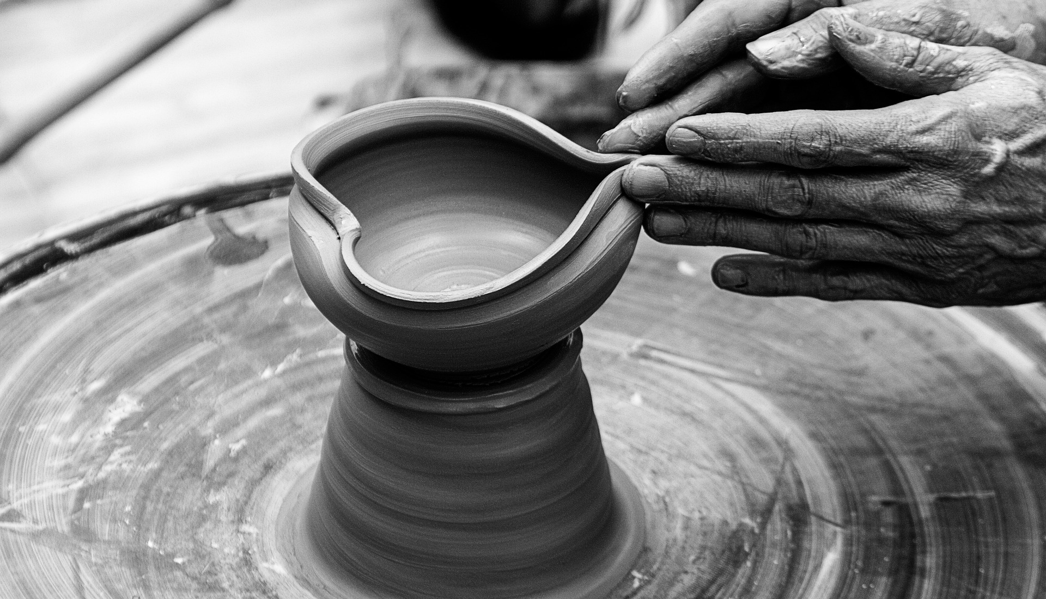
Shaped Over Time
Notes:
The ANS is shaped over time by life experiences, particularly trauma, so everyone’s triggers are somewhat different.

Slide 22
Trauma/Stress
Shock Trauma
Too much too fast!
Too much
& Too fast!
Perception is key
Perception is key
Notes:
“Big T” Trauma occurs when the nervous system is overwhelmed because one experiences an event that is perceived to be life threatening or seriously harmful to oneself or someone they love. Examples include violent attacks, natural disasters, domestic violence, sexual assault, combat or war, or accidents involving vehicles or machinery. In this way, these events occur like a lightening bolt. Perception is very important, because what one person perceives as traumatic, another person may not.

Slide 23
Too much or too little…
for too long
Notes:
“Small t” or “cumulative” traumas are experiences that are not perceived as a threat to our bodily integrity or as immediately life threatening, but exceed our ability to cope emotionally. They are called cumulative traumas since they often occur over long periods of time and their effects accumulate with time. Examples of “small t” trauma include physical or emotional neglect or abandonment in childhood, incarceration, homelessness, or systemic forms of oppression, such as poverty, racism, ableism, sexism, homophobia, transphobia, and religious persecution. Again, the perception of the person experiencing the trauma is very important in whether the experiences are traumatic.

Slide 24
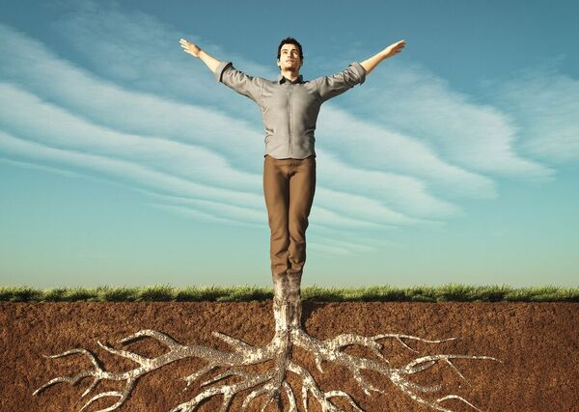
Grounding
Noticing the direct contact of an object with the body that provides a sense of support and stability.
Notes:
© 2018 Brendan Ozawa-de Silva, Michael Karlin and Life University
____________________________________________________________________________________________________________________________________________________________________________________________________________________________________________________________________________________________________________________________________________________________________________________________________________________________________________________________________________________________________________________________________________________________________________________________________________________________________________________________________________________________________________________________________
Compassionate Integrity Training
A Secular Ethics Approach to Cultivating Personal, Social and Environmental Flourishing
Presenter Notes:
Grounding is the practice of noticing the direct contact of one’s body with an object (including another part of the body) in order to bring oneself back to the present moment. When the nervous system is dysregulated, it can be helpful to notice a part of the body that feels grounded or supported. For example, if you are sitting in a chair and your feet feel firm and supported on the ground, you can notice this sensation and sit with this for a few moments. As you sense into this part of the body that feels grounded, you may notice yourself relaxing and feeling more stable. This is another way of returning to or staying in the resilient zone. It is helpful to practice resourcing before grounding, because if the body gets dysregulated while grounding, then we can use our resource as a tool to return to the resilient zone. It’s helpful to recognize that we engage in grounding practices naturally. For example, we may have a necklace, bracelet or other object that we instinctively touch or hold and that makes us feel more secure when we do so. We may cross our arms or sit in a particular way. There may be objects that we like to keep with us because they make us feel more secure. When we consciously engage in grounding and combine it with tracking, we are strengthening our ability to regulate our nervous system consciously.

Slide 25
Group Activity
Notes:
“Grounding” Critical Insight Activity from the Facilitator Guide

Slide 26
COMPASSIONATE INTEGRITY TRAINING
Center for Compassion, Integrity and Secular Ethics
Life University
© 2020 Brendan Ozawa-de Silva, Michael Karlin and Life University
COMPASSIONATE INTEGRITY TRAINING SERIES I: SELF-CULTIVATION SKILL 1: CALMING BODY AND MIND

