Slide 1
COMPASSIONATE INTEGRITY TRAINING
Center for Compassion, Integrity and Secular Ethics
Life University
© 2018 Brendan Ozawa-de Silva, Michael Karlin and Life University
COMPASSIONATE INTEGRITY TRAINING
OVERVIEW

Slide 2
Notes:
These are only some of the locations where CIT has been facilitated and organizations using CIT as of 12/31/18.

Slide 3
Over 3,000 CIT Graduates
Afghanistan, Algeria, Argentina, Australia, Bangladesh, Bhutan, Bosnia, Botswana, Canada, Chile, Colombia, Egypt, Eswatini, Ethiopia,
Fiji, France, Germany, Ghana, Honduras, India, Israel, Ireland, Ivory Coast, Italy, Jordan, Kenya, Lebanon, Lesotho, Liberia, Libya, Lithuania, Malawi, Malaysia, Mauritius,
Mexico, Namibia, Nepal, Netherlands, New Zealand, Nigeria, Northern Ireland, Pakistan, Palestine, Portugal, Romania, Rwanda, Senegal, Spain, Sri Lanka, Somalia, South Africa, Sudan, Sweden, Switzerland, Tanzania, Tunisia, Uganda,
United Arab Emirates, United Kingdom, Uganda, the United States, Zambia and Zimbabwe.

Slide 4
125 Certified Level 1 Facilitators
Afghanistan, Algeria, Argentina, Australia, Bangladesh, Bhutan, Bosnia, Botswana, Canada, Chile, Colombia, Egypt, Eswatini, Ethiopia,
Fiji, France, Germany, Ghana, Honduras, India, Israel, Ireland, Ivory Coast, Italy, Jordan, Kenya, Lebanon, Lesotho, Liberia, Libya, Lithuania, Malawi, Malaysia, Mauritius,
Mexico, Namibia, Nepal, Netherlands, New Zealand, Nigeria, Northern Ireland, Pakistan, Palestine, Portugal, Romania, Rwanda, Senegal, Spain, Sri Lanka, Somalia, South Africa, Sudan, Sweden, Switzerland, Tanzania, Tunisia, Uganda,
United Arab Emirates, United Kingdom, Uganda, the United States, Zambia and Zimbabwe.

Slide 5
90 Facilitators-in-Training
Afghanistan, Algeria, Argentina, Australia, Bangladesh, Bhutan, Bosnia, Botswana, Canada, Chile, Colombia, Egypt, Eswatini, Ethiopia,
Fiji, France, Germany, Ghana, Honduras, India, Israel, Ireland, Ivory Coast, Italy, Jordan, Kenya, Lebanon, Lesotho, Liberia, Libya, Lithuania, Malawi, Malaysia, Mauritius,
Mexico, Namibia, Nepal, Netherlands, New Zealand, Nigeria, Northern Ireland, Pakistan, Palestine, Portugal, Romania, Rwanda, Senegal, Spain, Sri Lanka, Somalia, South Africa, Sudan, Sweden, Switzerland, Tanzania, Tunisia, Uganda,
United Arab Emirates, United Kingdom, Uganda, the United States, Zambia and Zimbabwe.

Slide 6
Compassionate Integrity
The ability to live one’s life in accordance with one’s values with a recognition of common humanity, our basic orientation to kindness, and reciprocity.
Notes:
CIT focuses on and builds toward compassionate integrity: the ability to live one’s life in accordance with one’s values with a recognition of common humanity, our basic orientation to
kindness, and reciprocity. Unlike some definitions of integrity that focus on mere consistency with one’s values, without examining what those values are, compassionate integrity insists that consistency with one’s values is not enough if those values promote harm to oneself, others or the world. Instead, maintaining and increasing consistency with one’s values is most beneficial when they are values that promote one’s own well-being as well as that of others.

Slide 7
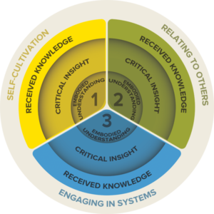
Notes:
CIT utilizes a “three-in-three” educational model that integrates three domains of knowledge and three levels of understanding. The three domains begin with a focus on the self (Self-cultivation), then move to others (Relating to Others), and finally to a systems perspective, meaning the larger networks we exist in.

Slide 8
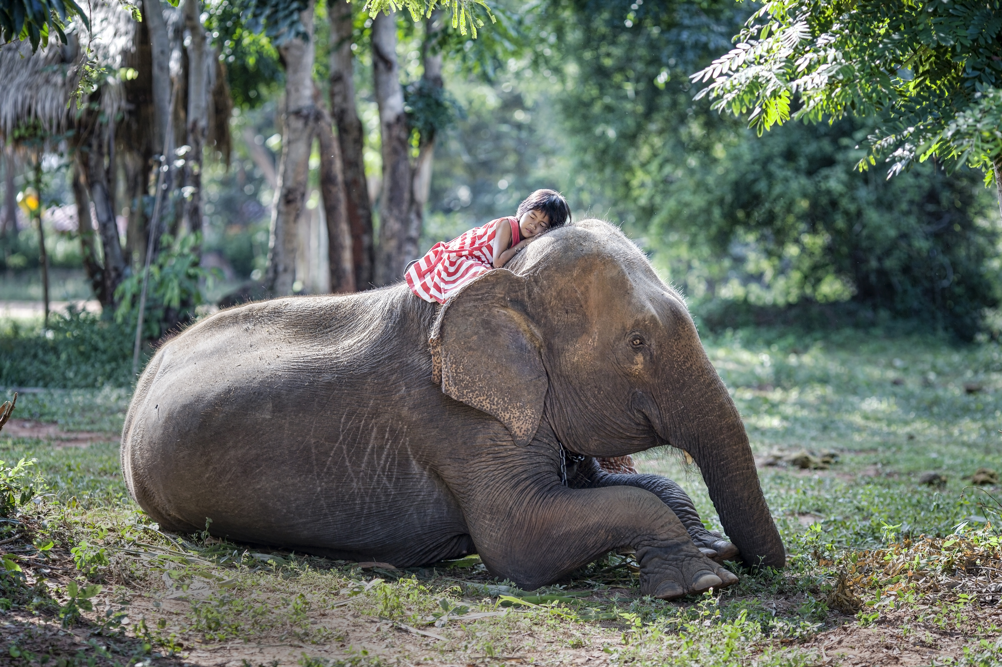
Series I: Self-Cultivation
1. Calming Body and Mind
2. Ethical Mindfulness
3. Emotional Awareness
4. Self-Compassion
Notes:
Self-Cultivation covers how one relates to oneself and the knowledge and skills related to the inner life of the individual. This begins with the body in the skill Calming Body and Mind, where we learn to become more aware of bodily sensations and techniques to better regulate our autonomic nervous system to remain in our Resilient Zone. Next we move to regulating our speech and actions with Ethical Mindfulness. From there we move to the mental states and emotions that drive those speech and actions. These build into genuine self compassion with inner qualities like courage, fortitude, forbearance and the identification of one’s values.

Slide 10
Notes:
From that firm foundation, we move to Relating to Others.

Slide 11
Series II: Relating to Others
5. Impartiality and Common Humanity
6. Forgiveness & Gratitude
7. Empathic Concern
8. Compassion
Notes:
Relating to Others covers how one relates to others constructively and in a way that promotes one’s own and others’ well-being. Built on the foundation of self-regulation and restraint from harming others, this involves strengthening the prosocial skills of impartiality, forgiveness, gratitude, empathic concern and compassion.

Slide 13
Notes:
Compassion is the motivation to alleviate the suffering of another. Compassion alone does not tell one how to engage to alleviate that suffering. Engaging in Systems, therefore, covers how one engages compassionately and with integrity as a participant in complex systems.

Slide 14
Series III: Engaging in Systems
Compassion
Wisdom
Discernment
9. Appreciating Interdependence
10. Engaging with Discernment
Notes:
Just as a bird cannot fly with one wing, compassion is not effective without the “wing” of wisdom or discernment to enable us to determine the best course of action to alleviate the suffering of others. Engaging in Systems involves recognizing our interdependence and the interdependence of systems, which can be as small as our family or local community, or as vast as the world, and developing the skills and discernment to act effectively for constructive change within those systems. Engaging with compassionate integrity and critical thinking gives us the best chance for achieving positive results that enhance the well-being and flourishing of ourselves and others.

Slide 15
Notes:
Each module in CIT is intended to allow participants to progress through three levels of understanding. In CIT, it is important that knowledge not remain at an intellectual level; to be effective, it must lead to realizations and lasting changes in behavior. Knowledge becomes transformative when it moves from head to heart to hand.

Slide 16
Notes:
The first of three levels of understanding is Received Knowledge: This refers to learning new
information and developing a clear understanding of a particular topic. It is the first step in developing understanding. Received knowledge can be quite extensive, but at this level it has not yet become personal.

Slide 17
Notes:
The second level of knowledge is Critical Insight.

Slide 18
Notes:
Critical Insight is when the participant, through exercises and practices, uses his or her own life experiences and reason to come to a flash of personal insight, an “aha moment”, when he or she
realizes how the knowledge relates to his or her own life. At this point knowledge has started to become transformative.

Slide 19
Notes:
The third level is Embodied Understanding. Moments of critical insight are often not powerful enough to dislodge habits. Therefore, embodied understanding refers to the deepening and further internalizing of knowledge so that it becomes second-nature and spontaneous: not just something one knows, but part of who one is. This happens through repeated practice and continued reflection on one’s critical insights. Recent discoveries in neuroplasticity and neurogenesis show that sustained practice changes brain structure and neural functioning, suggesting that long-term changes in body, brain and behavior are possible. This is where knowledge (including the knowledge and skills of self-compassion, compassion, integrity and so on) becomes transformative at its deepest level.

Slide 20
Notes:
These three levels of knowledge apply to learning many skills, such as speaking a foreign language or playing a musical instrument. At first the student needs to learn the different parts of the instrument, how to read sheet music and so on. Ongoing study and repeated practice eventually leads to moments where things just “click” and the student gains insights that lead to sudden increases in their understanding and ability to play. For these gains to be consolidated, however, the student needs to continue to practice in the correct way over a long period of time. Eventually, over a longer period of practice and study time, this leads to a degree of fluency where the student’s ability to play a piece (or speak the language) is spontaneous and embodied.

Slide 21
Notes:
Or learning to shoot foul shots through repeated practice.

Slide 22
Notes:
Each CIT module includes content for received knowledge (including a written explanation, audio podcasts, and PowerPoint presentations), activities for achieving critical insight and guided reflective practices for deepening insights into embodied understanding.

Slide 23
COMPASSIONATE INTEGRITY TRAINING
Center for Compassion, Integrity and Secular Ethics
Life University
© 2018 Brendan Ozawa-de Silva, Michael Karlin and Life University
COMPASSIONATE INTEGRITY TRAINING
OVERVIEW

